Slide 1
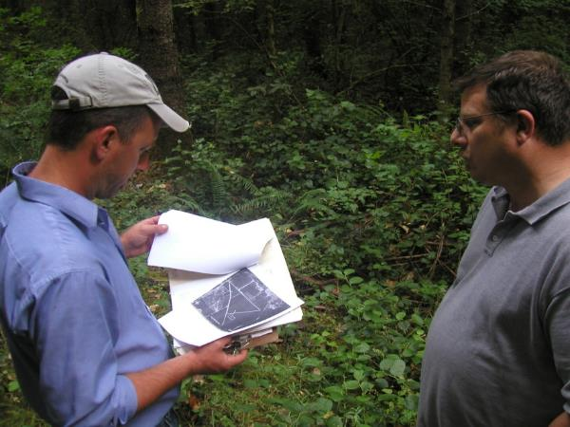
Forestry
Conservation Activity Plans (CAP)
“A forest management plan is a site specific plan developed for a client, which addresses one or more resource concerns on land where forestry-related conservation activities or practices will be planned and applied.”

Slide 2
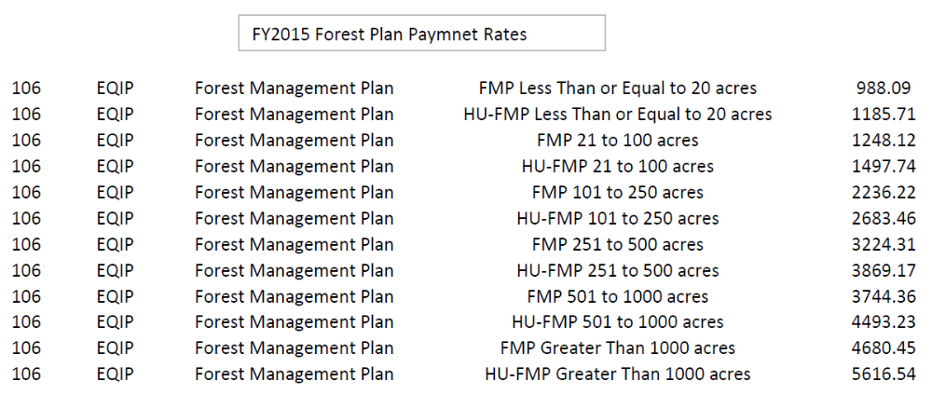

Slide 3
Why a CAP?
Current use taxation
Certification
Prep for subsequent EQIP application
  A CAP helps an EQIP application rank higher
  Not all conservation recommendations made in a CAP are guaranteed to be funded

Slide 4
NRCS Priority Resource Concerns
    WATER QUALITY DEGRADATION - Excessive sediment in surface waters
    DEGRADED PLANT CONDITION - Undesirable plant productivity and health
      Tree mortality due to disease, insects and animals.
    DEGRADED PLANT CONDITION - Excessive plant pest pressure
    DEGRADED PLANT CONDITION - Wildfire hazard, excessive biomass accumulation
    INADEQUATE HABITAT FOR FISH AND WILDLIFE - Habitat degradation

Slide 5
A Complete CAP Is Comprised of:
    Forest management plan (aka CAP)
    Job sheets
    Soils data appendix
    Biological Technical Note 14 (optional)

Slide 6
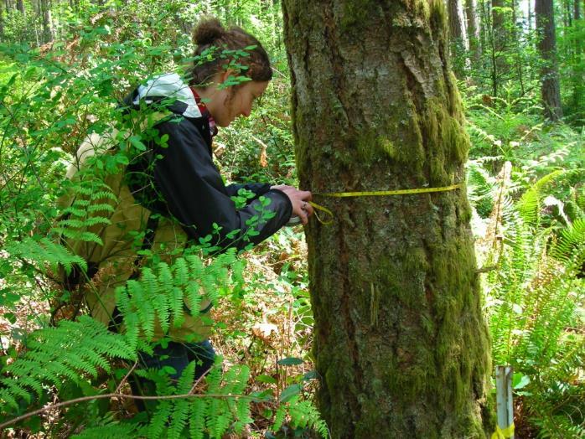
Site Visit & Field Data Collection
  Priority resource concerns
  Inventory method
  Stream assessment
  Roads

Slide 7
Forest Management Plan
EFOTG
Section III
    WA Integrated Forest Management Plan
    CAP Plan Criteria
    CAP Planner’s Guide

Slide 8
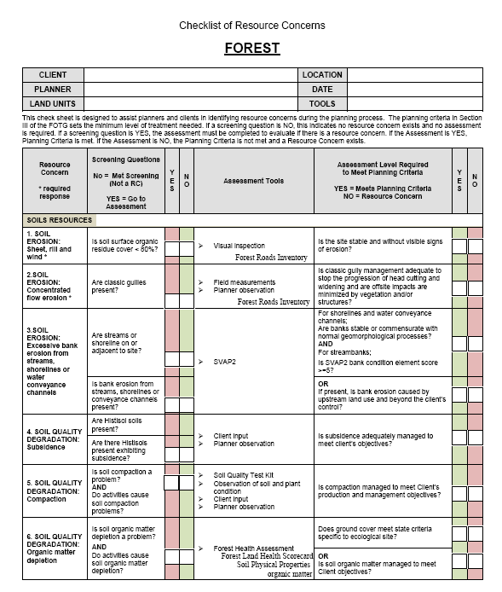

Slide 9
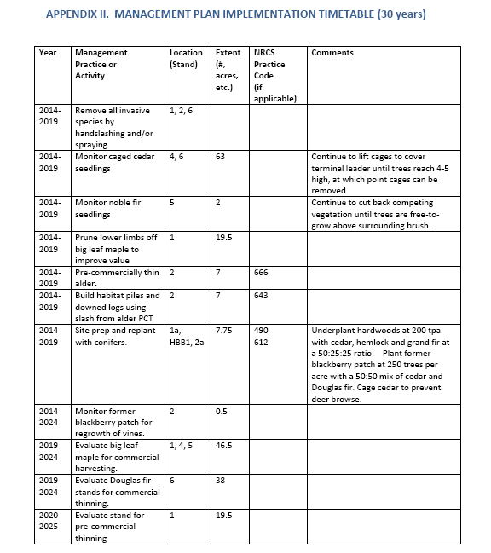
Job Sheets

Slide 10
Job Sheets
EFOTG
Section IV

Slide 11
Biological Technical Note 14
EFOTG
Section I

Slide 12
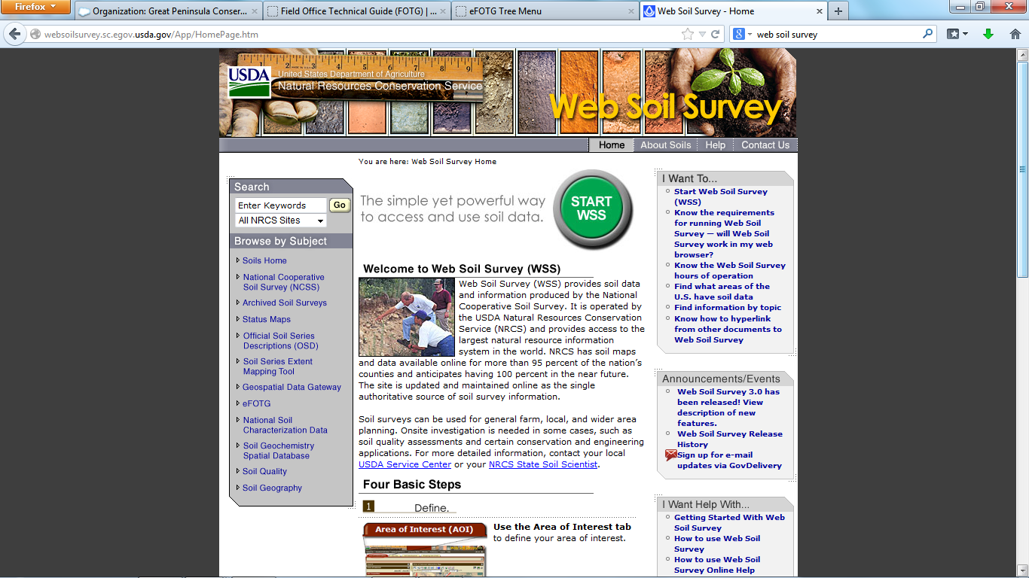
Soil Report

Slide 13
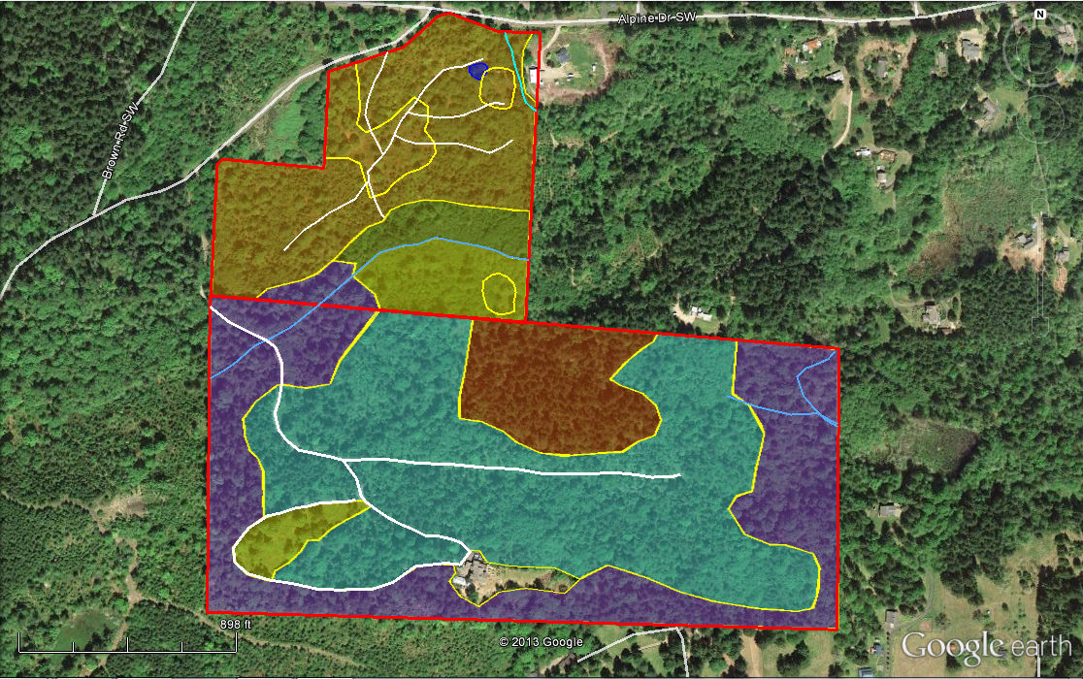
Conservation Activity Plan Map
Client’s Name
Farm: 1234; Tract: 1234
Total project acres: 111
Date Created: 8/20/2013 By: Kirk Hanson, NW Certified Forestry
HBB1
FMU 1a
FMU 1
FMU 2
FMU 2a
HBB2
FMU 4
FMU 3
Legend
Property boundary
Roads
Streams
FMUs
Culvert
FMU 6
FMU 5

Slide 14
Submitting a CAP
NRCS Review and approval
    Signatures
    CAP Checklist

Slide 15
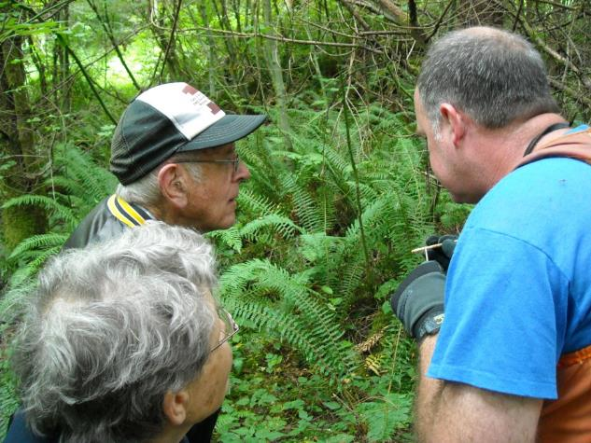
Managing EQIP Projects
Landowner Selected TSP Option
  Landowner should request TSP option at outset
  TSP funding is NOT guaranteed and may take some time to be committed
    TSP funding is added to an EQIP contract as part of a contract modification
  Funding is allocated annually, and landowner must request TSP funding each year
  TSP payment options
    TSP can bill landowner
    NRCS can assign payment directly to TSP

Slide 16
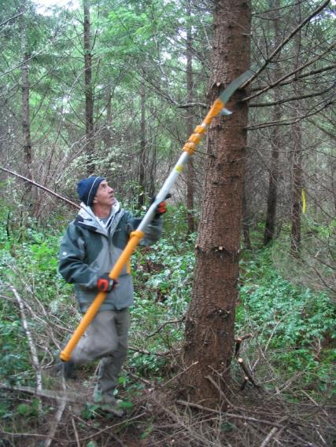
Types of Forestry Projects
Funded by EQIP
Code | Practice Name
311 | Alley Cropping
379 | Multi-Story Cropping
380 | Windbreak/Shelterbelt Establishment
381 | Silvopasture Establishment
383 | Fuel Break
384 | Woody Residue Treatment
394 | Firebreak
472 | Access Control
490 | Tree/Shrub Site Preparation
612 | Tree/Shrub Establishment
650 | Windbreak/Shelterbelt Renovation
654 | Road/Trail/Landing Closure and Treatment
655 | Forest Trails and Landings
660 | Tree/Shrub Pruning
666 | Forest Stand Improvement
Code | Practice name
314 | Brush Management
315 | Herbaceous Weed Control
327 | Conservation Cover
338 | Prescribed Burning
342 | Critical Area Planting
382 | Fence
395 | Stream Habitat Improvement and Management
560 | Access Road
578 | Stream Crossing
580 | Streambank and Shoreline Protection
595 | Integrated Pest Management
643 | Restoration and Management of Declining Habitats
644 | Wetland Wildlife Habitat Management
645 | Upland Wildlife Habitat Management
647 | Early Successional Habitat Development/Management

Slide 17
Role of the TSP
  Design
  Installation
  Check-out

Slide 18
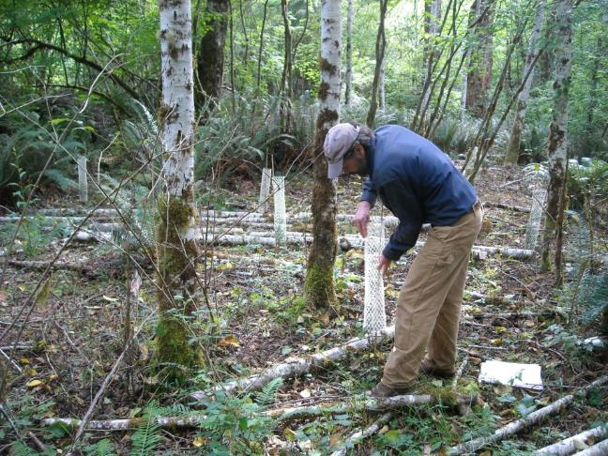
Role of the TSP
  Design
  Site Visit
  Job Sheet
  EFOTG (Section IV)
Planting trees/shrubs
Tree/Shrub Site Preparation – 490
Tree/Shrub Establishment - 612

Slide 19
Role of the TSP
  Installation
  Site Visit
  Job Sheet
  EFOTG (Section IV)

Slide 20
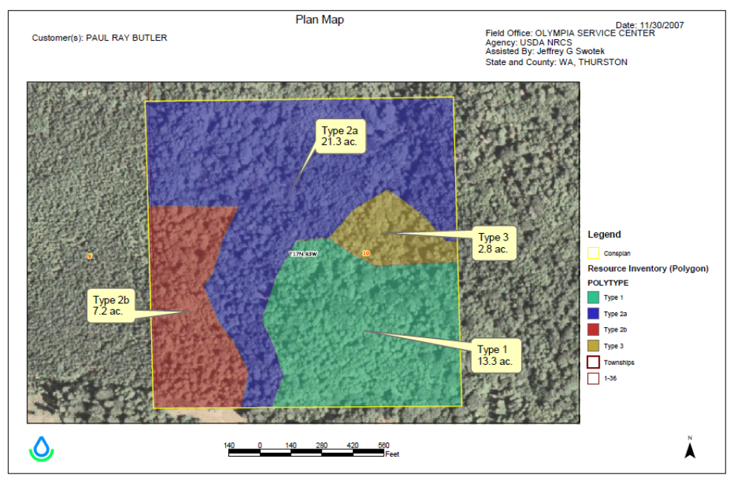

Slide 21
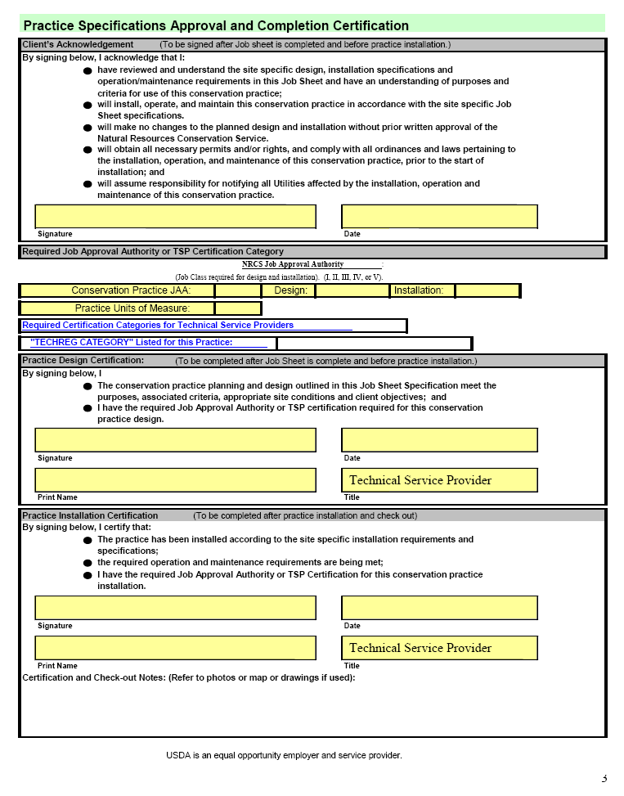

Slide 22
EQIP Payment Rates
For conservation practices: NRCS Website
For TSP’s: TechReg http://techreg.usda.gov.

Slide 23
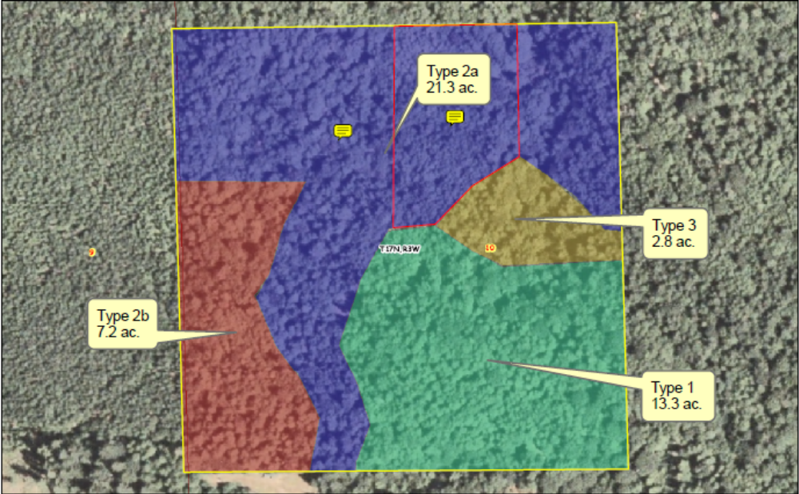
Examples of EQIP Projects
40 acres near Olympia
2009
NRCS Priority Concerns:
Degraded Plant Conditions (Overstocked stands, low natural regeneration)
Inadequate Habitat for Fish & Wildlife (no CWD or snags, limited forage)

Slide 24
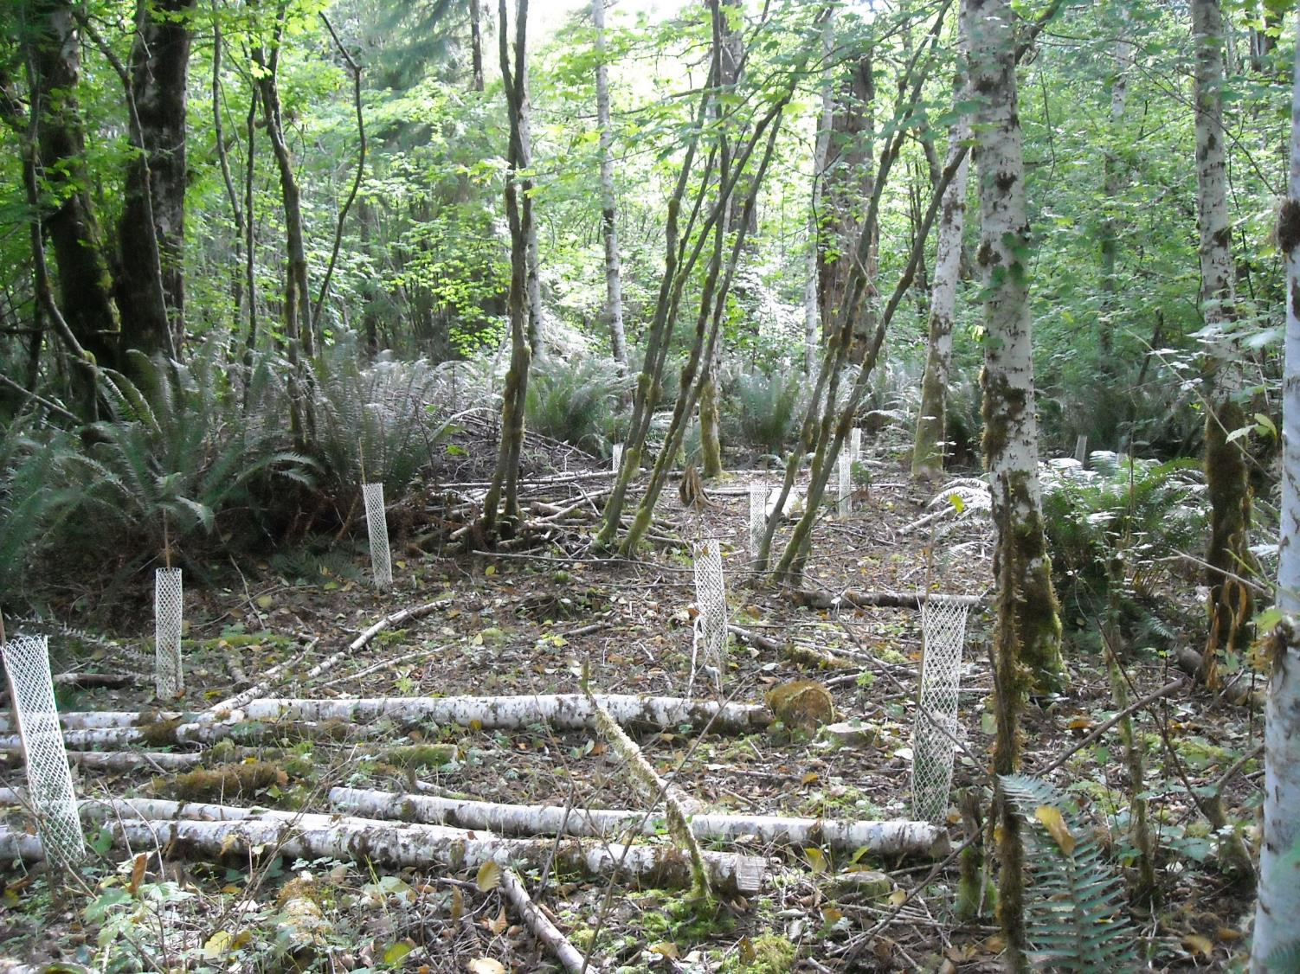
Pre-commercial thin 16.5 acres = $1,650 ($100/acre)
Site Prep for planting 17.6 acres = $3,960 ($225/acre)
Tree/Shrub planting (400 hdwds @ $2.07) = $831
Tree/Shrub planting (1,675 conifers @ $0.90) = $1,507
Tree protectors (1,675 @ $1.48) = $2,479
Post planting veg. control = $880 ($50/acre)

Slide 25
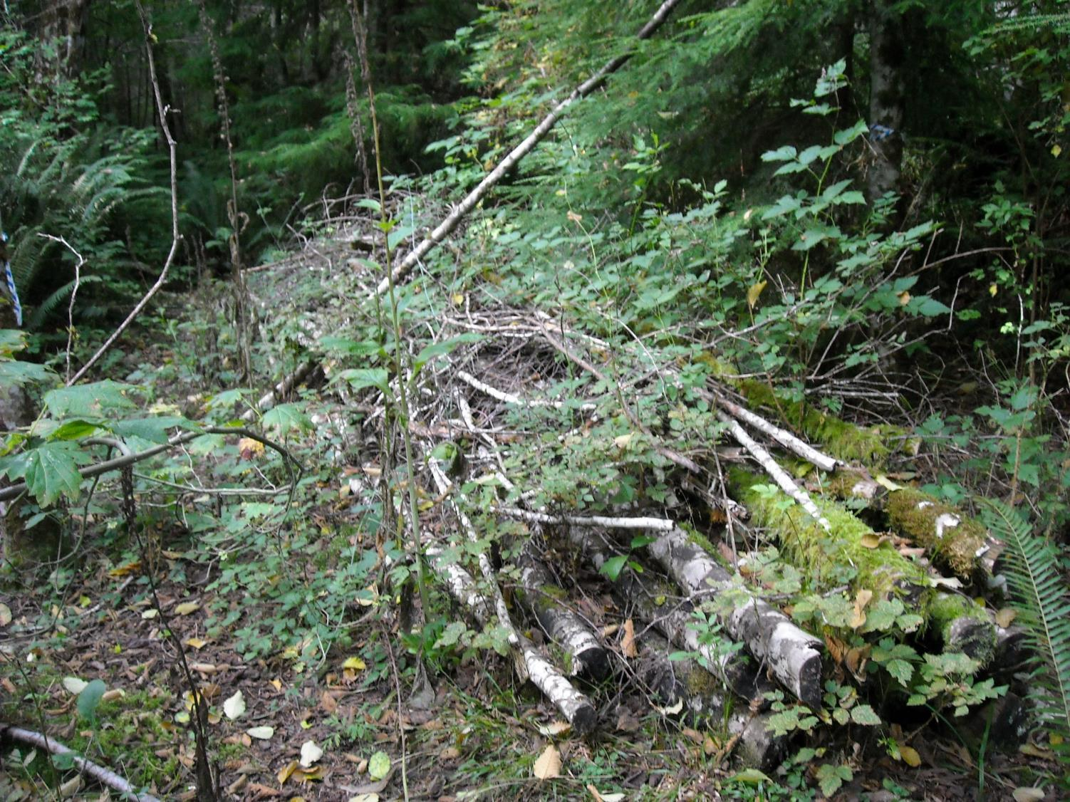
123 habitat piles and downed logs = $11,070 ($90/structure)

Slide 26
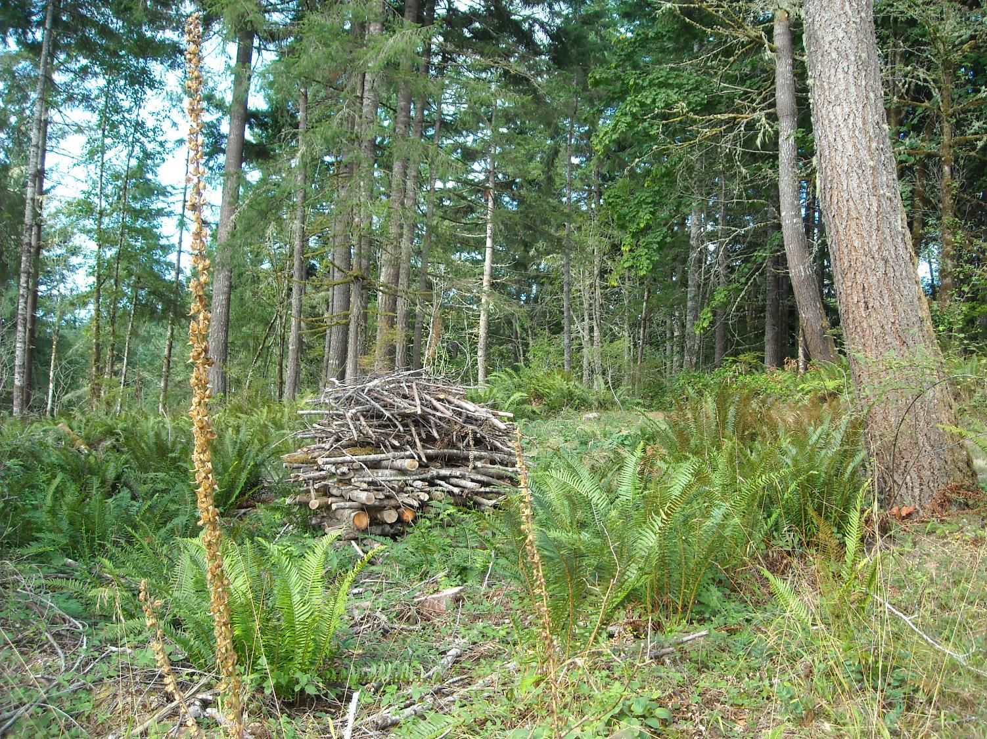

Slide 27
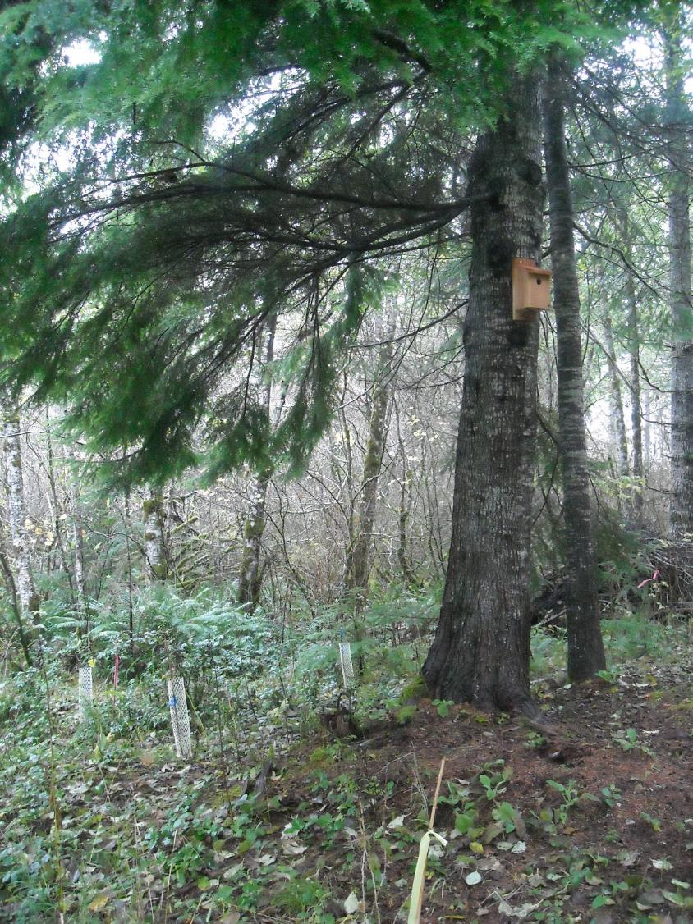
44 bird boxes = $1,980 ($45/box)

Slide 28
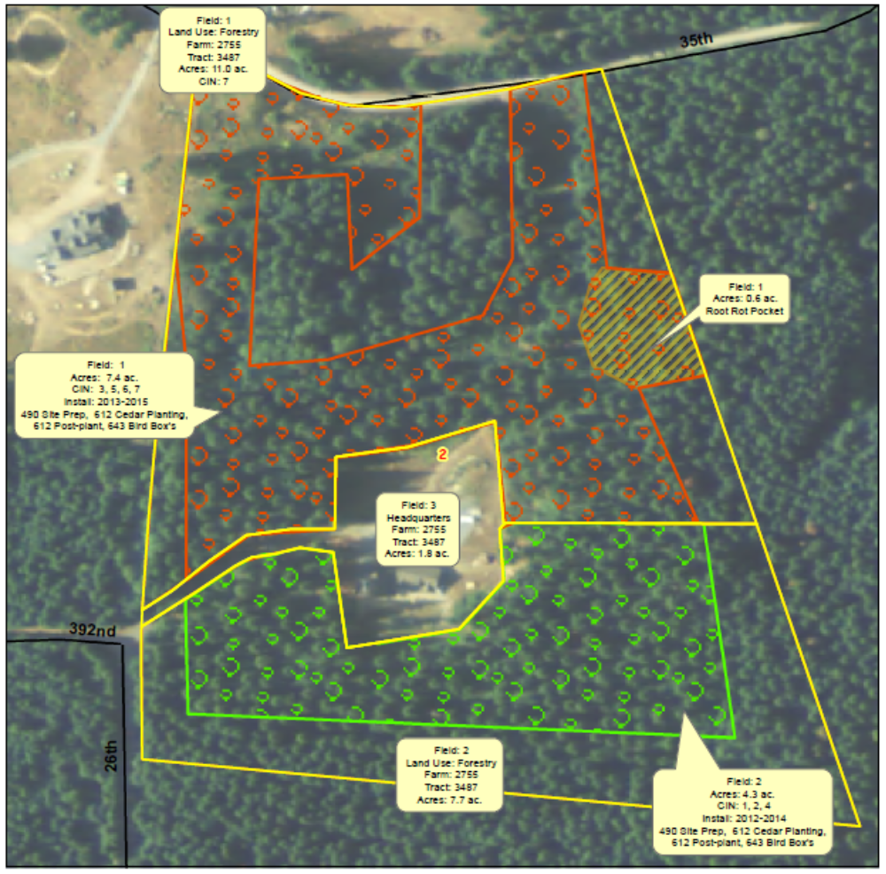
20 acres near McKenna
2011
NRCS Priority Concerns:
Degraded Plant Conditions (Overstocked stands, low natural regeneration)
Inadequate Habitat for Fish & Wildlife (no CWD or snags, limited forage)

Slide 29
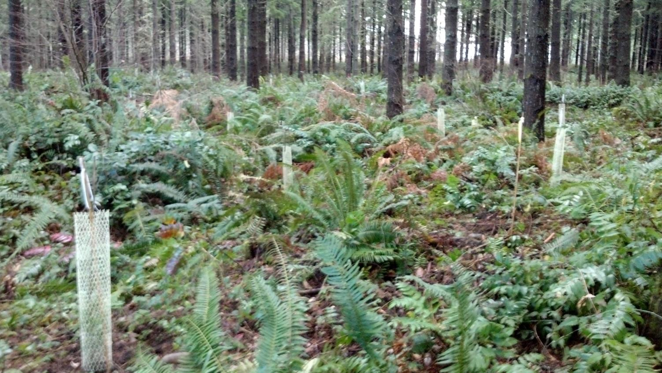
Site Prep for planting 11.7 acres = $4,212 ($360/acre)
  Mechanical slash + hand spot treatment
Tree/Shrub planting (880 hdwds @ $2.07) = $1,821
Tree/Shrub planting (1,755 conifers @ $0.90) = $1,580
Tree protectors (2,635 @ $1.48) = $3,026
Post planting veg. control = $1,187 ($100/acre)

Slide 30
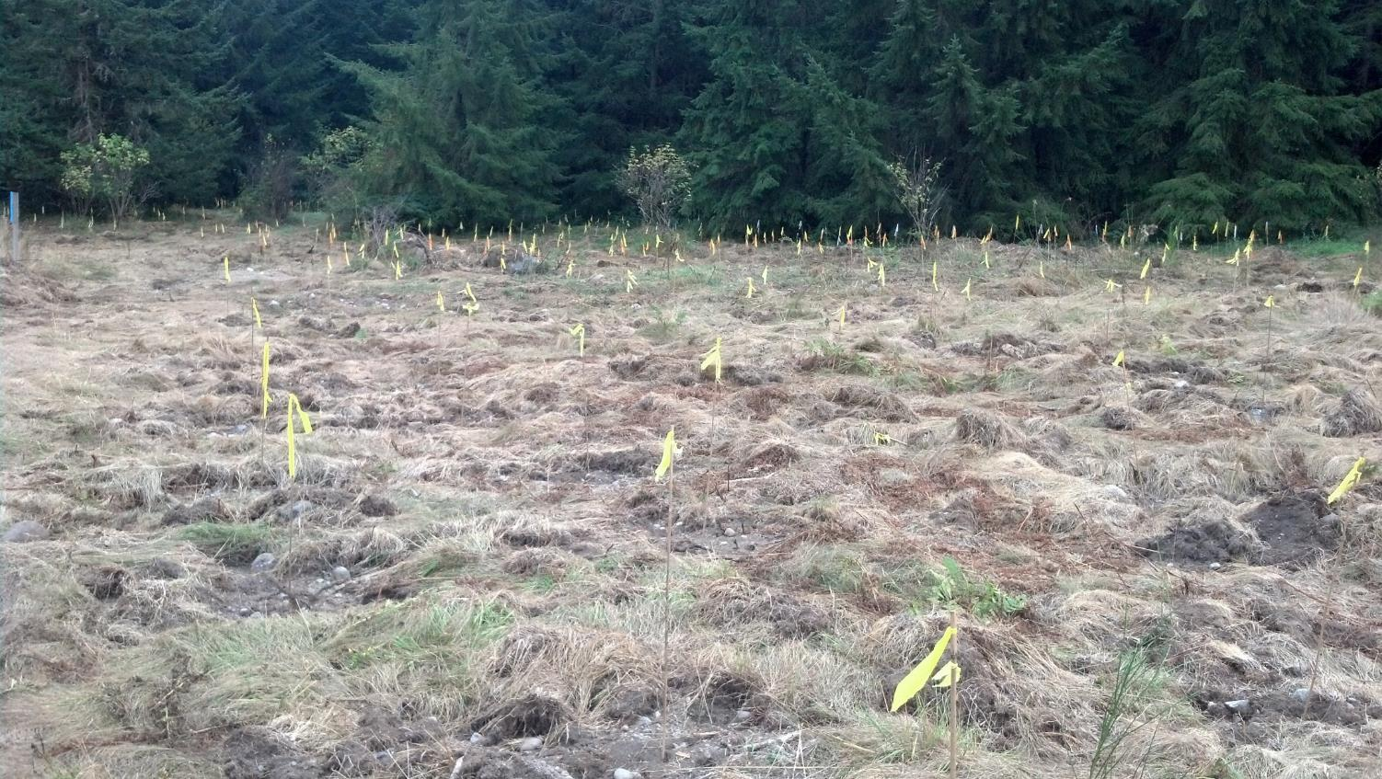

Slide 31
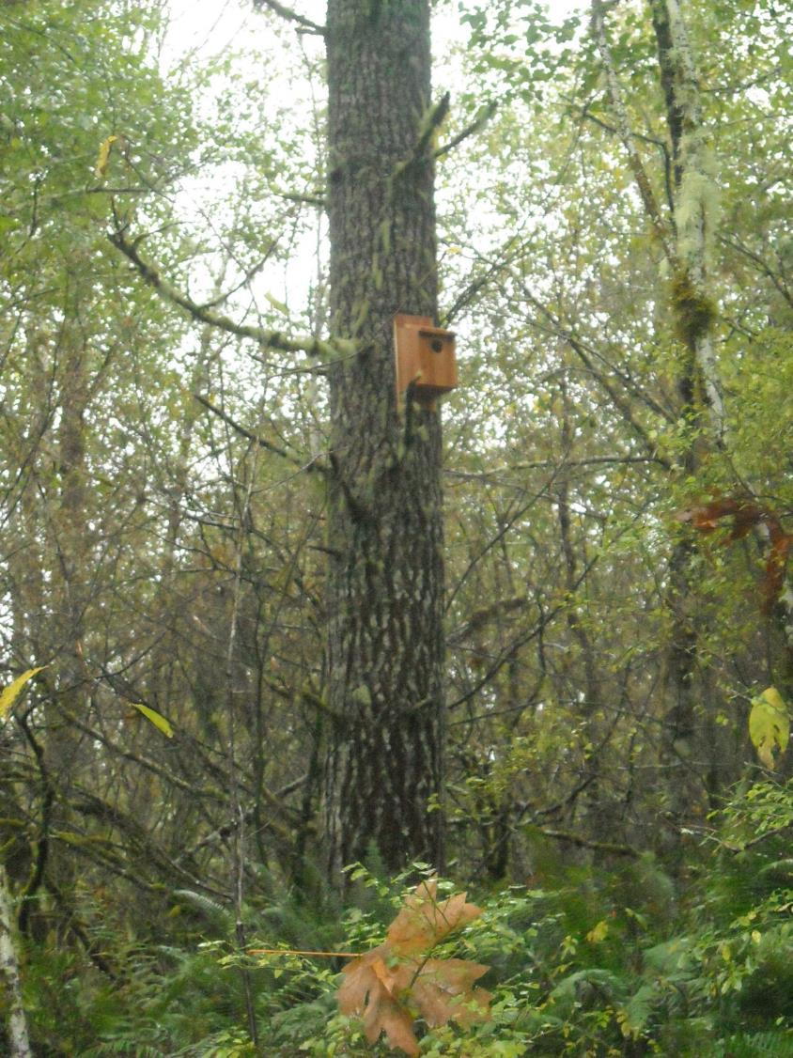
20 bird boxes = $900 ($45/box)

Slide 32
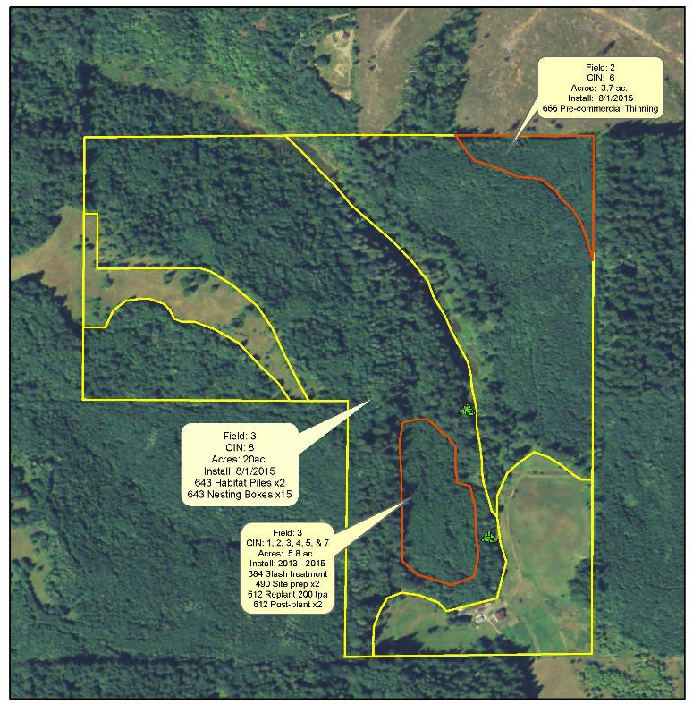
69 acres near Chehalis
2012
NRCS Priority Concerns:
Degraded Plant Conditions (Overstocked stands, storm damage)
Inadequate Habitat for Fish & Wildlife (no CWD or snags, limited forage)

Slide 33
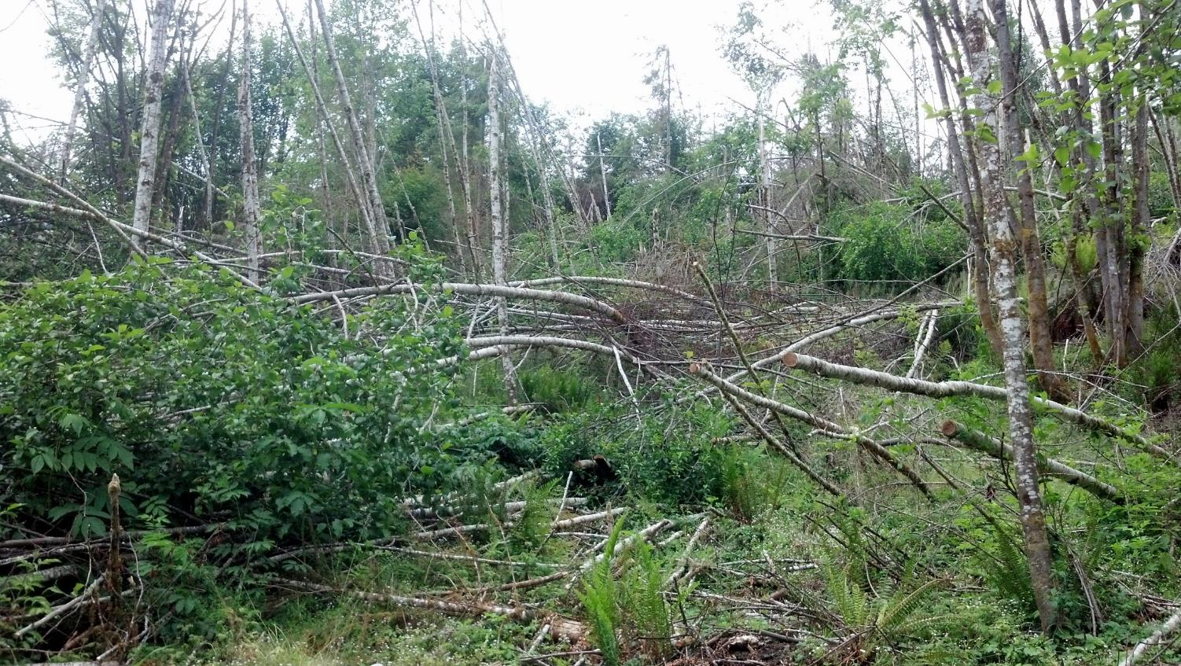
5.8 acres of Forest Slash Treatment = $1,305 ($225/acre)
5.8 acres of Mechanical/Hand Slash = $1,253 ($216/acre)
5.8 acre of hand spot treatment = $470 ($81/acre)

Slide 34
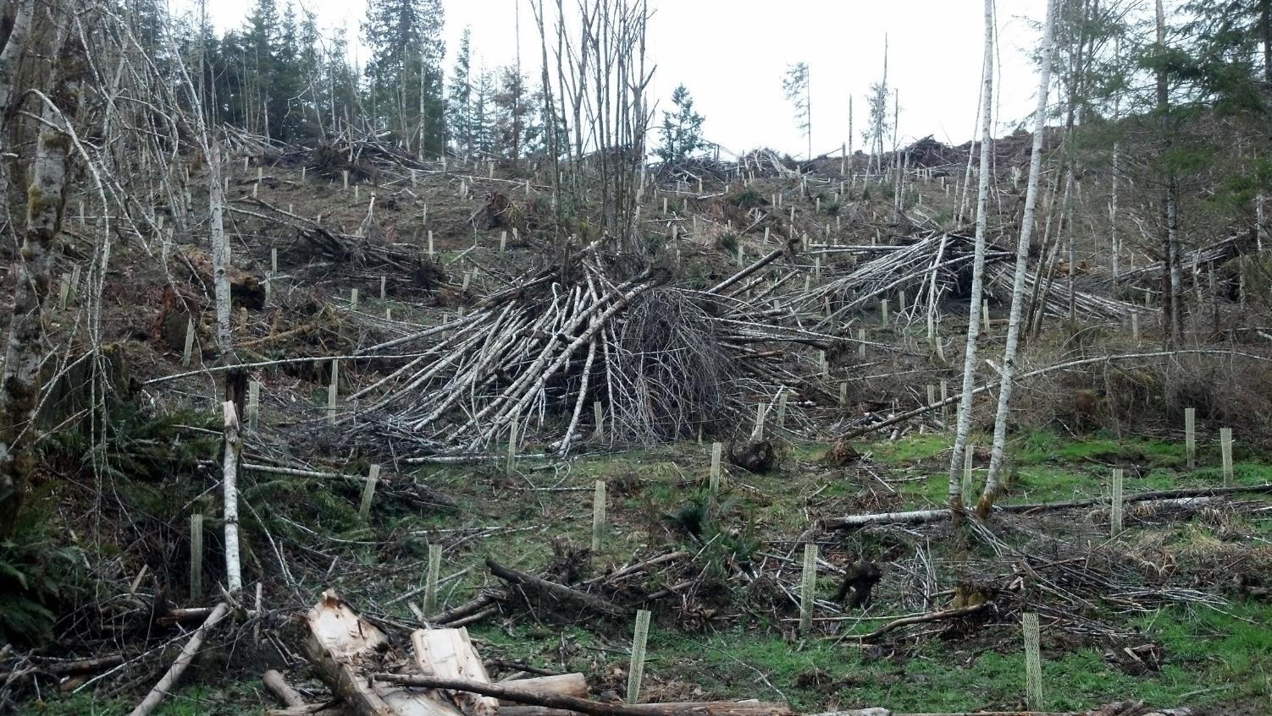
Tree/Shrub planting (1,160 conifers @ $0.90) = $1,044
Tree protectors (1,160 @ $1.48) = $1,728

Slide 35
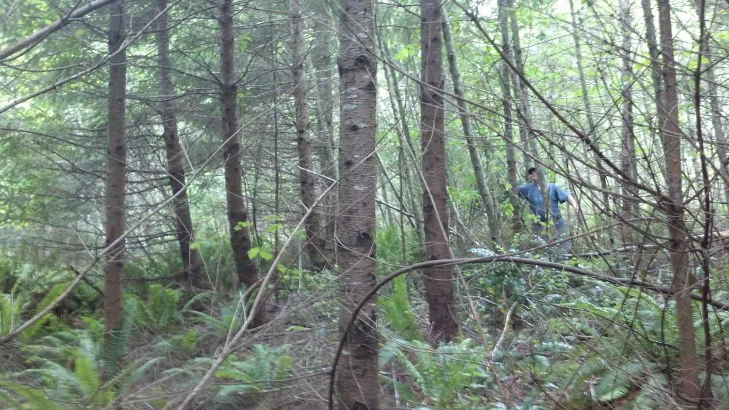
5.8 acres of Tree Planting 1,160 conifers @ $0.90 = $1,044
5.8 acres of Post Plant Competing Veg Control =
Pre-commercial thin (light) 3.7 acres = $597 ($160/acre)

