Slide 1
SARE TSP Training 2015
Joshua Himsl
Puget Sound Team Forester
1011 E. Main, Suite 306
Puyallup, WA 98372
Joshua.himsl@wa.usda.gov
(253) 845-9272 ext.110
USDA is an equal opportunity provider and employer

Slide 2


Natural Resources Conservation Service
U. S. Dept. of Agriculture
http://www.nrcs.usda.gov/wps/portal/nrcs/site/wa/home/

Slide 3
Non – Discrimination Statement
USDA prohibits discrimination in all its programs and activities on the basis of race, color, national origin, age, disability, and where applicable, sex (including gender identity and expression), marital status, familial status, parental status, religion, sexual orientation, political beliefs, genetic information, reprisal, or because all or part of an individual’s income is derived from any public assistance program. (Not all prohibited bases apply to all programs.)

Slide 4
Soil Conservation Service
Established in 1935
Provide Soil & Water Conservation
Dust Bowl Era
Changed name to NRCS in 1994
Better describes the resources we work with

Slide 5
NRCS Mission
Helping People Help the Land
“…provides products and services that enable people to be good stewards of the Nation’s soil, water, and related natural resources on non-Federal lands. With our help, people are better able to conserve, maintain, or improve their natural resources.”

Slide 6
Purpose
Provide Technical & Financial Assistance
TA – Foresters, Soil Scientist, Conservations, Agronomist
FA – Cost-share incentive programs
    EQIP, CSP
    Easement programs
    Initiatives – RCPP

Slide 7
EQIP
Environmental Quality Incentive Program
Incentive payment to improve resources
Targets non-industrial private forest landowners
Treats Resource Concerns
Main funding source for Conservation Activity Plans (CAP) & TSP’s

Slide 8
What Makes Us Different?
Targets non-Federal, State or Public Lands
  USFS, BLM, State, County, Cities, Tax-funded organization – Do not qualify
Voluntary
Non-regulatory

Slide 9
Farm Bill Funding
National
  SWAPA+HE
    Soil, Water, Air, Plant, Animal, Human, Energy
State
  State Priority Assessment
Local
  Local Working Group Priorities

Slide 10
State Priority Resource Concerns
WA State Resource Assessment
http://www.nrcs.usda.gov/Internet/FSE_DOCUMENTS/nrcs144p2_033900.pdf

Slide 11
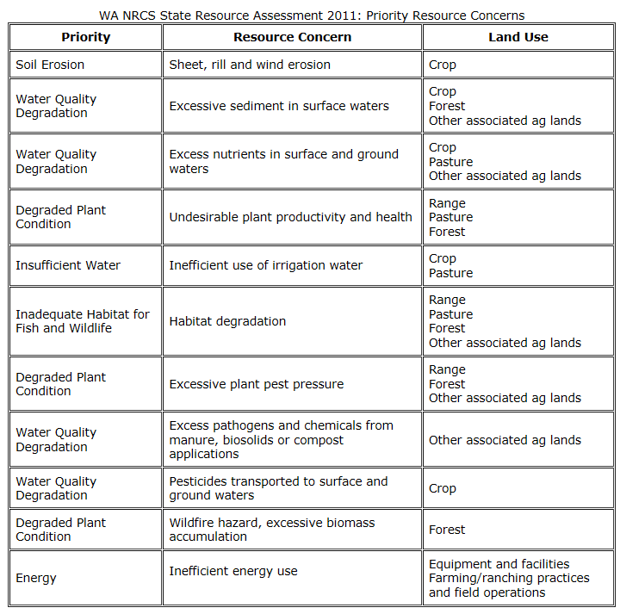

Slide 12
Puget Sound Team LWG Priorities
Water Quality - Sediment in Surface Waters
  Forest Roads
Fish & Wildlife – Habitat Degradation
  Stream Crossings, Wildlife structures
Degraded Plant Condition – Productivity & Health
  Pre-commercial Thinning, Reforestation
Degraded Plant Condition Plant/Pest pressure
  Invasive control

Slide 13
Local Working Groups
“Local Working Groups are composed of agricultural producers, owners/operators of nonindustrial private forestland and individuals representing a variety of disciplines as they relate to the soil, water, wetland, plant, forestry and wildlife sciences who are familiar with agricultural issues in the local community.”

Slide 14
Local Working Group Cont.
“…annual meeting of stakeholders at a unique event and is essential in identifying the various natural resources conservation priorities and objectives for the Puget Sound Area of Washington in 2015…contain information pertaining to programmatic and policy changes”

Slide 15
EQIP Application Process
Contact your local USDA/NRCS Service Center to start the process
  One located in each County throughout the Nation
http://offices.sc.egov.usda.gov/locator/app

Slide 16
EQIP Application Required Doc’s
CPA-1200 EQIP Application
AD -1026 HELC/WC certification
ESA/NHPA Waiver
SF1199AD – Direct Deposit
SCIMS Info sheet – FSA Document

Slide 17
EQIP Eligibility
Control or own eligible land
Comply with adjusted gross income limitation (AGI) provisions
Be in compliance with the highly erodible land and wetland conservation requirements
Develop an NRCS EQIP plan of operations

Slide 18
EQIP Application Cont.
Site visit to determine Resource Concerns & establish a conservation plan.
Screen Applicants
Rank based off of resource concerns
Fund highest ranked first

Slide 19
Typical Funded Projects
Pre-commercial Thinning
Reforestation
Stream Crossings
Forest Roads
Pruning for disease & fire
Invasive Treatment
Fuel Break

Slide 20
Conservation Activity Plans
CAP 106 Forest Management Plan
CAP 142 Fish & Wildlife Habitat Management Plan
Other CAPs for Landscape, Headquarters, Energy, etc…

Slide 21
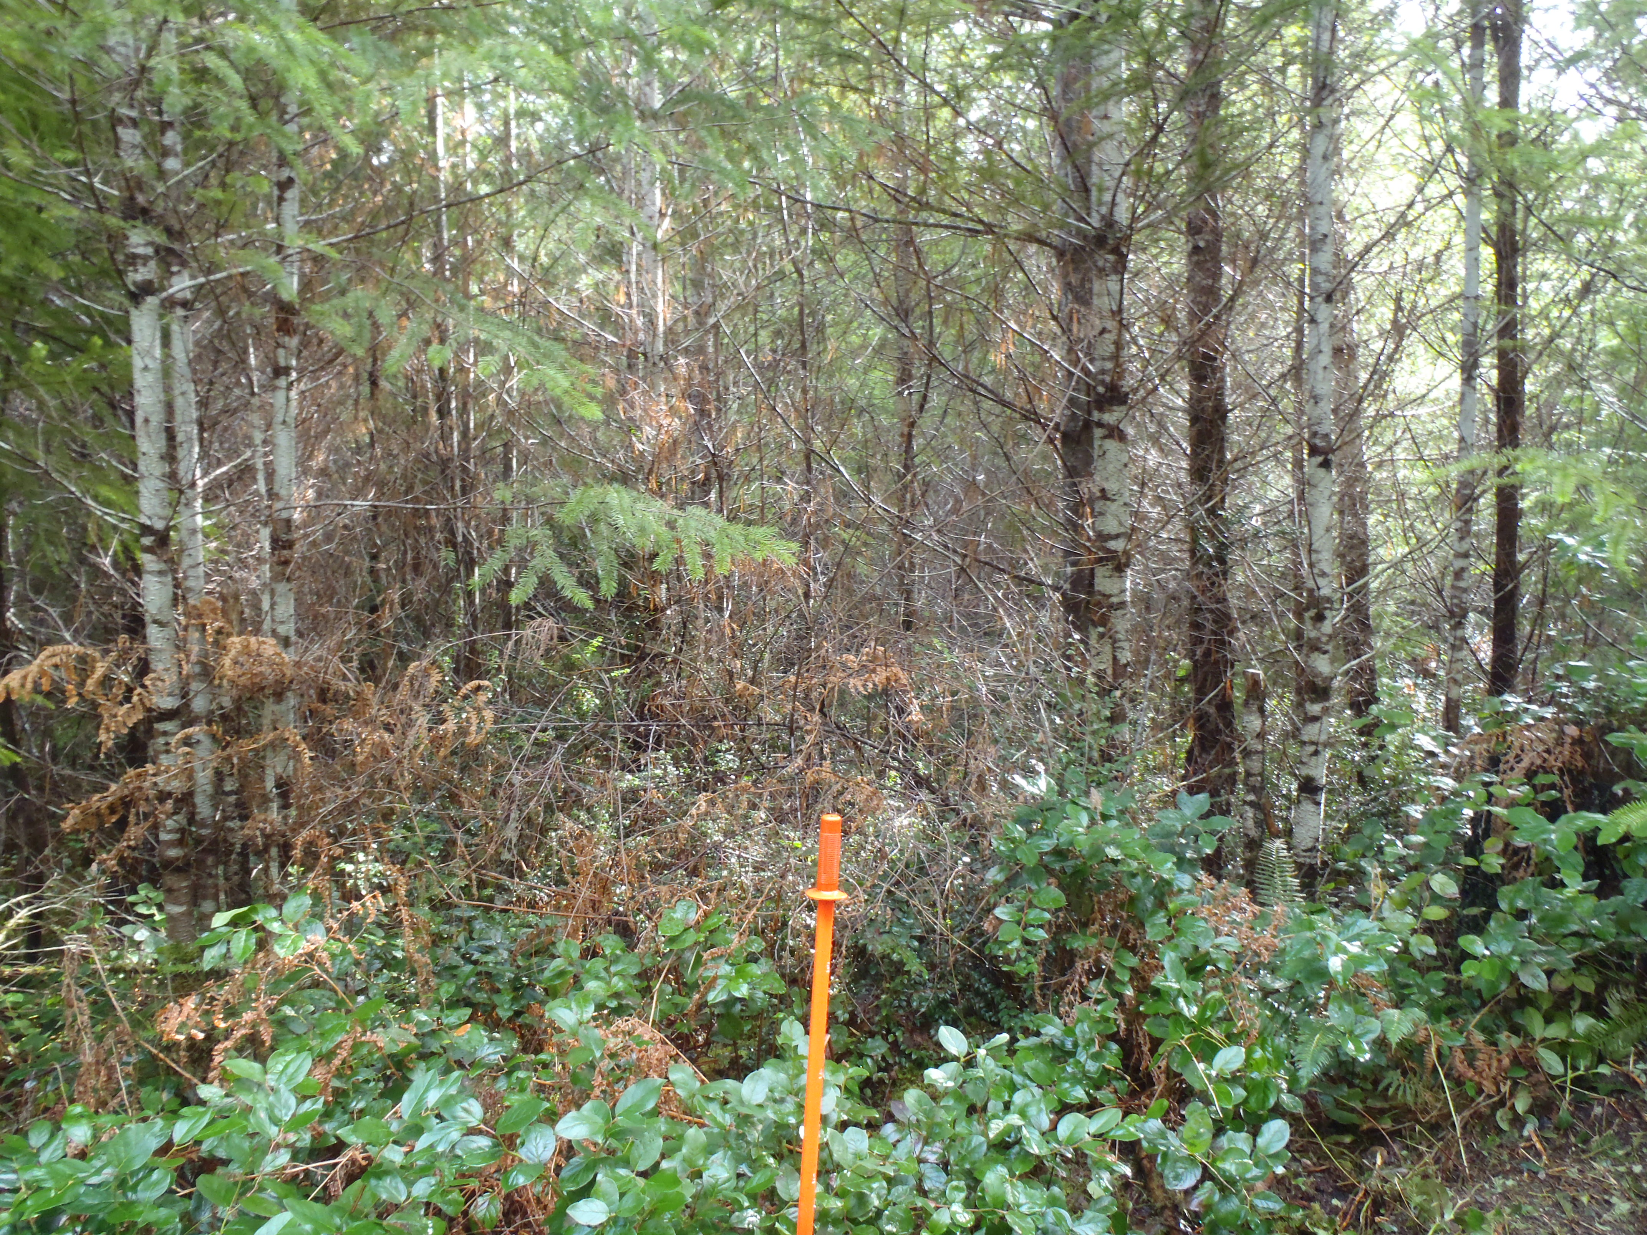

Slide 22
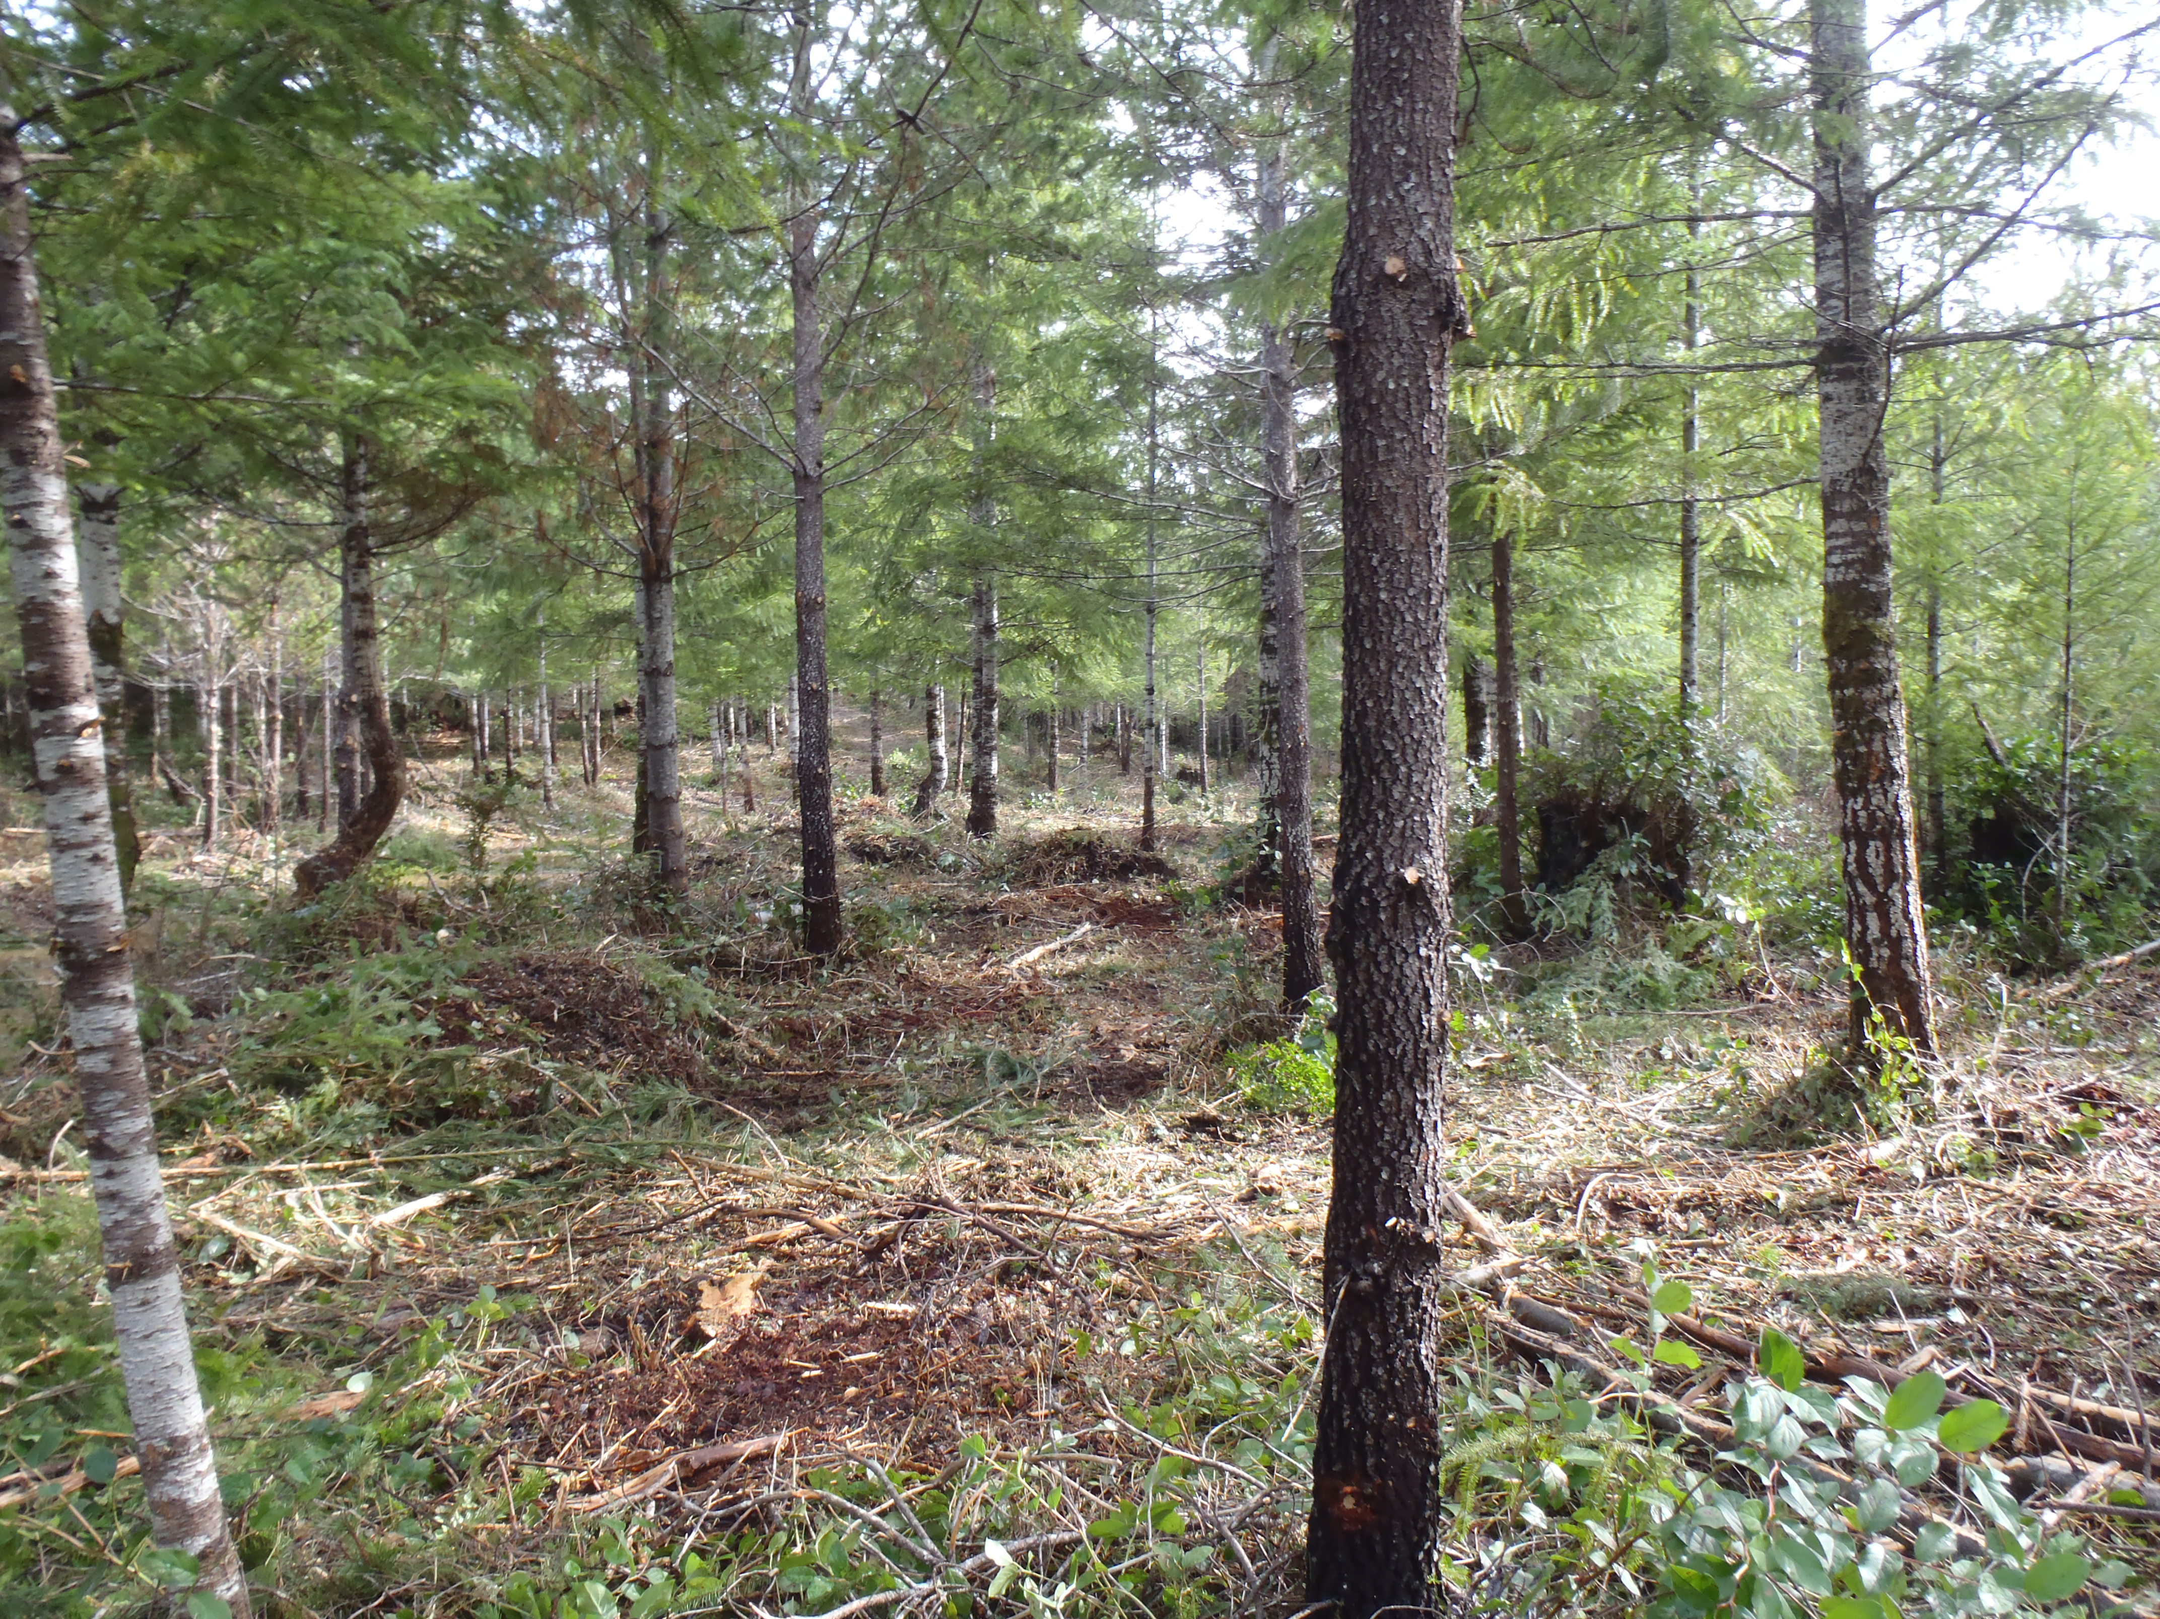

Slide 23
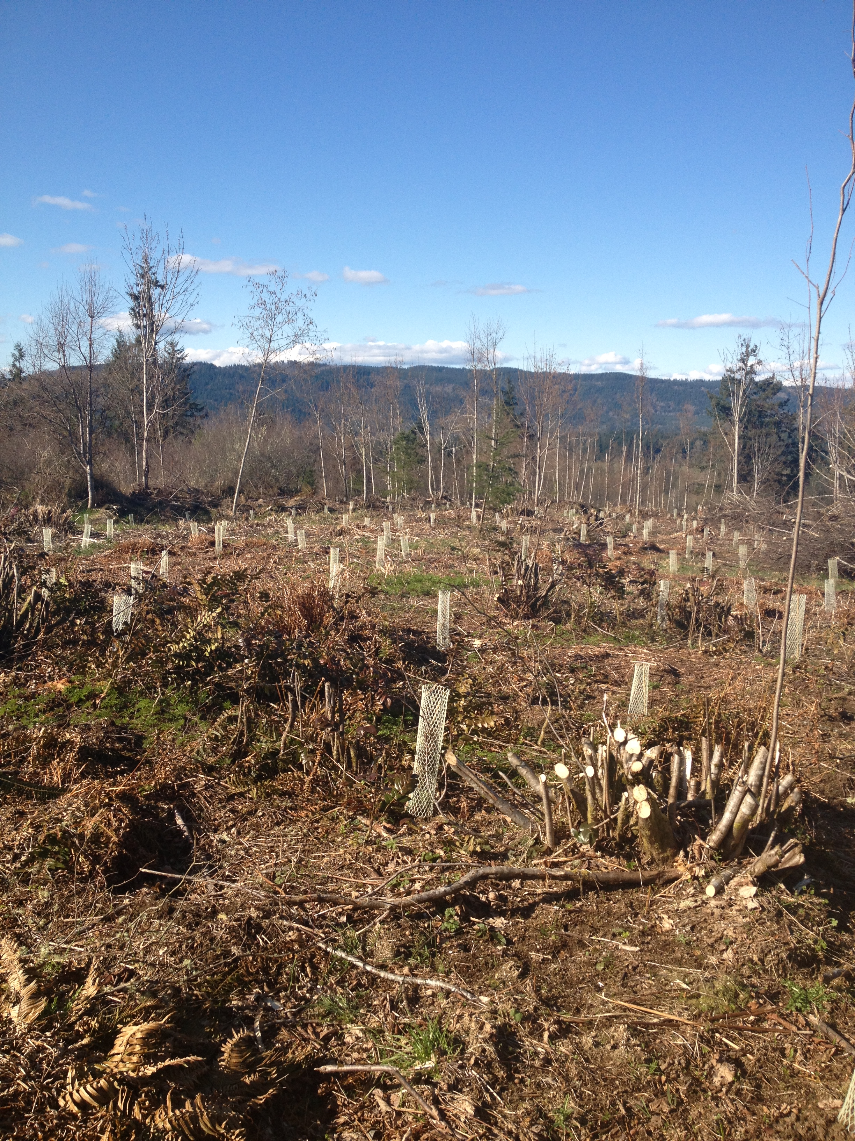

Slide 24
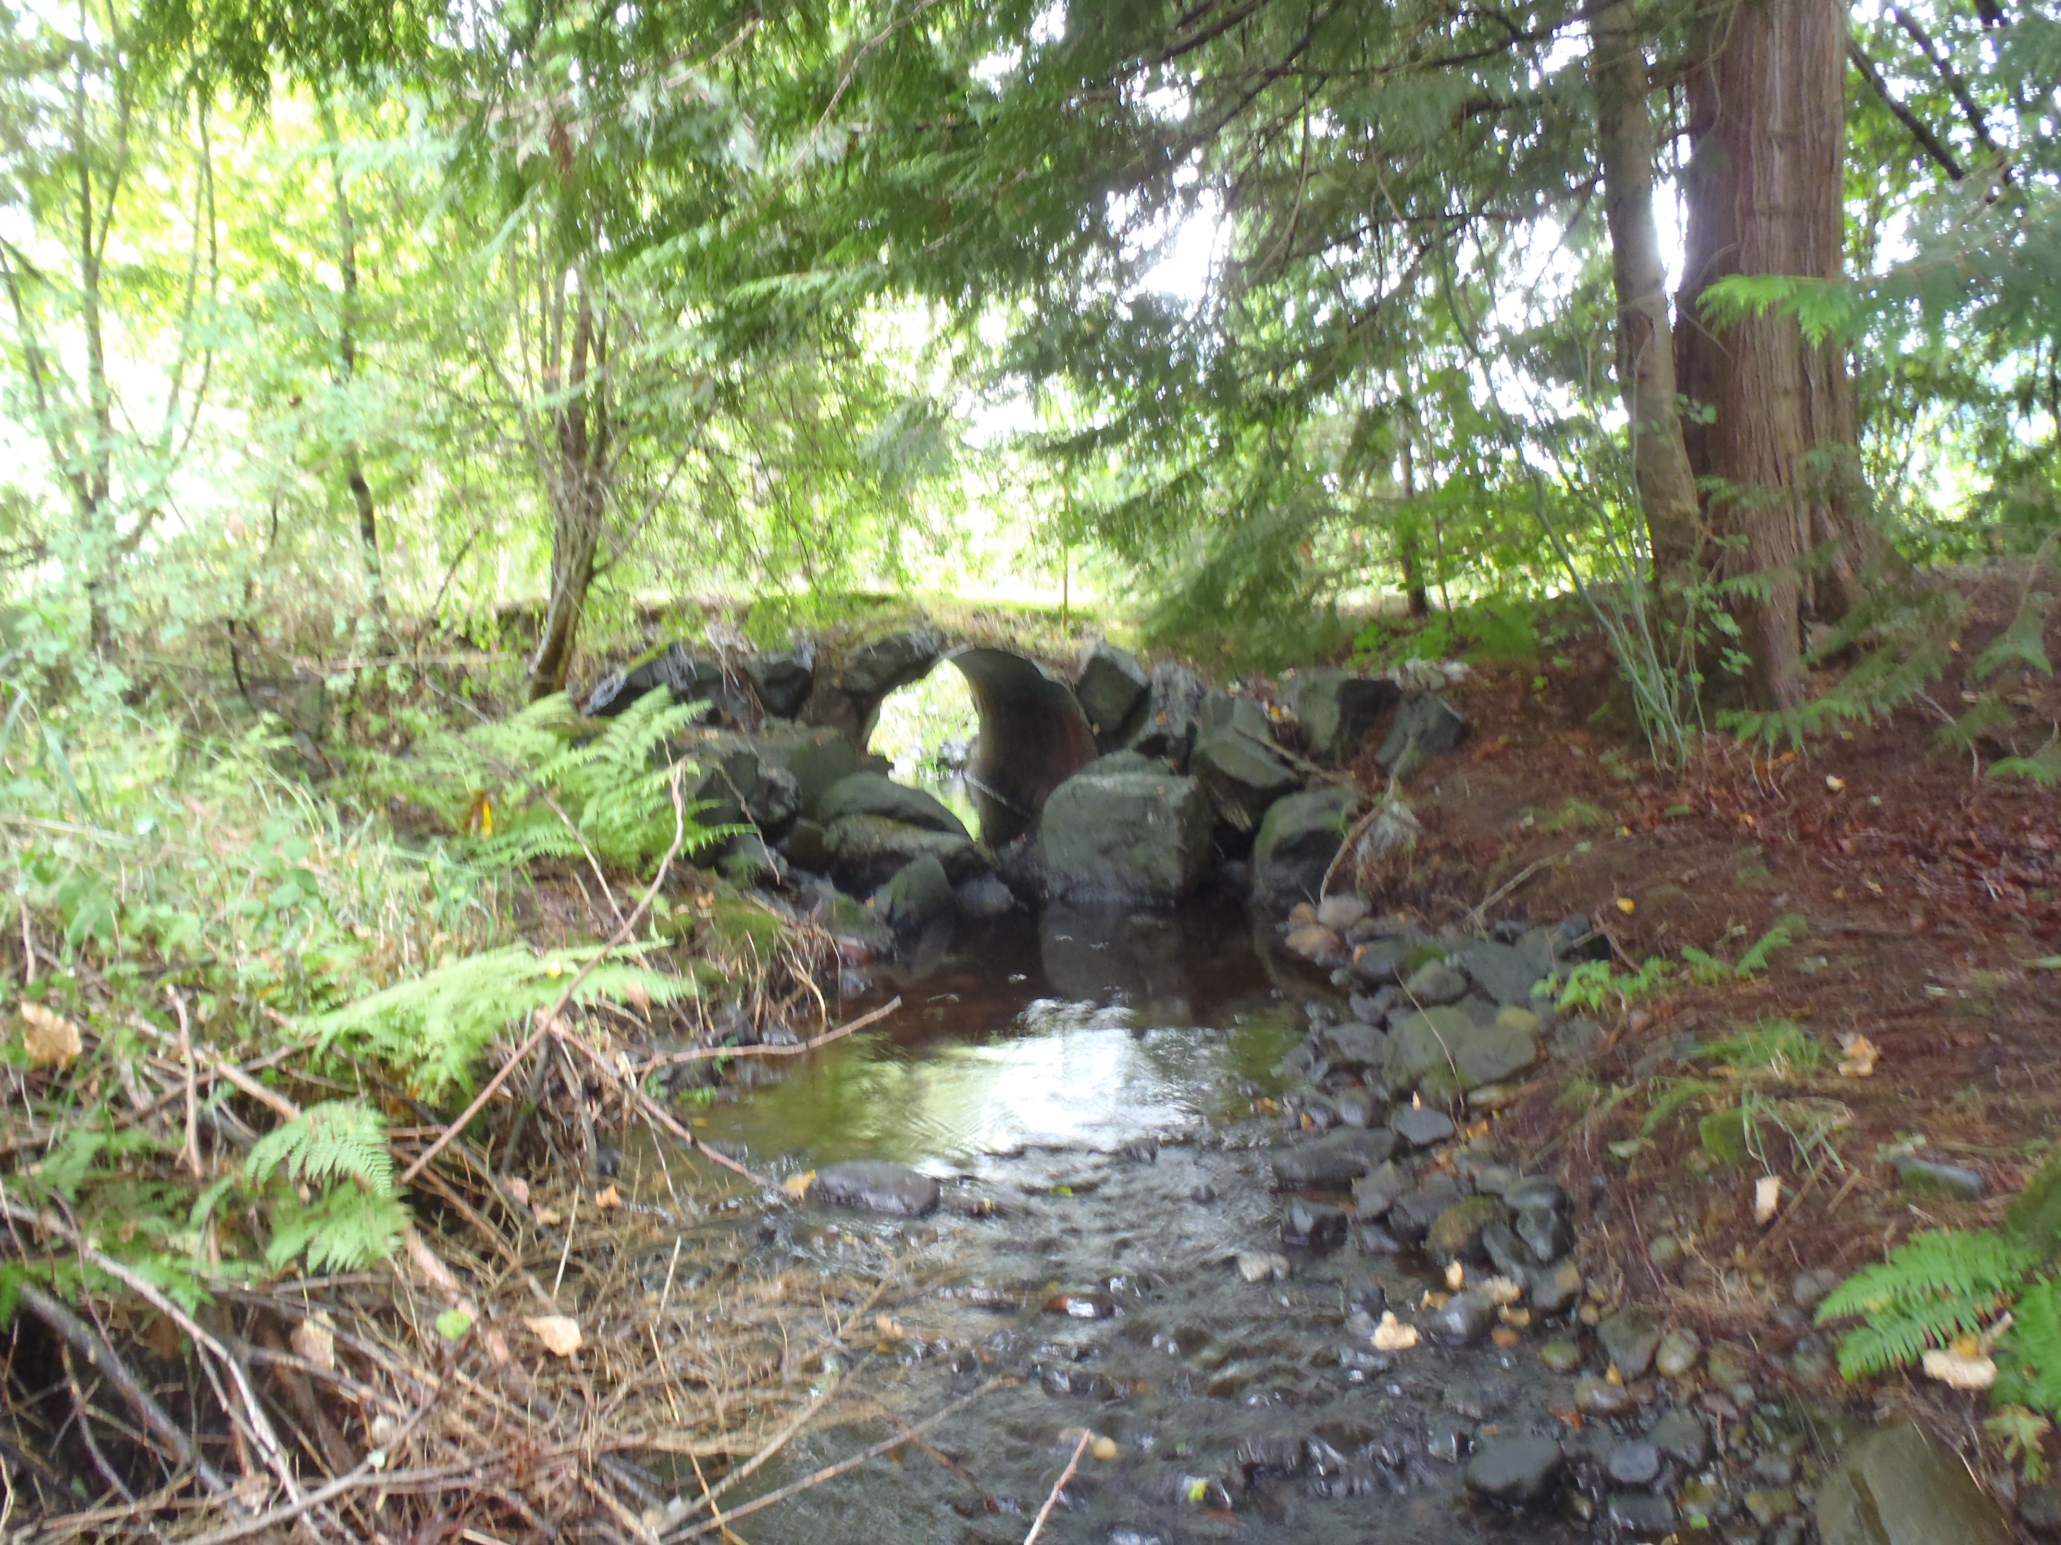

Slide 25
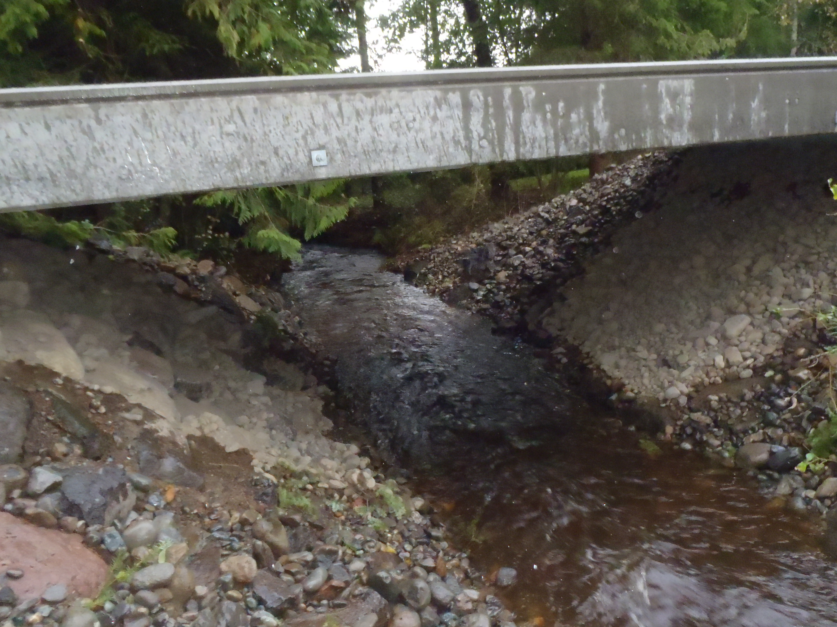

Slide 26
Questions?
USDA is an equal opportunity provider and employer

