Slide 1
Technical Service Provider Overview
March 24, 2015

Slide 2
USDA 2008 Farm Bill
The 2008 Farm Bill amended the 1985 Farm Bill, which authorized use of TSPs, by allowing NRCS participant contract holders to receive technical assistance by individuals and entities other than NRCS.

Slide 3
USDA 2008 Farm Bill
This provision is designed to ensure NRCS has the capacity to address the significant workload associated with implementing Farm Bill programs.

Slide 4
Overview
Technical Service Providers (TSPs) are individuals or businesses certified to help agricultural producers plan and apply conservation practices on their land.

Slide 5
Overview
TSPs work with the Natural Resources Conservation Service (NRCS) to ensure conservation services are delivered quickly and efficiently.

Slide 6
When working with NRCS,
TSPs can:
Develop specialized conservation plans to identify resource concerns on the farm or ranch; (Example: Conservation Activity Plans)

Slide 7
When working with NRCS,
TSPs can:
Design, lay out and install conservation practices to address resource concerns; (Example: NRCS Conservation Practice Implementation)
and

Slide 8
When working with NRCS,
TSPs can:
Inspect completed practices for certification and payment, as applicable. (Example: NRCS Practice Documentation Checklist)

Slide 9
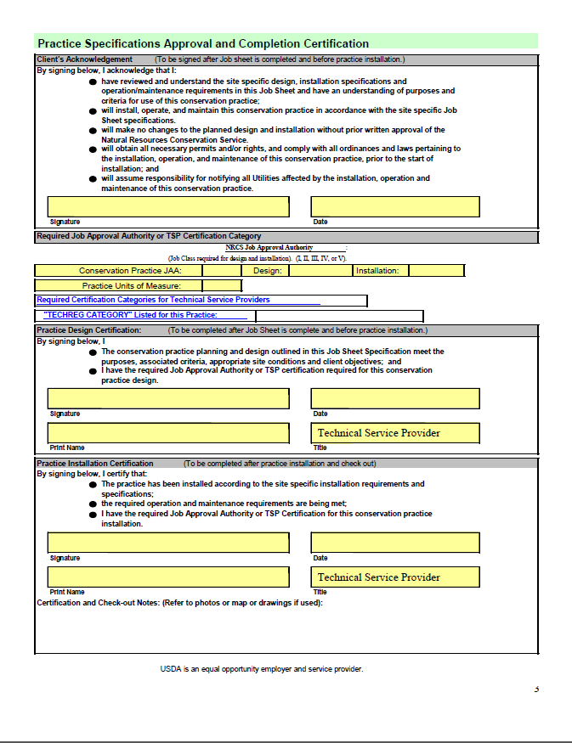

Slide 10
How NRCS Contract Holder Receive TSP Assistance:
The NRCS participant contract holder selects an individual, entity, American Indian Tribe, or public agency from the list of certified TSPs.

Slide 11
How NRCS Contract Holder Receive TSP Assistance:
The provided technical services must meet all legal, technical, and programmatic requirements.

Slide 12
How NRCS Contract Holder Receive TSP Assistance:
Funding is made available at the State level through NRCS.

Slide 13
How NRCS Contract Holder Receive TSP Assistance:
The practice must be obligated in the NRCS participant contract prior to TSP services being commenced.

Slide 14
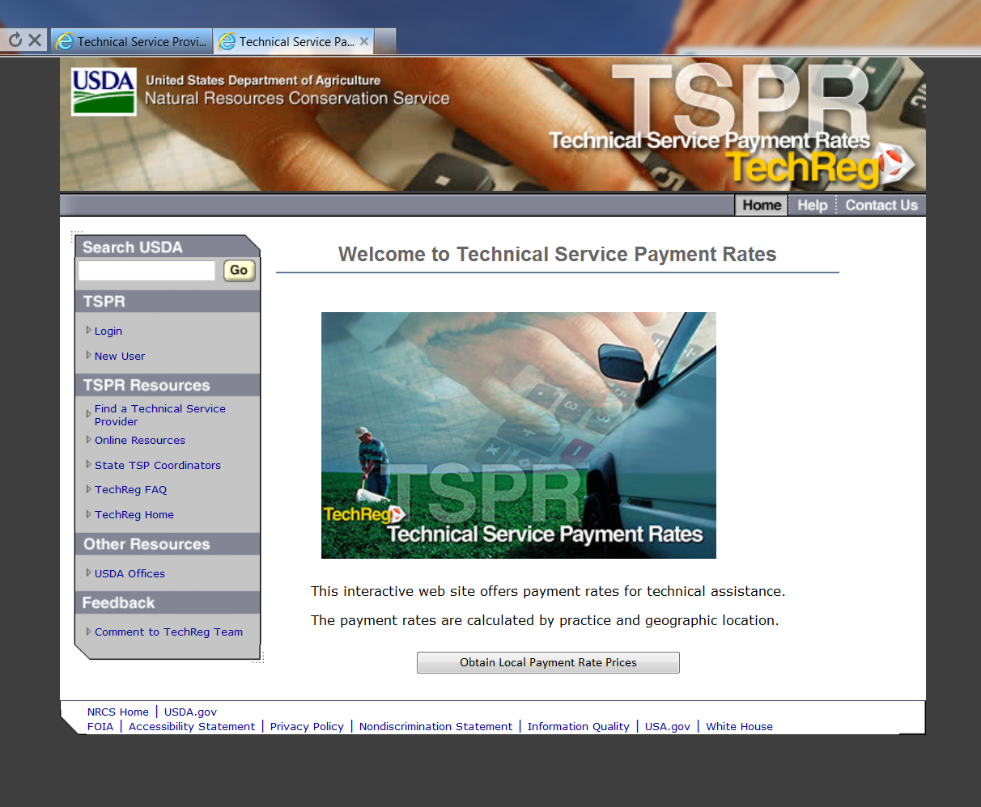
Funding for TSP’s
NRCS Conservation Practice Assistance
TSP Payment Rates Vary Depending on:
Practice
Number of units
Regional Rate

Slide 15
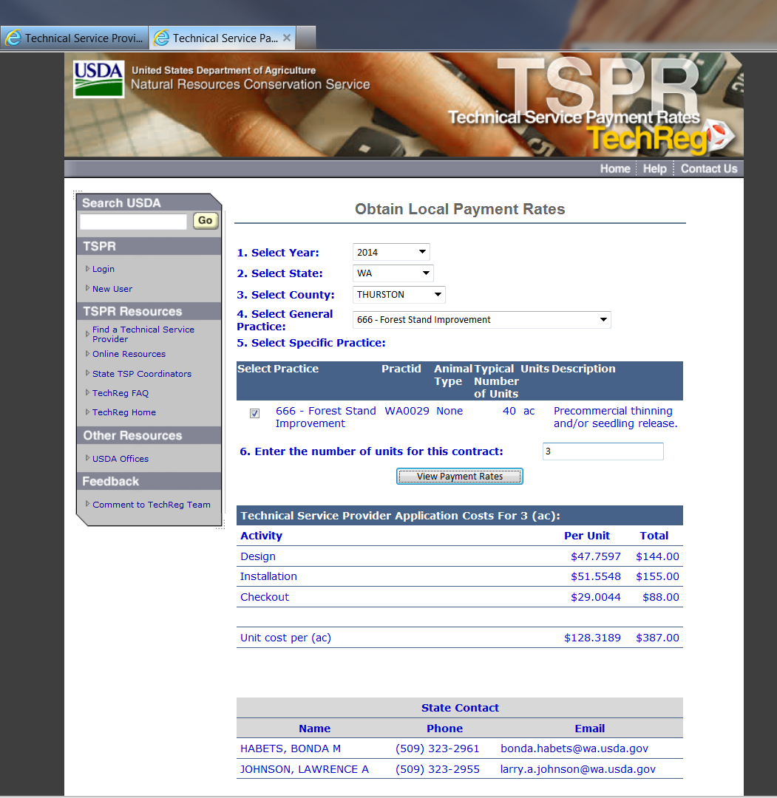
Funding for TSP’s
NRCS Conservation Practice Assistance

Slide 16
Funding for TSP’s
CAP 106, Forest Management Plan
106 | EQIP | Forest Management Plan | FMP Less Than or Equal to 20 acres | 988.09
106 | EQIP | Forest Management Plan | HU-FMP Less Than or Equal to 20 acres | 1185.71
106 | EQIP | Forest Management Plan | FMP 21 to 100 acres | 1248.12
106 | EQIP | Forest Management Plan | HU-FMP 21 to 100 acres | 1497.74
106 | EQIP | Forest Management Plan | FMP 101 to 250 acres | 2236.22
106 | EQIP | Forest Management Plan | HU-FMP 101 to 250 acres | 2683.46
106 | EQIP | Forest Management Plan | FMP 251 to 500 acres | 3224.31
106 | EQIP | Forest Management Plan | HU-FMP 251 to 500 acres | 3869.17
106 | EQIP | Forest Management Plan | FMP 501 to 1000 acres | 3744.36
106 | EQIP | Forest Management Plan | HU-FMP 501 to 1000 acres | 4493.23
106 | EQIP | Forest Management Plan | FMP Greater Than 1000 acres | 4680.45
106 | EQIP | Forest Management Plan | HU-FMP Greater Than 1000 acres | 5616.54

Slide 17
Questions?
Larry Johnson
TSP Coordinator
LAWRENCE A. JOHNSON, P.E.
State Conservation Engineer
316 W. Boone Ave, #450
Spokane, WA 99201
(509) 323-2955

