Slide 1
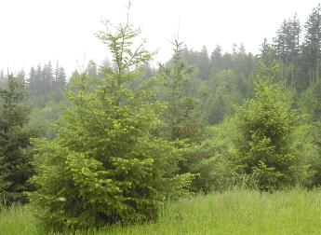
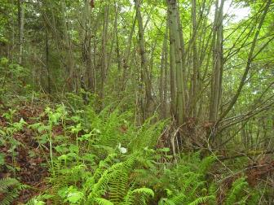
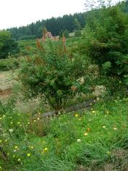
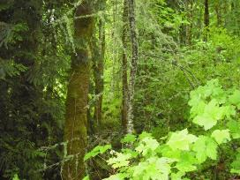

Forest Use Taxation
Michael Ahr

Slide 2
Forest Tax Deferral
Property is “used for the predominant purpose of growing and harvesting trees of a marketable species”
Incentive to keep lands in production
It’s a deferral, not a discount or exemption
Payback when you switch
  Potential back taxes of 5 to 10 years

Slide 3
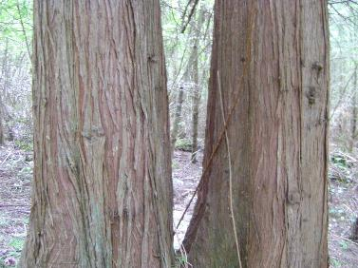
“Growing”
Typically defer to Oregon Forest Practices Act
Forest is stocked with:
  200 seedlings per acre
  120 trees per acre (1-10” DBH)

Slide 4
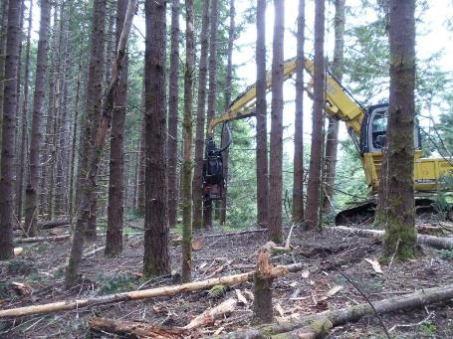
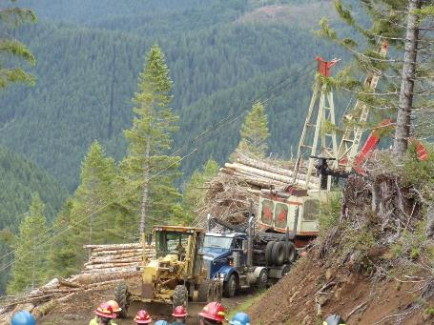
“Harvesting”
Clearcut
Thinning

Slide 5
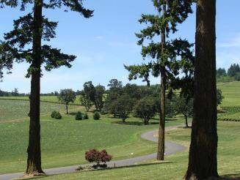
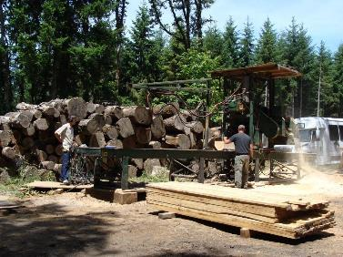

“Marketable”
Douglas-fir, hemlock, fir, cedars, and other conifers
Hardwood
  Red alder
  Bigleaf maple
  Others get “iffy”

Slide 6
So, you just bought a forest
Multnomah Co. Example
Forest Questionnaire comes in mail (15 business days)
Are you growing trees?
About how old are they?
Do you plan to harvest them?
When?
Do you have a Forest Management Plan?
  Yes, please send it
  No, can you write down what you’re planning?

Slide 7
So, you just bought a forest
Multnomah Co. Example
If they have further questions, you’re probably on your way to writing a plan
They’ll set a time limit with you
You’ll need to address
  Stocking
    Species
    Age
  Harvest plans
  Other restoration work
You’re not required to work with a professional on this….but most people should ☺

Slide 8
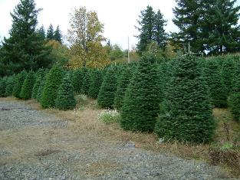
I don’t want to harvest trees
Pay property taxes in full – not a bad option
Wildlife Habitat Conservation Management Plan – ODFW
Conservation Easement
Open Space ?
If growing Christmas trees, Orchard, etc. you want to explore Agricultural Deferral Programs

Slide 9
Learn More
Call the County Tax Assessor
  Mult. Co. – Mary Holliman – (503) 988-3278
Oregon Department of Revenue
  http://www.oregon.gov/DOR/programs/property/Pages/timber.aspx
    Info on Property tax and Timber tax
    Small Tract Forestland Program
      Pay some of your property tax obligation after you harvest timber

