Slide 1
If you can’t beat’em eat’em
Edible weeds
Dana Coggon
Kitsap Noxious Weeds

Slide 2
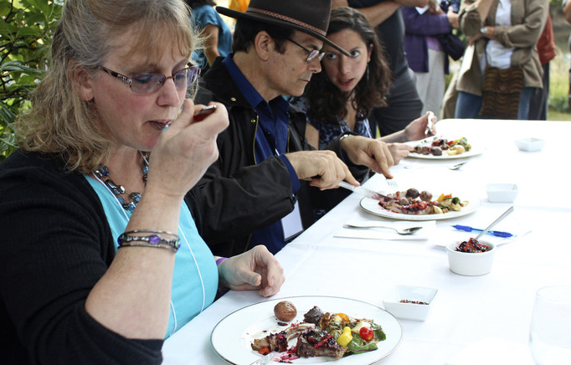
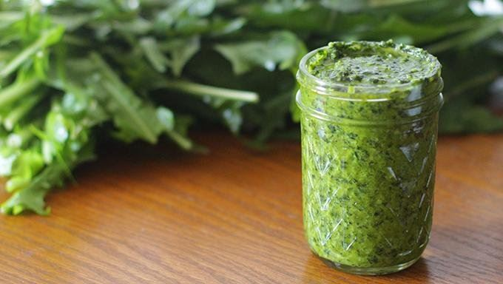
Top 20 weeds that you hate but you should Plate
  “Part of the resistance to eating plants that we believe to be weeds is that we are conditioned to only consider the items we find in the grocery store as food. ”

Slide 3
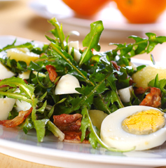
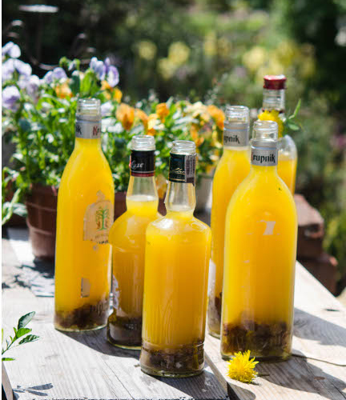
Dandelion
Edible parts:
    Flowers
      Eaten raw or fried
      Can be turned into wine
    Roots
      Can be dried and roasted and used as a coffee substitute, or added to any recipe that calls for root vegetables
    Leaves
      Smaller leaves are considered to be less bitter and more palatable raw, the bigger leaves can be eaten as well, especially as an addition to a green salad
      They can also be steamed or added to a stir-fry or soup

Slide 4
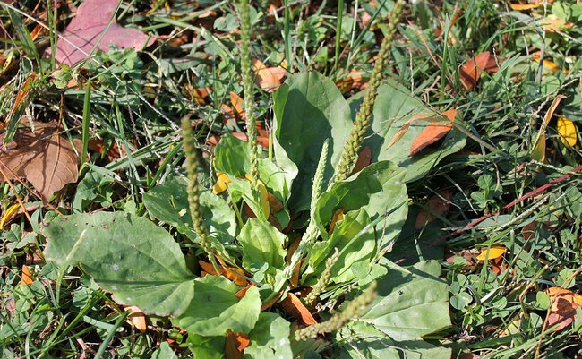
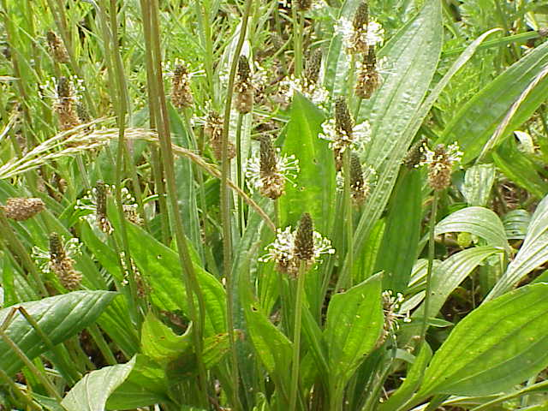
Plantain
Edible parts:
    Leaves
      Young leaves steamed or boiled or sateed
    Seeds
      can be cooked like a grain or ground into a flour
Other uses:
    can be used topically to soothe burns, stings, rashes, and wounds

Slide 5
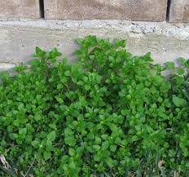
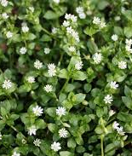
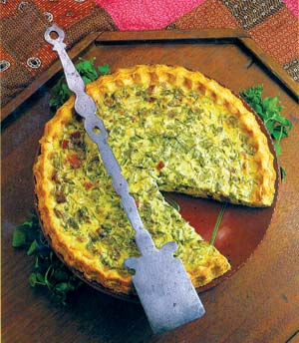
Chickweed
Edible parts:
    leaves, stems, and flowers can all be eaten either raw or cooked, where it adds a delicate spinach-like taste to any dish
Other Uses
    can be used topically to soothe burns, stings, rashes, and wounds
    an be made into a tea for use as a mild diuretic

Slide 6
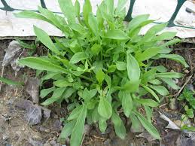
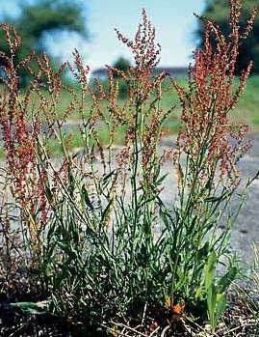
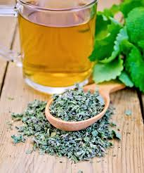
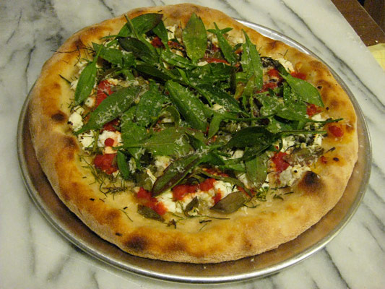
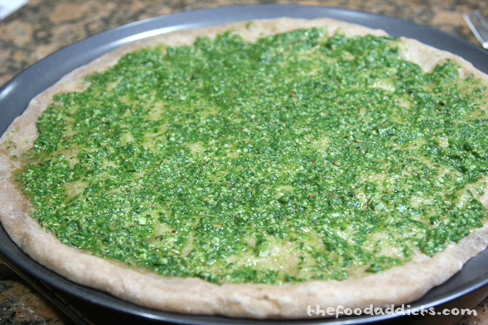
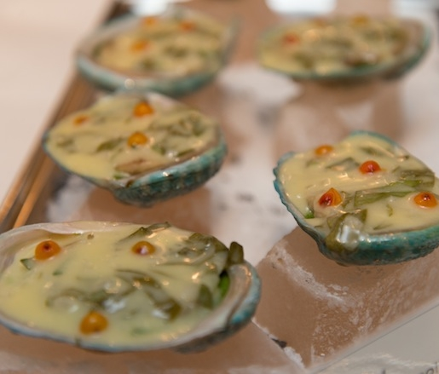
Sheep sorrel
Edible parts:
    leaves, stems, and flowers
      can all be steeped then blended with a bit of mint
      Blend as pesto
      Make a soup along with nettle
      Dried then used as tea

Slide 7
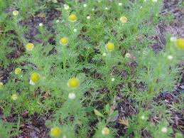
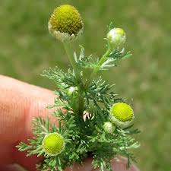
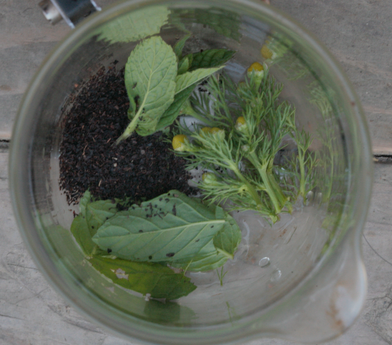
Pineapple Weed
Edible parts:
  Leaves, shoots, flowers
    Dried plant is said to have more soothing and relaxing properties than chamomile tea.
    Dried plants can be added to dough to add a lemon flavor
    Can be eaten raw or cooked, although it’s rather bitter
Other uses:
  Works as a bug deterrent, either in fresh or powdered form. You can rub fresh plant on exposed skin, or infuse the powder in oil and apply it.
  Sprinkling the dried plant over food may help prevent spoilage.

Slide 8
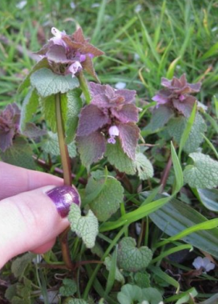
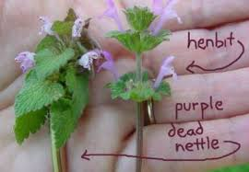
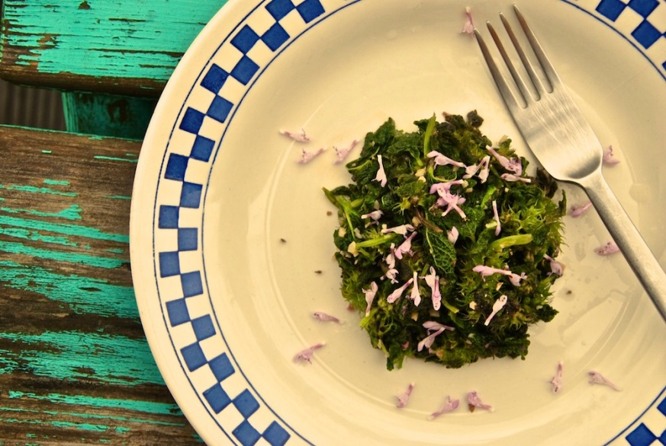
Purple Deadnettle and Henbit
Edible parts:
  Leaves, shoots, flowers
    Henbit can be consumed fresh or cooked as an edible herb, and it can be used in teas.
    Very nutritious, high in iron, vitamins and fibre. You can add raw henbit to salads, soups, wraps, or green smoothies.
Other uses:
  Is noted as an anti-rheumatic, diaphoretic, an excitant, febrifuge, a laxative and a stimulant.

Slide 9
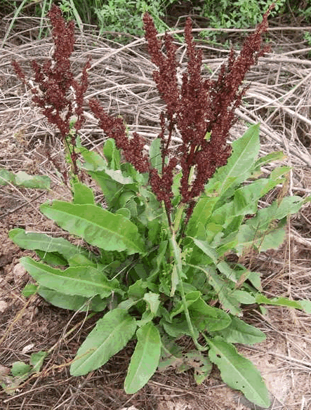
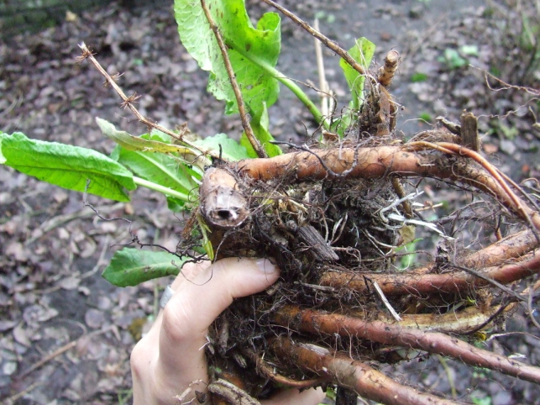
Curly Dock
Edible parts:
  Seeds:
    The sand-like seeds, cousins of buckwheat, they can be gathered, cleaned, and ground into flour.
  Leaves:
    Dock leaves are amazingly impressive sources of iron
  Roots:
    are edible, especially when young
Other uses:
    It is alterative, astringent and tonic, combating some skin diseases and other problems. Docks also make various dye colors, depending upon the part of the plant used.

Slide 10
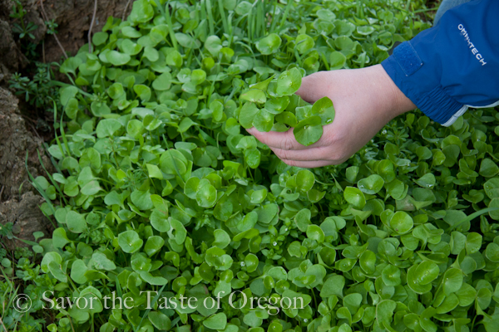
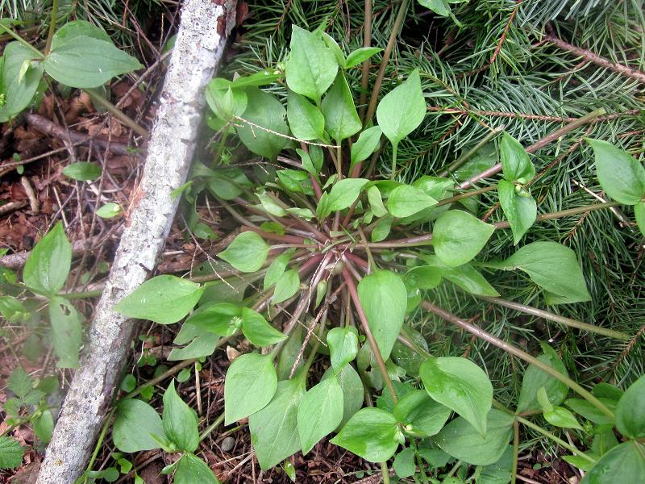
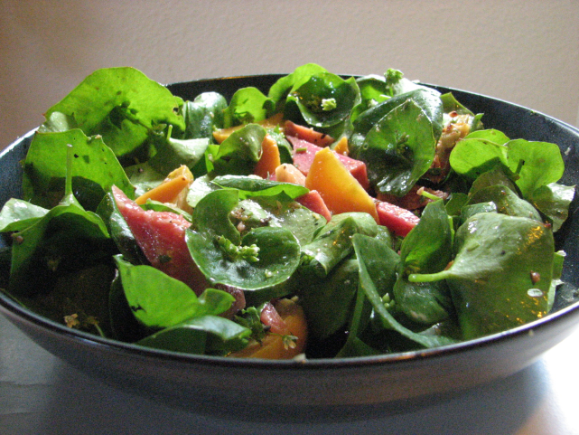
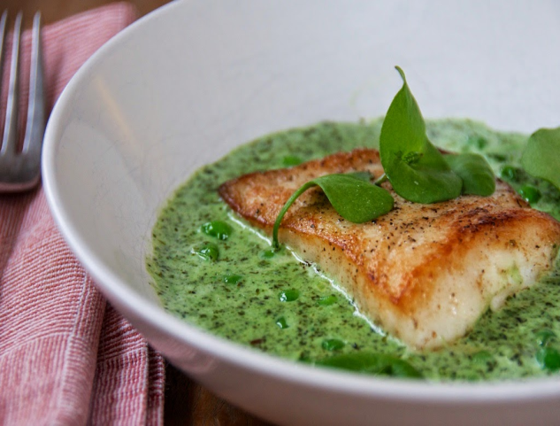
Miner's lettuce
Edible parts:
  Leaves, shoots, flowers
    Can be added to soups and salads
    Steamed
    Pesto

Slide 11
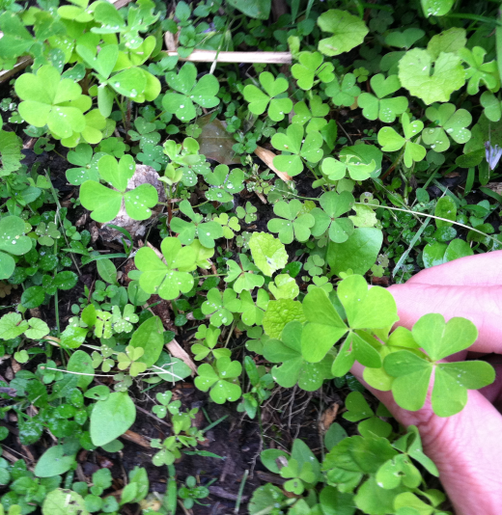
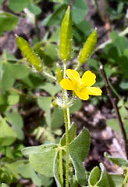
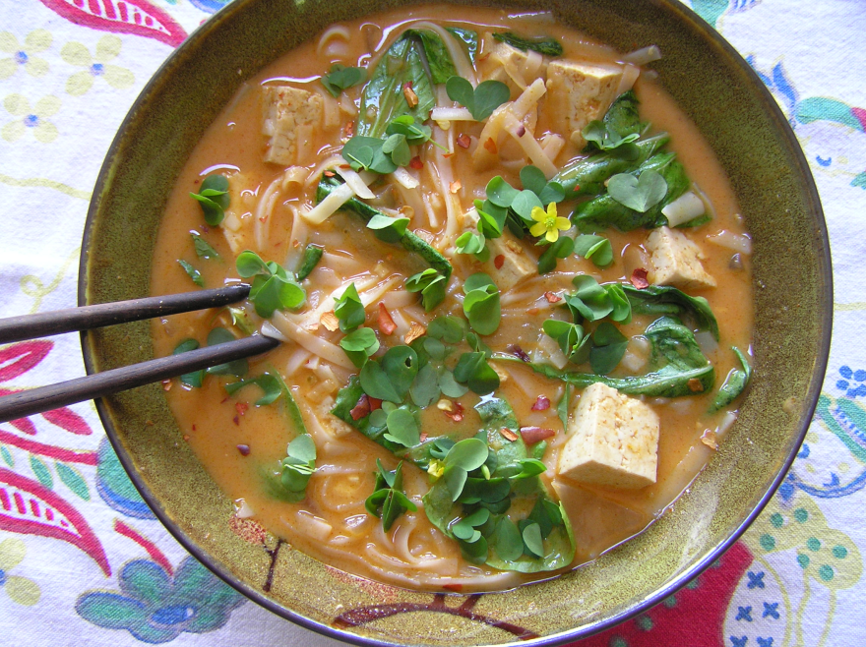
Wood sorrel
Edible parts:
  The leaves, flowers, and immature green seed pods are all edible having a mild sour flavor that some say resemble lemons.
  can be added to salads, used in soups, sauces and it can also be used as a seasoning.
  Cool tea can make a refreshing beverage especially when sweetened with honey.
    In moderate dosages, wood sorrel is cooling (refrigerant, febrifuge), diuretic, stomachic (soothing to the stomach, relieves indigestion), astringent, and catalytic.

Slide 12
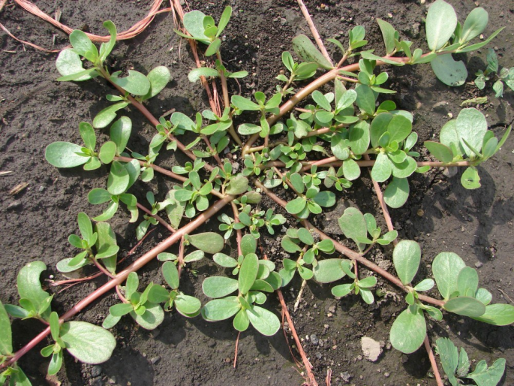
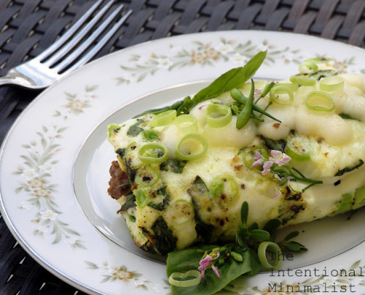
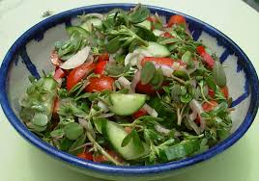
Purslane
Edible parts:
  The leaves stems
    Soups, sauces (curry) and it can also be used as a pesto.
      Noted as being rich in dietary fiber, vitamins, and minerals
      leaves contain surprisingly more omega-3 fatty acids (α-linolenic acid) than any other leafy vegetable plant.
      rich source of vitamin C, and some B-complex vitamins like riboflavin, niacin, pyridoxine and carotenoids, as well as dietary minerals, such as iron, magnesium, calcium, potassium, and manganese

Slide 13
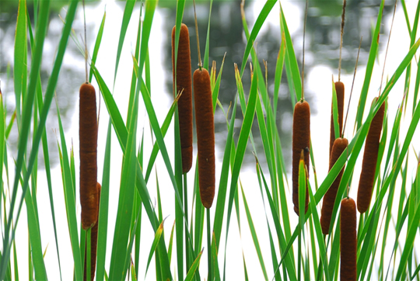
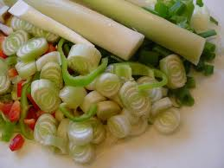
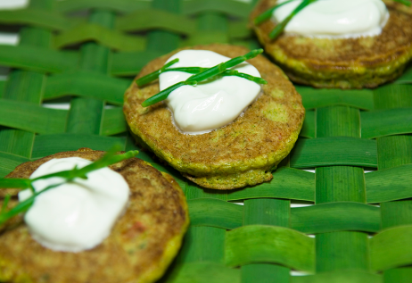
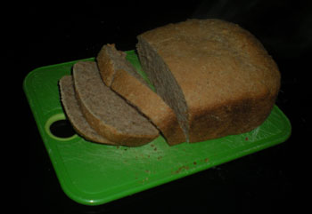
Cattail
Edible parts:
  The stems, Roots, Flowers
    “You name it and we’ll make it from cattails!” Cattails are the supermarket of the wilds.
    The young cob-like tips of the plant are edible
    Dry the peeled roots
      Chop roots into small pieces, and then pound them used as flour.
      The roots also can be boiled like potatoes

Slide 14
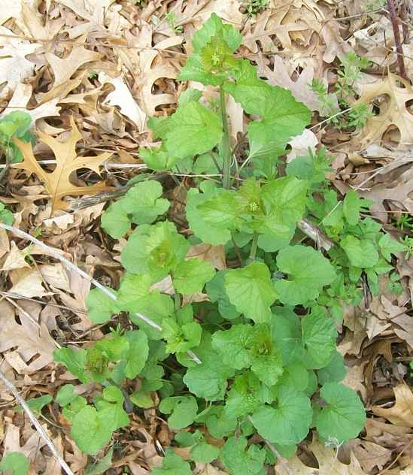
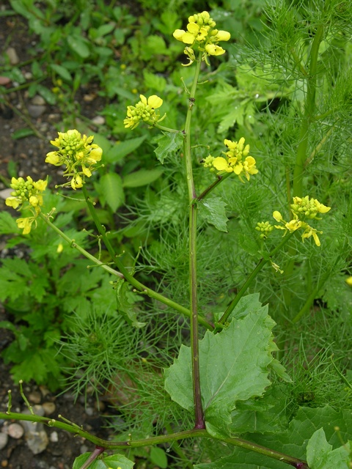
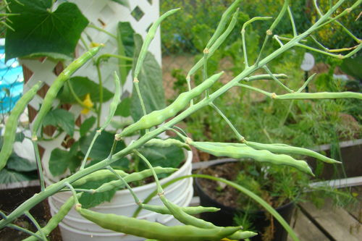
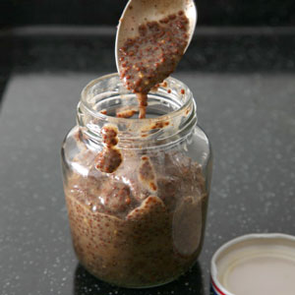
field mustard
Edible parts:
  Leaves, flowers, stems, roots
    The greens well and cook in salted water. Wild mustard can be somewhat sharp when raw and somewhat bitter when cooked.
    Flowering tops can be cooked like broccoli just before they open.
    The seeds can be used to make mustard. They can also be used in pickling.

Slide 15
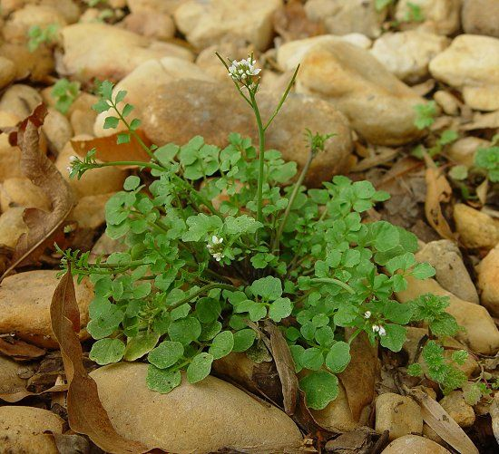
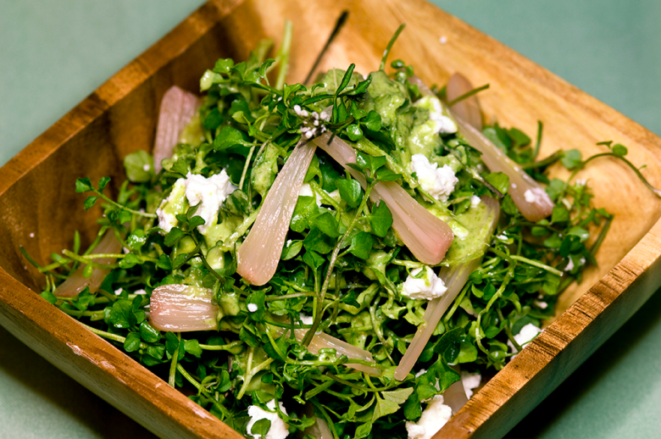
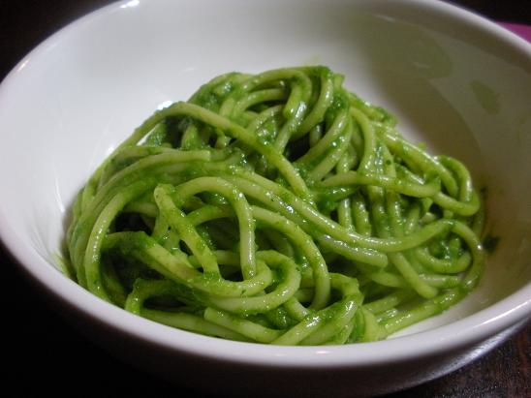
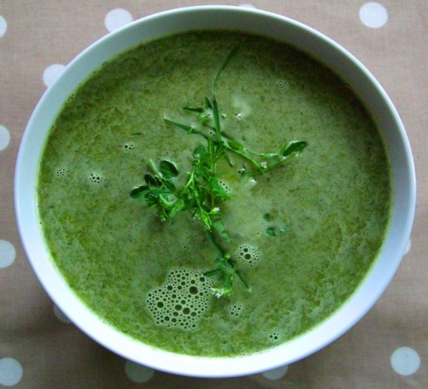
bittercress
Edible parts:
  Leaves, shoots, flowers
    Can be added to soups and salads
    Bitter mustard flavor

Slide 16
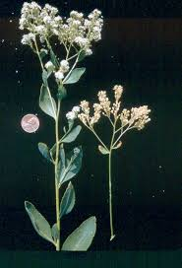
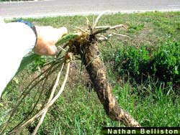
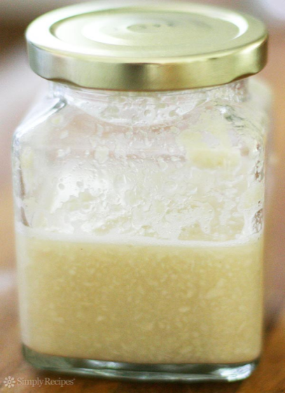
Perennial Pepperweed
Edible parts:
  Leaves & roots
    The spring greens are edible when cooked
    Root can be used as a horseradish
      8-10-inch long piece of root
      2 Tbsp water
      1 Tbsp white vinegar
      Pinch salt

Slide 17
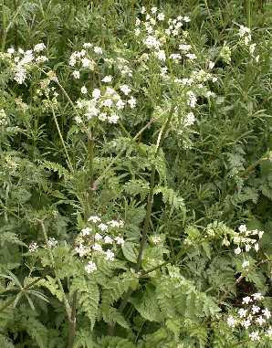
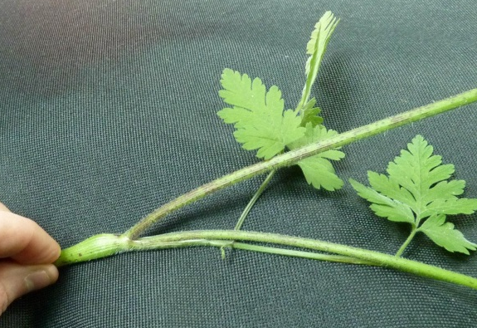

Chervil
Edible parts:
  Chervil looks like a petite feathery version of flat leaf parsley and has a mild, sweet aniseed flavor.
    Leaves can be chopped up and used to flavor any number of dishes, either hot or cold, much like you would use any other culinary herb. It works well with fish, elegant soups, and butter sauces and adds a final flourish to many a restaurant dish.
    Roots can be cooked and roasted

Slide 18


Wild Carrot / Queen Anne’s Lace
Edible parts:
  Root: roasted root veg in soups and or over greens
    Can also be cooked into cakes
  Flowers: Used in jelly and as garnish

Slide 19


Wild Carrot VS Hemlock
  Caution:
  do not confuse this plant with poison hemlock!
  Hemlock is highly toxic!!!

Slide 20



Fennel
Edible parts:
  Leaves can be chopped up and used to flavor any number of dishes, either hot or cold, much like you would use any other culinary herb. Use it in dishes that also feature citrus, or in any dish that reminds you of spring. The fronds also make a beautiful garnish for dishes containing fennel.
  Seeds are one of the primary spices in Italian sausage, and they are also used frequently in Indian and Middle Eastern cuisine.
  Pollen is one of those ingredients that is almost exclusively used in fine dining kitchens. It has a very concentrated, musky-anise aroma and flavor. A little goes a long way, mix some into a cream sauce or use it as part of a dry spice rub.
  Roots/Bulb can be cooked and caramelized with onions adding a bright spring flavor.

Slide 21



Lamb’s Quarters
Edible parts:
  Leaves,shoots,flowers
    Lamb’s quarters contain some oxalic acid therefore when eating this raw, small quantities are recommended. Cooking removes this acid.
    Eaten in salads or added to smoothies and juices.
      Steaming this edible weed is one method of cooking, or can be added to soups, sautés and much more.
      Drying this wild edible is one way to add this nutritious plant to your meals throughout the winter or you can blanch and freeze the leaves.

Slide 22



Burdock
Edible parts:
  Roots of the first years growth.
    Stir-fry, or pickle it and toss with a salad, or slice thinly and add to miso-based soups.
  The leaves and stalk are only desirable when they are young and tender.
    It is possible to eat the mature leaves and stalks but they generally take on a fibrous and tough texture that is rather unappealing.

Slide 23



Chicory
Edible parts:
  Roots have other uses than leading coffee astray, they can be boiled and eaten
  The young leaves are edible in salads, as are the aforementioned blossoms.
  The flower buds can be pickled

Slide 24




Knotweed
Edible parts:
  stems
  Roots

Slide 25
What ever your meal you can find it in your yard
Meal plans:
  You don’t need to use all weeds but just start adding some to each of your meals.
  If you want to make a full meal plan you can!
    Many weeds have a bit of a bitter flavor don’t mask the flavor but work with it.

Slide 26
Dandelion Wine
1 package (7 g) dried brewing yeast
1/4 cup (60 mL) warm water
2 quarts (230 g) whole dandelion flowersUsing 2 quarts+ of just the petals can make for a less bitter wine.^{[2]}
4 quarts water (3.785 L)
1 cup (240 mL) orange juice
3 tablespoons (45 g) fresh lemon juice
3 tablespoons (45 g) fresh lime juice
1/2 teaspoon (1.25 g) powdered ginger
3 tablespoons (18 g) coarsely chopped orange zest; avoid any white pith
1 tablespoon (6 g) coarsely chopped lemon zest; avoid any white pith
6 cups (1200 g) sugar

Slide 27
Dandelion Wine
Soak the flowers for 2 days
Place flowers in 4 quarts of water with the lime, orange and lemon juices
Stir in the ginger, cloves, orange peels, lemon peels, and sugar. Bring the mix to a boil for an hour. This creates the 'infusion' that will later become wine after fermentation.
Filter stir in yeast cover and let stand overnight

Slide 28

Nutty Plantain Snack
1 handful of plantain seed
3 handfuls of pumpkin seeds
3 handfuls of sesame seeds
Olive oil
(enough to just cover the seeds)
Sea salt to taste
Place seeds into a bowl, add olive oil and salt. Be sure to coat all seeds.
Either roast seeds in oven on a baking sheet at 300°F for 10-15 minutes or roast them in a frying pan on the stove.

Slide 29
Roasted Plantain & Kale Chips
2 cups young common plantain leaves, mixed with kale
2 tsp. sesame oil
1/2 tsp. fennel seeds, ground
1/2 tsp. caraway seeds, ground
1/4 tsp. powdered ginger
1/2 tsp. salt
A dash of hot sauce
1. Stir all the ingredients together
2. Spread onto 3 cookie sheets covered with non-stick mats (or oiled cookie sheets) and bake about 6 minutes, or until very lightly browned and crisp, in a preheated 425 degree oven. Stir occasionally, being careful not to let the leaves burn

Slide 30
lambsquarter breakfast ramekin
lambsquarters
1 medium onion
2 eggs
1 tb butter
1 tb white wine vinegar
1/4 cup water
2 tbs grated parmesan cheese
salt & pepper to taste
preheat oven to 350º if using a large oven, hold off if using the toaster oven.
pull the leaves from the stems of all lambsquarters and wash in a colander. chop the onion and sauté in butter over medium heat until translucent, 5 minutes. add vinegar, water and the lambsquarters leaves, cover and turn heat down to low, wilt the leaves 5 minutes. uncover and sauté until lambsquarters are sufficiently wilted and liquid is cooked down.
place a scoop of the sauté mix into 2 ramekin dishes, crack an egg over each, sprinkle parmesan over the top and bake 20 minutes at 350º, or shorter if you prefer soft-cooked eggs.
Lamsquarters is one of the highest natural forms of nutrition, it is right up there with dandelion, watercress, and stinging nettles. It is a huge source of vitamin A and K
http://parlatodesign.com/2012/02/14/experimenting-with-lambsquarters/

Slide 31

Lambsquarters Stuffed Mushrooms
Ingredients
1/4 tsp. garlic powder
1/4 tsp. pepper
4 ounces feta cheese
2 ounces cream cheese
8 oz. fresh lambsquarters (Approximately, I just filled a brown paper lunch bag.)
14 oz. can artichoke hearts, drained and chopped
24 fresh mushrooms, stems removed
Directions
Preheat oven to 350 degrees F.
Bring a pot of water to a rolling boil. Add lambsquarters and boil until wilted (about 5-7 minutes.)Drain in a colander and press out all excess water with a slotted spoon.
In mixing bowl, combine all ingredients except mushrooms and parmesan cheese. (Keep in mind that feta and parmesan are very salty, so you won’t need to add much salt to the mix, if any.) Fill mushroom caps with mixture and place on a cookie sheet. Sprinkle with parmesan cheese and bake for 15 to 20 minutes.
http://kentuckyforager.com/2013/08/30/lambsquarters-stuffed-mushrooms/

Slide 32


Chickweed QUICHE FLORENTINE
2 tbsp butter
1/4 cup minced shallots
1 lb chopped Chickweed
1 tsp freshly ground black pepper
Deep dish pie shell
Canola oil
Combine the milk and cream in a large saucepan and heat over medium heat until scalded (a film forms on the surface). Remove from the heat and let cool for 15 minutes.
Put the eggs and half of the milk and cream mixture and remaining ingredients in a blender and blend on low speed to combine. Increase the speed to high and blend until the mixture is light and foamy.
Pour in enough of the batter to cover the cheese and chickweed in the pieshell and fill half way. Add another 1/4 C of the cheese and the remaining chickweed. Move the baking tray with the quiche to the oven rack. Mix the remaining batter and fill the quiche all the way to the top. Sprinkle the remaining 1/4 C cheese on top of the quiche.
Bake for 90 to 105 minutes, or until the top of the quiche is browned and the custard is set when you move the pan. Remove the quiche from the oven and let cool on a rack to room temperature.
Prepare quiche batter.
  2 cup milk
  2 cup heavy cream
  6 large eggs
  1 tbsp salt
  1/4 tsp freshly ground white pepper
  1/4 tsp fresh nutmeg

Slide 33

Sheep sorrel Sauce for seafood
    Saute some onion in butter or a combo of butter and olive oil
    Add shredded sorrel and stir till it melted (takes a lot of sorrel, it is like spinach in that respect)
    Add a bit of freshly ground pepper, garlic and a bit of cream.
      It is not pretty, as the sorrel turns greyish.
      If you have tons of sorrel, this freezes well at the pre-cream stage, then you can pull it out, heat it up and add the cream right before serving.

Slide 34


Queen Anne’s Lace Jelly
18 Large Queen Anne’s lace heads
4 Cups water
1/4 Cup lemon juice (fresh or bottled)
1 Package powdered pectin
3 2/3 Cups
Bring water to boil. Remove from heat. Add flower heads (push them down into the water). Cover and steep 30 minutes. Strain.
Measure 3 Cups liquid into 4-6 quart pan. Add lemon juice and pectin. Bring to a rolling boil stirring constantly. Add sugar and stir constantly. Cook and stir until mixture comes to a rolling boil. Boil one minute longer, then remove from heat.
Skim. Pour into jars leaving 1/4″ head space. Process in hot water bath for 5 minutes. Makes about 6 jars.
Queen Anne's Lace Cognac Apéritif
http://food52.com/blog/11124-queen-anne-s-lace-the-wild-mother-of-carrot-a-cognac-aperitif

Slide 35


Edible Wild Plants: Wild Foods From Dirt To Plate (The Wild Food Adventure Series, Book 1) Paperback – by John Kallas (Author)
Nature's Garden: A Guide to Identifying, Harvesting, and Preparing Wild Edible Plants
A Field Guide to Edible Wild Plants: Eastern and central North America (Peterson Field Guides)

