Slide 1
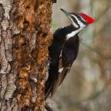
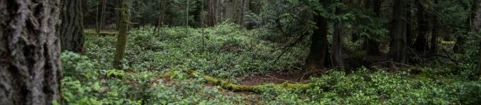
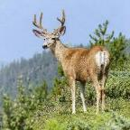
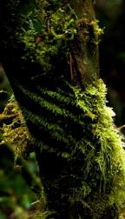
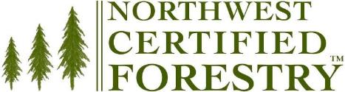
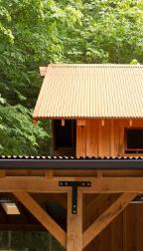
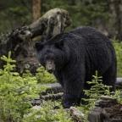
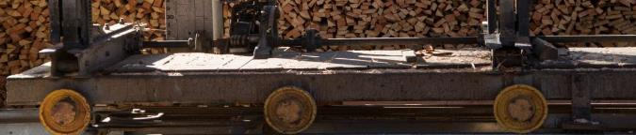
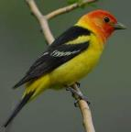
Kirk Hanson
kirk@nnrg.org
(360) 316-9317

Slide 2
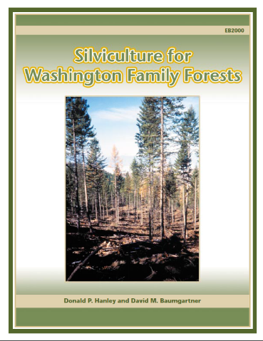
Forest Management Options

Slide 3
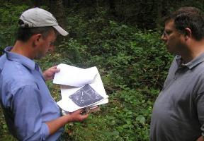
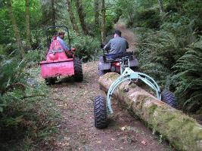
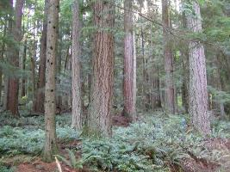
Management Objectives
A healthy forest
Wildlife
Stewardship
Long-term investment
Legacy
Periodic income
Wildlife
Privacy
Aesthetics
Recreation

Slide 4
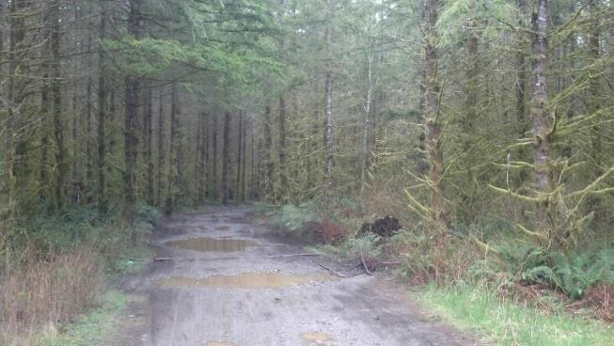
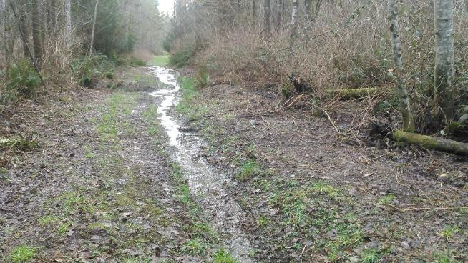

Slide 5
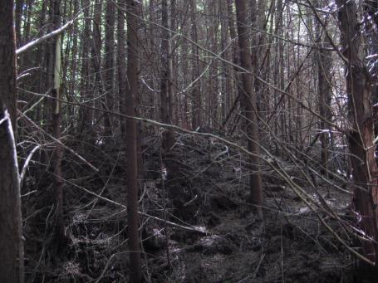
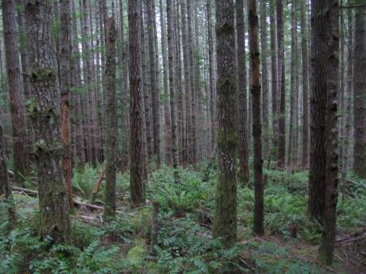
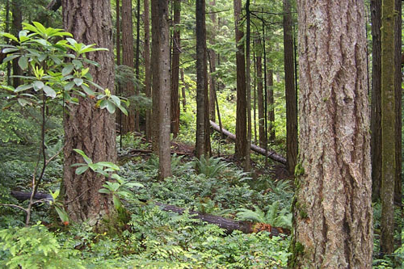
PNW Westside Forests
Very Young (~0-30 yrs)
Young (~30-60 yrs)
Maturing (~60+ yrs)

Slide 6
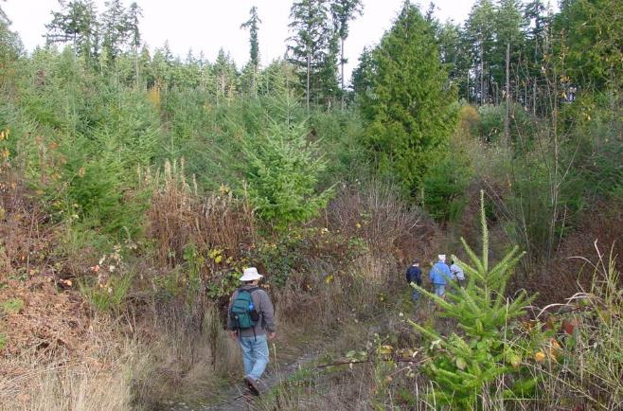
FOREST ASSESSMENT
0-30 YEARS
Access
Stocking
Brush comp.
Browse
Invasive spp.
Habitat
Wildlife use

Slide 7
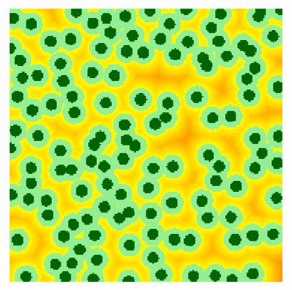
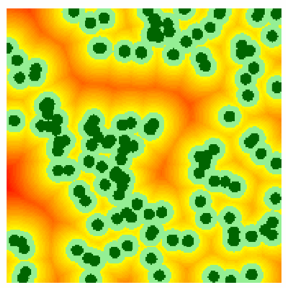
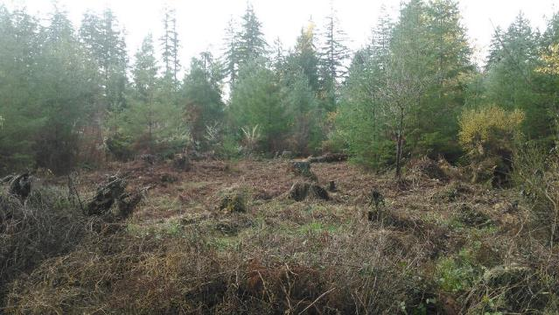

Slide 8
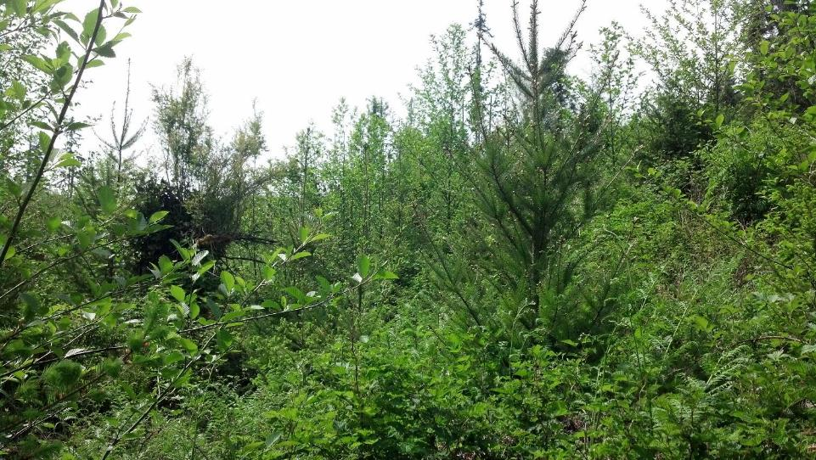

Slide 9
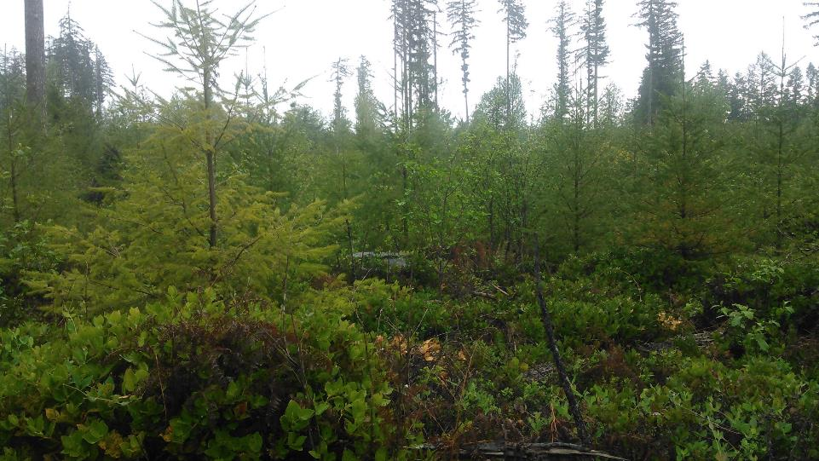

Slide 10
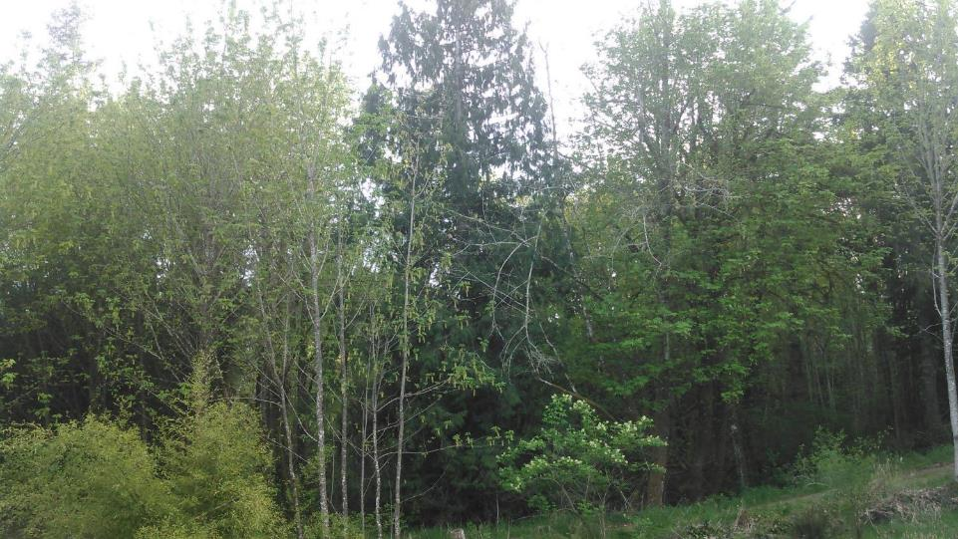

Slide 11
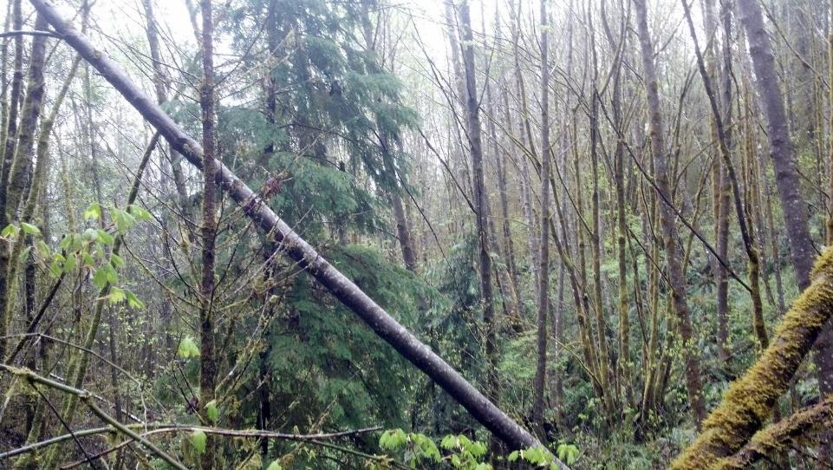

Slide 12
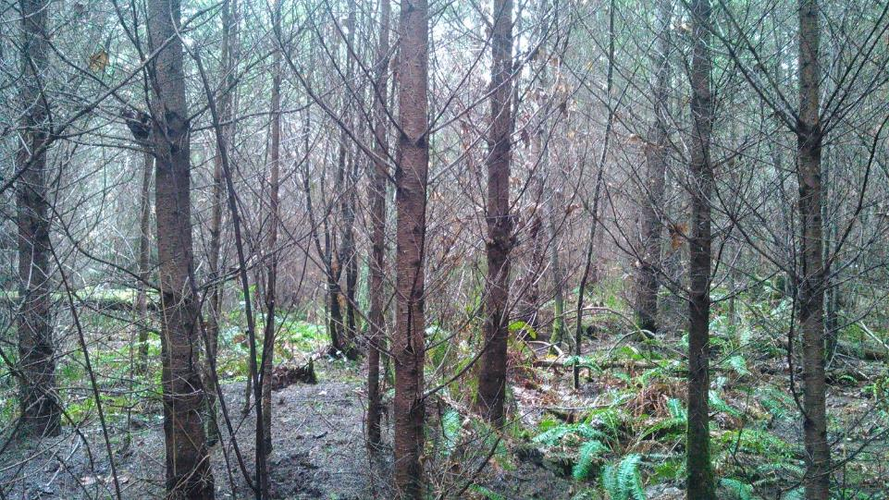

Slide 13
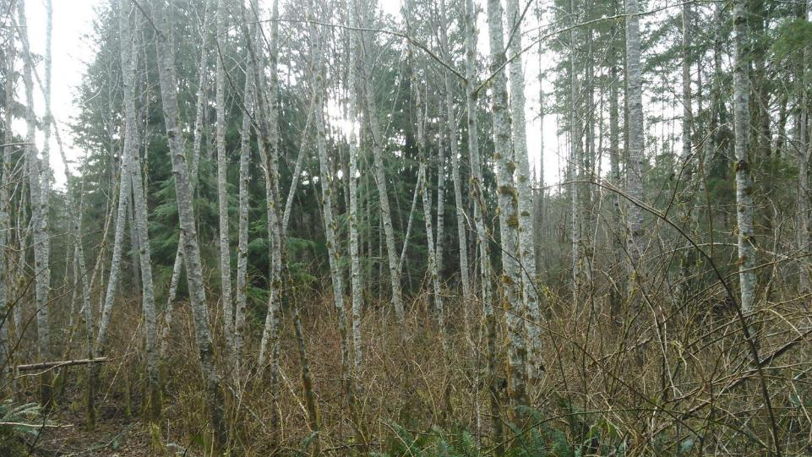

Slide 14
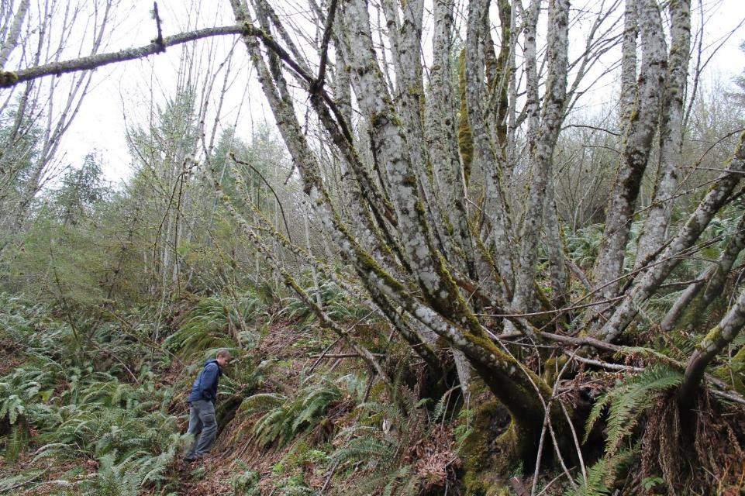

Slide 15
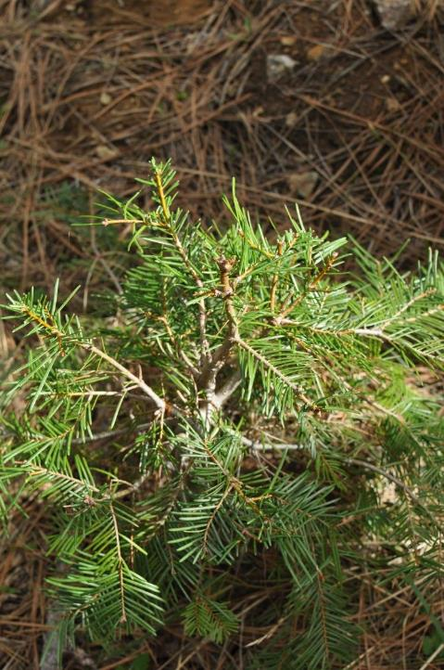

Slide 16
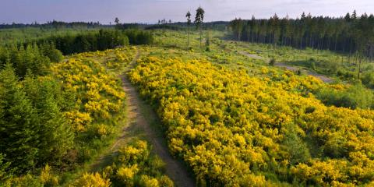
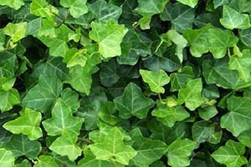
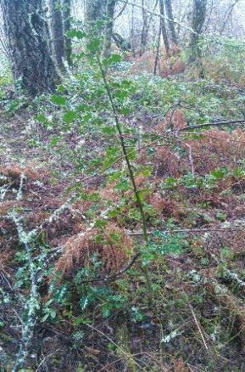
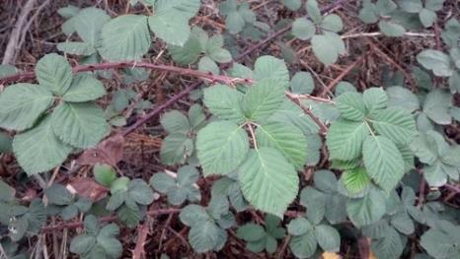

Slide 17
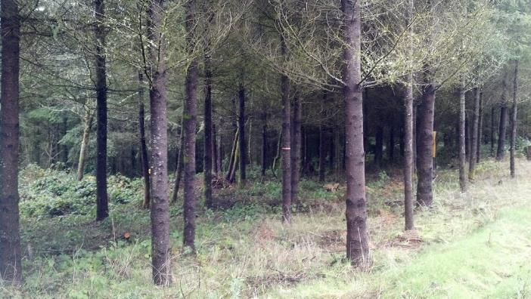
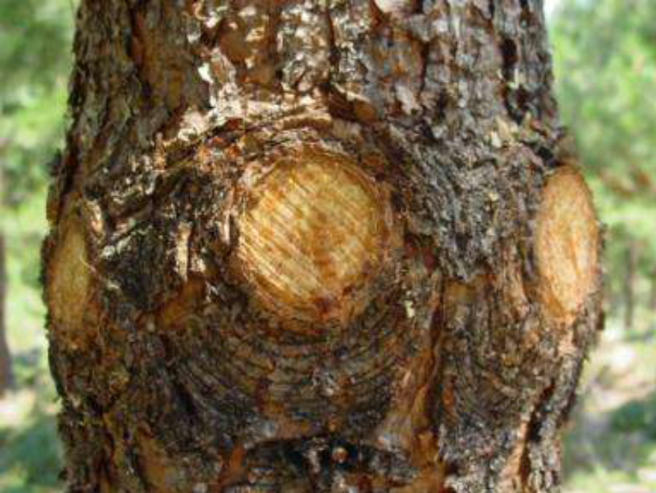
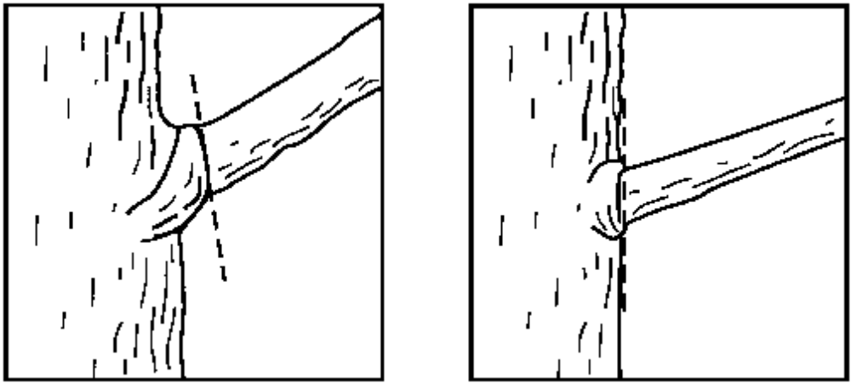

Slide 18
Management Actions
0-30 years
Replant large gaps
Cut back competing vegetation
Cage seedlings
Remove invasive species
Install bird nesting boxes
Inspect and repair forest access roads
Pre-commercially thin alder thickets
Pre-commercially thin to favor crop trees
Prune
Monitor!

Slide 19
Pre-Commercial Thinning Strategies
Thinning “from below”
Remove:
  Most suppressed
  Smallest diameter
  Trees with least live crown (<30%)
  Defective trees (broken tops, wane, forked, etc.)
  Non-preferred species
  Spacing
  “Release” understory trees
540 TPA
240 TPA

Slide 20
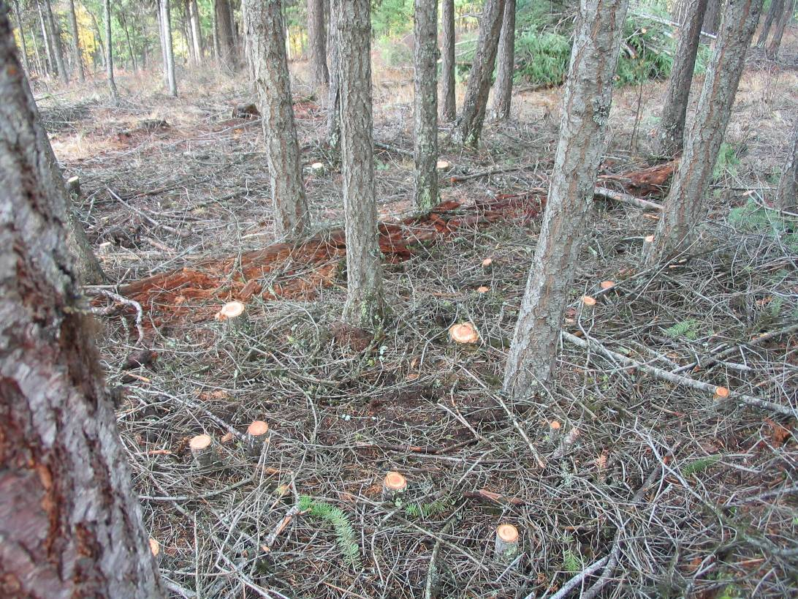

Slide 21
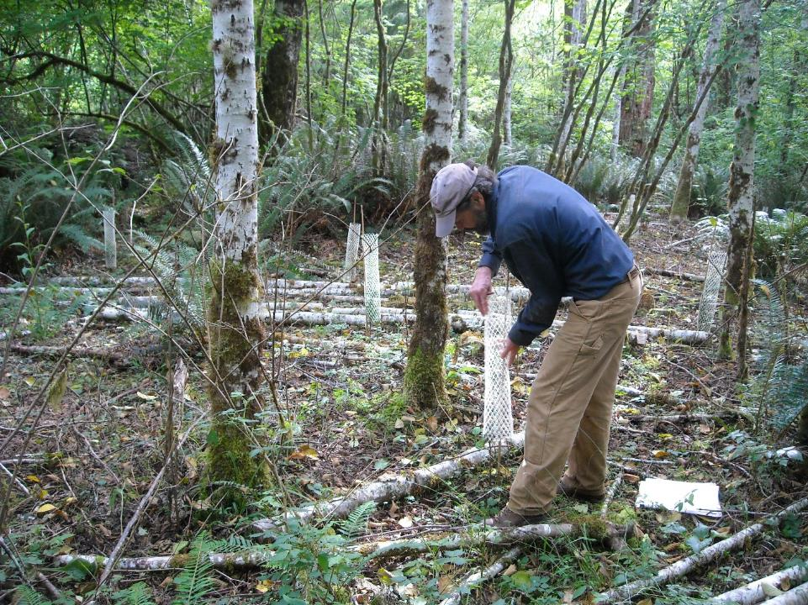

Slide 22
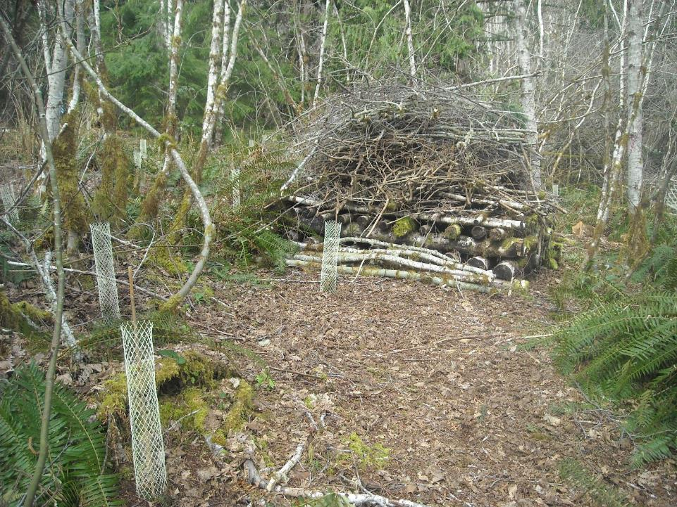
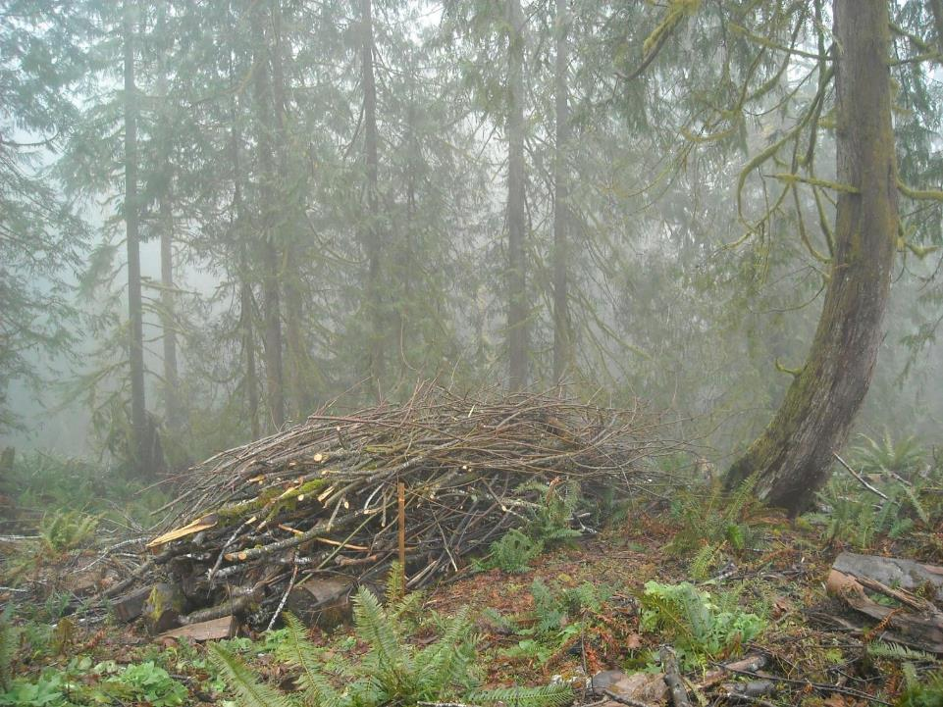

Slide 23
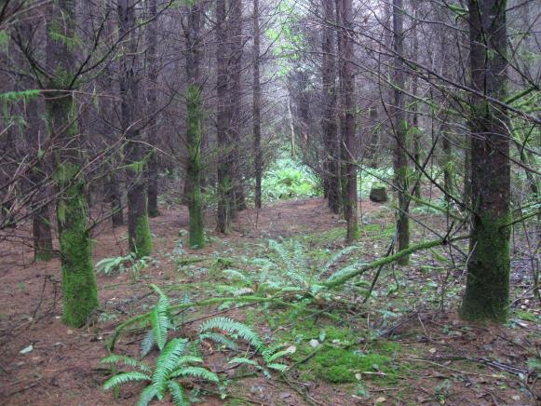
FOREST ASSESSMENT
30 - 60 YEARS
Stocking
Crown ratio
Health
Habitat
Merchantability?

Slide 24
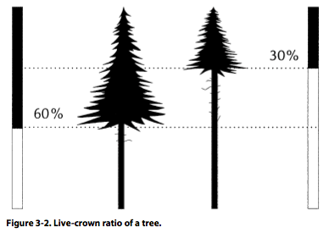

Slide 25
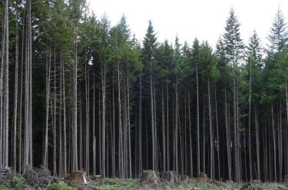

Slide 26
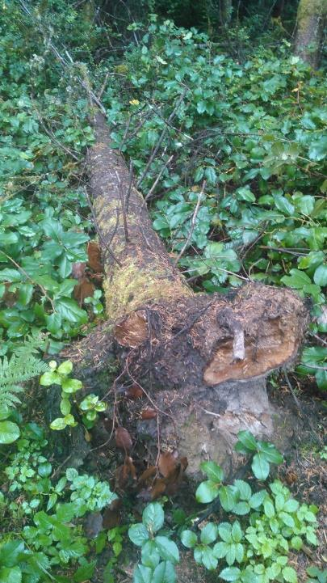
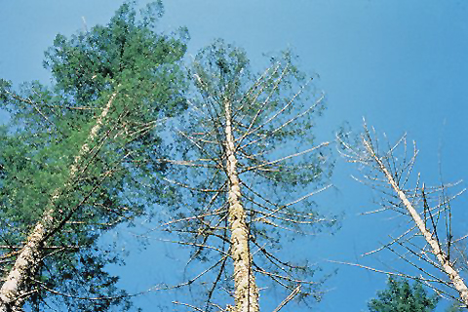

Slide 27
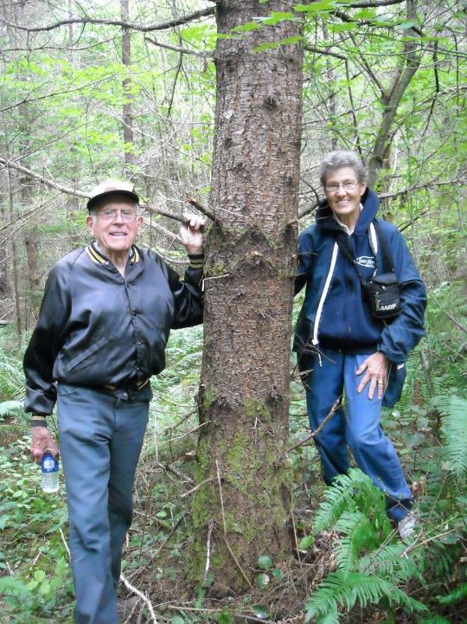

Slide 28
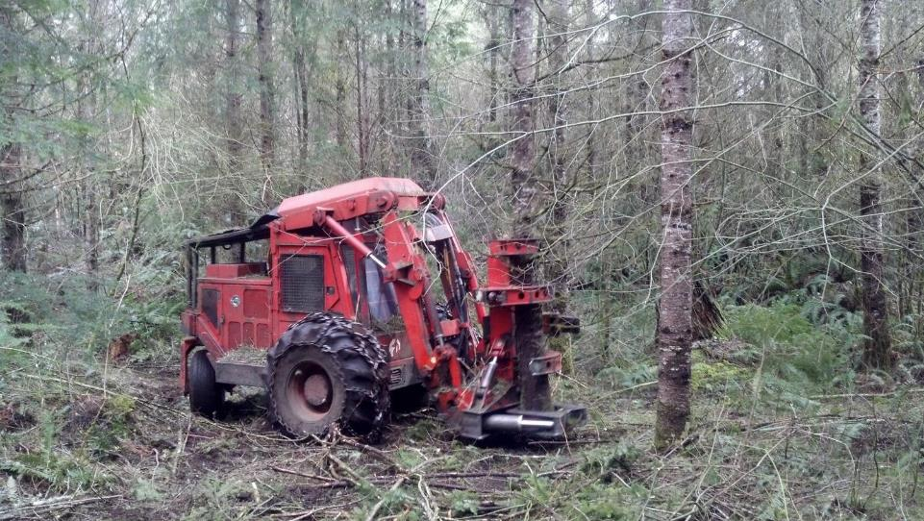

Slide 29
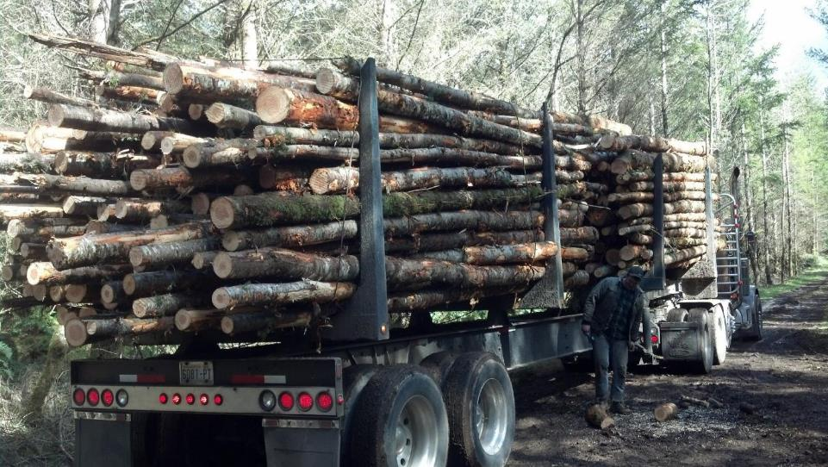

Slide 30
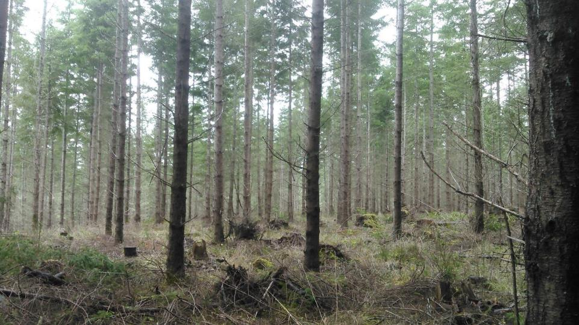

Slide 31
Continuous Cover Forestry
Thinning
Reduce density of a cohort to maintain or improve growth and crown development
Approaches
Individual Tree Selection
Group Selection
Thin from below
Variable density thinning
Variable retention
Managing Multi- Cohort Stands
Remove Overstory
Harvest trees for wood & revenue; and open growing space space for lower cohorts
Regeneration
Establish a new cohort

Slide 32




Cutting Cycle
2. Age 60
180 TPA
BA 180
Age 40
180 TPA
BA 120
4. Age 80
90 TPA
BA 160
3. Age 60
90 TPA
BA 120
Notes:
Preformed
Sustained
Site quality
Density independent

Slide 33



Slide 34


Slide 35
Management Actions
30-60 years
1st & 2nd commercial thinning
Replant understocked areas, disease gaps, hardwood patches
Underplant following commercial thinning
Create habitat structures
  Downed logs
  Habitat piles
Remove invasive species
Monitor!

Slide 36

FOREST ASSESSMENT
60+ YEARS
Stocking
Crown ratio
Height-to-diameter
Spp. composition
Understory
Habitat
Merchantability
Disease

Slide 37


Slide 38


Slide 39


Slide 40


Slide 41
Measuring Height to Diameter Ratio
Height (Feet)
Diameter: DBH (Feet)
80’
80’
18”
12”
80 (feet) = 80’ = 53
18” dbh 1.5’
80’ = 80’ = 80
12” 1’

Slide 42
Stage 1
No Mngt or past Commercial Thin
1. Thin Overstory
2. Establish understory
ITS w small gaps or VDT
1. Maintain release potential of understory
2. Harvest portion of overstory
Stage 2
Stage 3
Group Selection
Harvest most of overstory
Release understory

Slide 43



Understory Establishment – Initiation of Two-cohort Stand
Single cohort stand
dispersed
grouped
Transformation
to two-cohort
stand

Slide 44



Slide 45

Group Selection Structure Types
Regeneration
PCT
Matrix
Thinning
Notes:
Group Selection System
Provides: horizontal structural variability, vertical variability, edge trees, disturbance caused mortality, regeneration of Douglas-fir and hardwoods

Slide 46


Slide 47


Slide 48


Slide 49


Slide 50


Slide 51


Slide 52
Kirk Hanson
kirk@nnrg.org
(360) 316-9317

