Slide 1
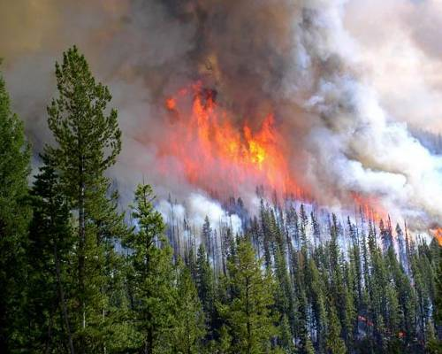
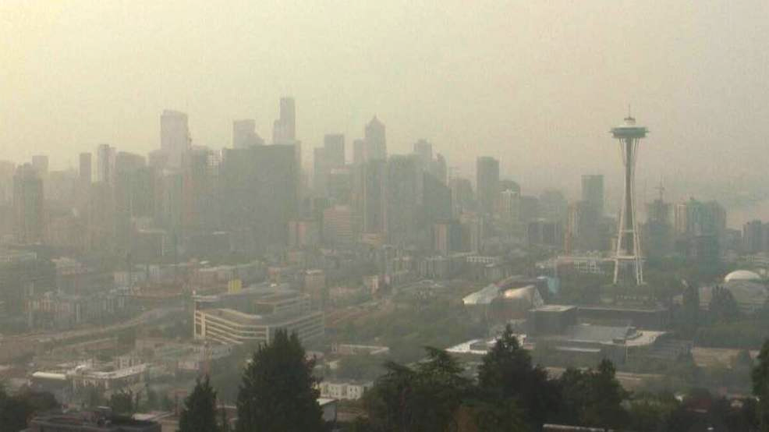
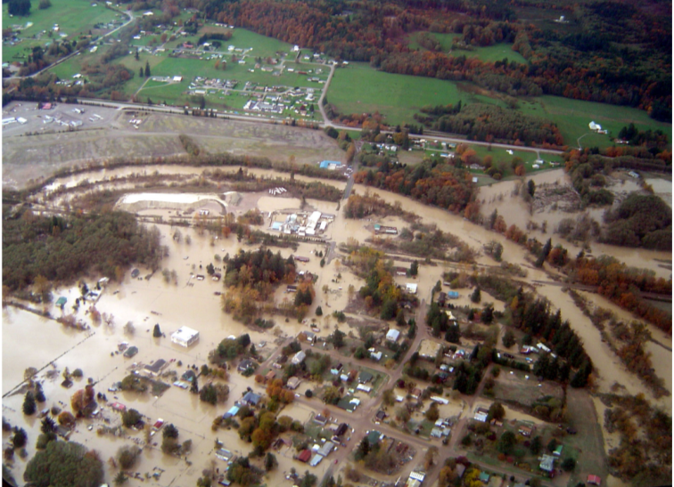
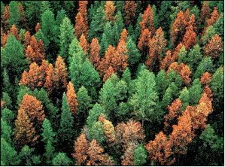
Climate Change: What is the current understanding and what to expect
Jessica Halofsky and David L. Peterson
University of Washington, School of Environmental and Forest Sciences and USDA Forest Service, Pacific Northwest Research Station

Slide 2
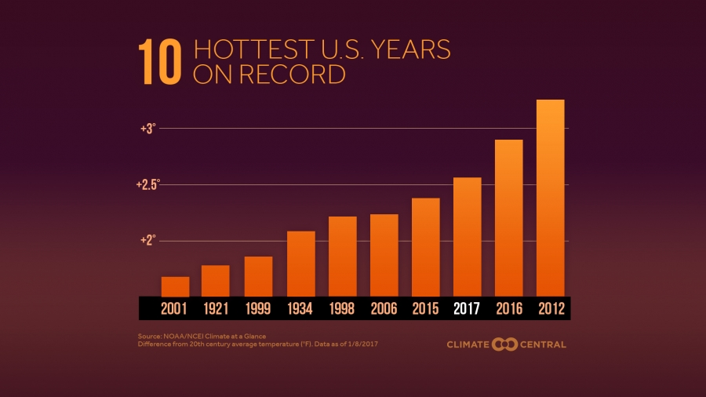
Some recent statistics:
Notes:
The four hottest years on record have come in the decade of the 2010s
Of the 10 hottest years on record, only two came before 1998 (1934, 1921)
Five states had their hottest year on record in 2017
2018 came in 4th.
July 2019 was hottest on record for the globe

Slide 3
Some recent statistics:
In Seattle, the five hottest years on record since 1948 were:
  2015 (63.4 degrees)
  2014 (62.6 degrees)
  2016 (62.5 degrees)
  1992 (62.5 degrees)
  2018 (62.3 degrees)

Slide 4
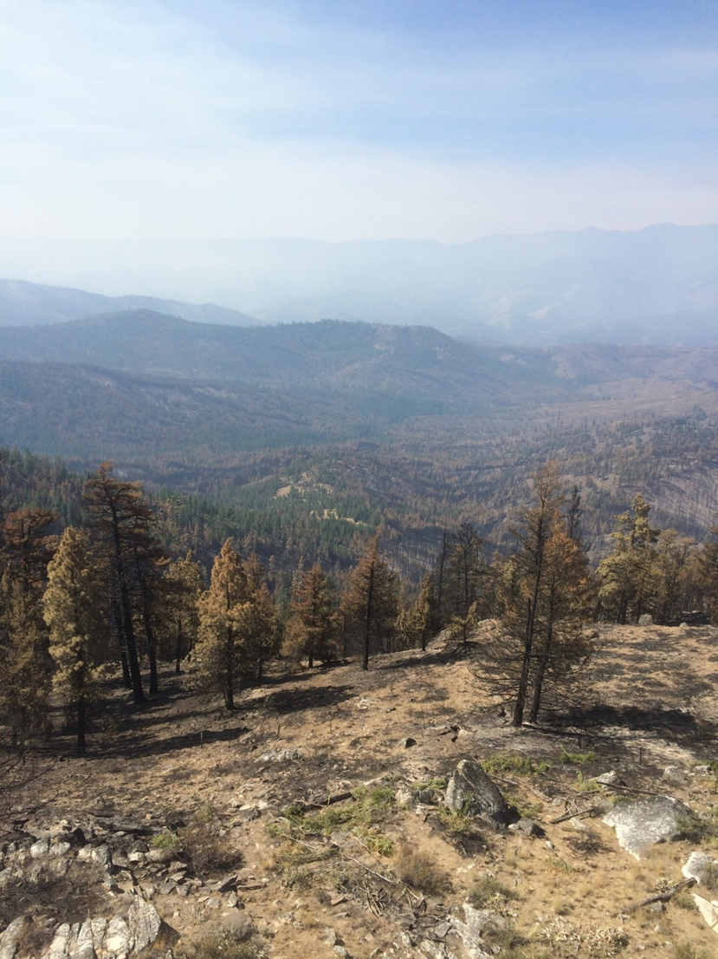
Some recent statistics:
In 2014, a record was set for the largest wildfire in Washington State history, the 256,100-acre Carlton Complex Fire

Slide 5
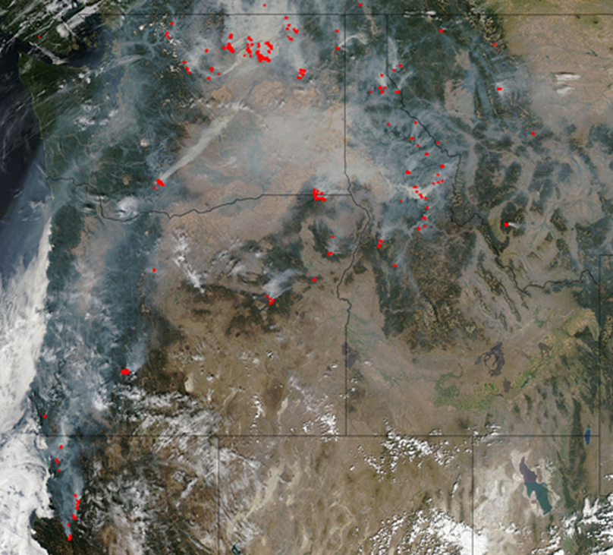
Some recent statistics:
Pacific Northwest, August 30, 2015
In 2015, 1.7 million acres were burned in Oregon and Washington, with over 9 million acres burned in the western United States.
NASA MODIS
Notes:
One year later, 2015 was a hot year with very low snowpack across the Pacific Northwest,

Slide 6
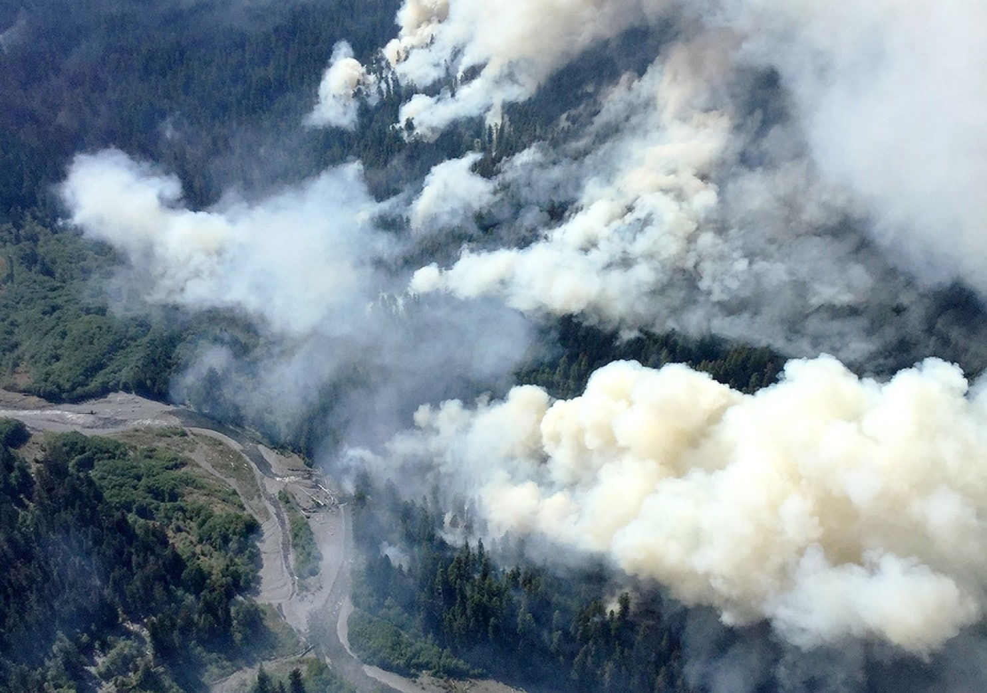
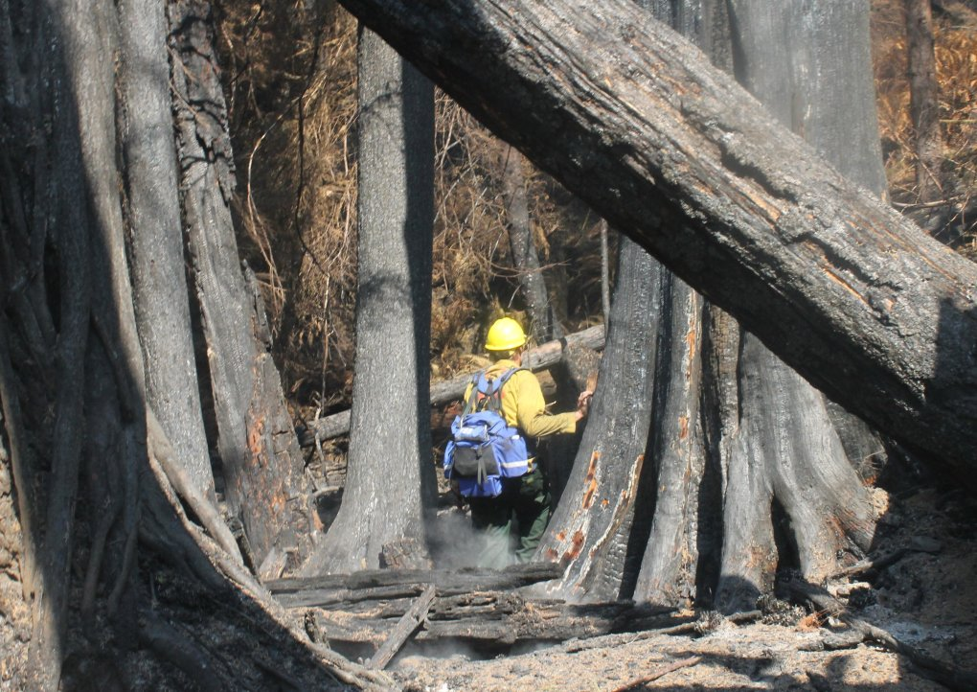
Several fires in 2015 occurred in west-side conifer forests, including a rare fire event in coastal temperate rainforest on the Olympic Peninsula.
Notes:
Paradise fire

Slide 7
Carbon dioxide is increasing
Atmospheric CO₂ is now 409 ppm.
It was 260 ppm in 1850.
Source: https://www.esrl.noaa.gov/gmd/ccgg/trends/full.html

Slide 8
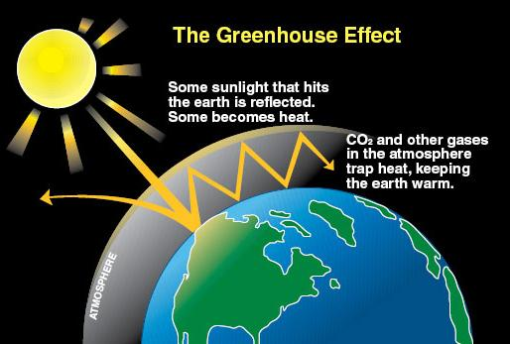
Greenhouse gases (water vapor, CO₂, CH₄, N₂O) play a critical role in determining global temperature
Rapid increases in greenhouse gases are
changing this natural balance
Notes:
Earth’s natural greenhouse effect warms surface temperatures by ~33ºC (60 º F)
H₂O vapor the most powerful greenhouse gas (GG)
other important GG’s are CO₂, CH₄, N₂O, HFCs, PFCs, and SF_{6 …}
Human caused emissions of these GG’s are increasing the natural greenhouse effect
Without drastic changes in current emissions trends, GG concentrations will increase dramatically in the next few centuries
C02 is about 65% of the anthropogenic gg issue; residence time is about a century
CH4 is about 15% of the anthropogenic gg issue;
Image source: http://www.ecy.wa.gov/climatechange/images/greenhouse_effect2.jpg
Greenhouse gases play a critical role in determining global temperature. Without these gases, the Earth’s average temperature would be somewhere on the order of 0°F -- a temperature so low that the Earth would be frozen and could not sustain life -- rather than the comfortable average of 59°F today (http://www.ucsusa.org/global_warming/science/global-warming-faq.html).
How does this happen?
When incoming solar radiation passes through the Earth’s atmosphere, much of this radiation is absorbed by the Earth’s surface. A portion of that energy is re-radiated back towards the atmosphere but at different wavelengths; rather than being visible light, the re-radiated energy is infrared. Various trace “greenhouse” gases (less than 1% by volume) in the atmosphere absorb much of the infrared radiation from the Earth’s surface and release that energy as heat back towards the Earth’s surface; the remainder escapes into space. These gases include water vapor, carbon dioxide, methane, nitrous oxide, ozone, and various chlorine-, flourine-, and bromine-containing compounds.
Rapid increases in the concentration of greenhouse gases are changing this natural balance.
(side note: nitrogen and oxygen, the two dominant atmospheric gases (78% and 21%, respectively), do not absorb solar or infrared radiation). Argon is the largest of the trace gases but it does not have a role in affecting climate. Water vapor, the largest greenhouse gas, remains in the atmosphere for only 7 days before it becomes a water droplet. We cannot control water vapor concentrations and as we get warmer we will get more water vapor in the atmosphere).

Slide 9
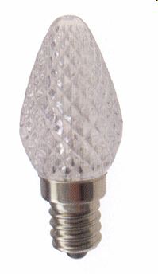
2.3 Watts
Radiative forcing
Notes:
Energy is constantly flowing into the atmosphere in the form of sunlight. Some of this sunlight (about 30 percent) is reflected back to space and the rest is absorbed by the planet. Subtract the energy flowing out from the energy flowing in, and if the number is anything other than zero, there has to be some warming (or cooling, if the number is negative) going on.
Radiative forcing, measured in watts per square meter of surface, is a direct measure of the impact that recent human activities are having on changing the planet’s climate.

Slide 10



------------- 1 meter ------------
----------- 1 meter -----------
Notes:
All of the greenhouse gases created by humans and added to the air since the Industrial Revolution began cause a heating equal to that of about one small Christmas light over every square m of Earth's surface.

Slide 11
------------- 1 meter ------------
----------- 1 meter -----------
X 500 trillion
for the entire Earth
Notes:
Plausible scenario currently considered by climate modelers is 8.5 W per m squared.

Slide 12
In 2100?
------------- 1 meter ------------
----------- 1 meter -----------
X 500 trillion

Slide 13
Global temperature trend
2017
2016 – record
2015
2014
2010
Source: https://www.ncdc.noaa.gov/cag/time-series/global

Slide 14
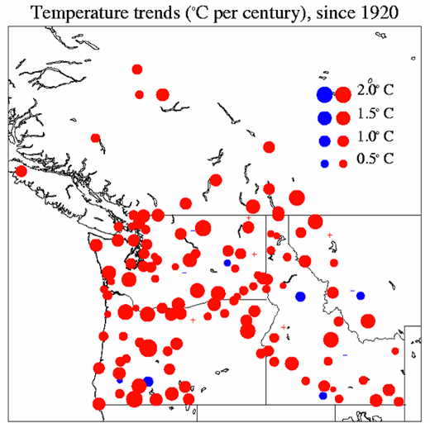
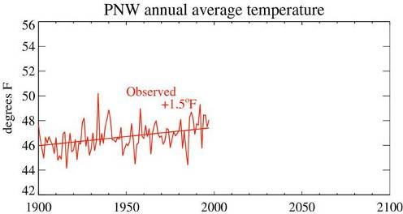
Temperature trends by station
Average annual temperature has increased +1.6°F since 1920.
Almost every station shows warming.
Extreme cold conditions have become rarer.
Minimum temperatures rose faster than maximum temperatures.
Cooler Warmer
3.6 °F
Annual variability present throughout the warming trend
2.7 °F
1.8 °F
0.9 °F
Notes:
Temperature increase spread throughout the PNW; in rural areas as well as urban areas.
Each dot represents a station with data going back at least to 1920, size of dot shows magnitude of linear trend. Most trends in the 1-3°F range. These data have been quality-controlled and corrected by the National Climate Data Center. This includes removing the “urban warming” effect, which is statistically estimated and is very small.
Small + and – in the figure: denote tiny increases (+) or decreases (-) in temperature on the order of 0.3 degrees C or less
154 stations analyzed for the trends analysis.
Much of the 20th century warming took place in the second half of the 20th century (+ 1.6°F from 1950 to 2000)
Winter warmed 2.7 °F (1.3 °C) since 1950; approx. 1/3 of the winter warming was due to natural variation in North Pacific climate

Slide 15
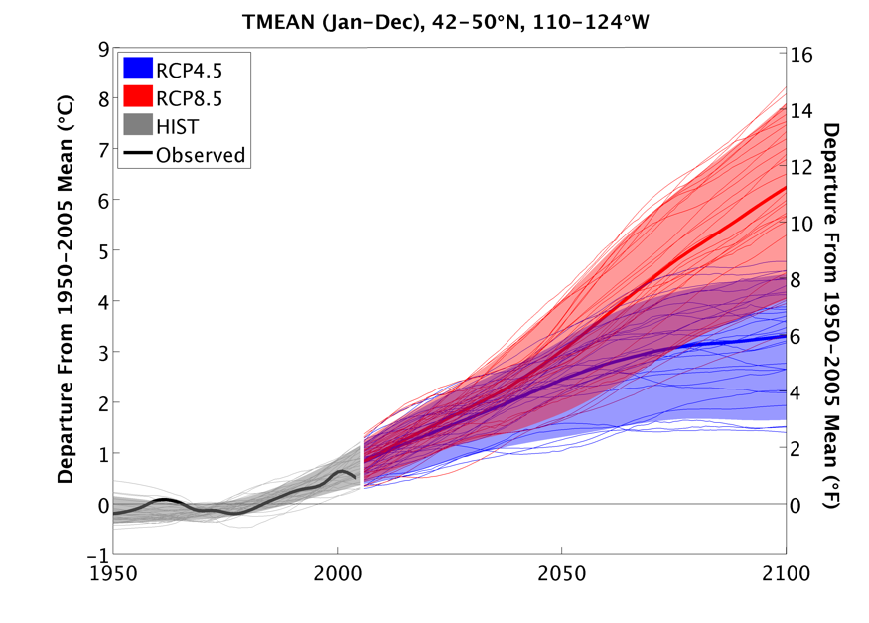
Projected temperature in Pacific Northwest
Business as usual
Trends diverge here
Global cooperation
Notes:
So how is climate in the PNW projected to change?
The average warming rate in the Pacific Northwest during the next century is expected to be in the range 0.1-0.6°C (0.2-1.0°F) per decade, with a best estimate of 0.3°C (0.5°F) per decade. For comparison, observed warming in the second half of the 20th century was approximately 0.2°C (about 0.4°F) per decade. The warming trend for the 20th century overall was 0.15°F per decade. In every scenario, the future warming greatly exceeds natural variability. For precipitation this is not the case; the range of simulated precipitation could increase substantially or decrease substantially but the weighted-average annual mean change is small throughout the 21st Century.
Figure: Smoothed traces in temperature for the 39 model simulations, relative to the 1970-99 mean. The smooth curve for each scenario is the Reliability Ensemble Average (REA) value, calculated for each year. The average provided above each box is the REA for that decade; the low and high values represent the lowest and highest value from either scenario (B1 or A1B)
2020s* temperature precipitation
low 0.6°C (1.1°F) -9%
average* 1.2°C (2.2°F) +1%
high 1.9°C (3.4°F) +12%
2040s* temperature precipitation
low 0.9°C (1.6°F) -11%
average* 2.0°C (3.5°F) +2%
high 2.9°C (5.2°F) +12%
2080s* temperature precipitation
low 1.6°C (2.8°F) -10%
average* 3.3°C (5.9°F) +4%
high 5.4°C (9.7°F) +20%
15

Slide 16

What about precipitation?
Global climate models do not project precipitation reliably.
Most models project a small increase in winter or no change.

Slide 17
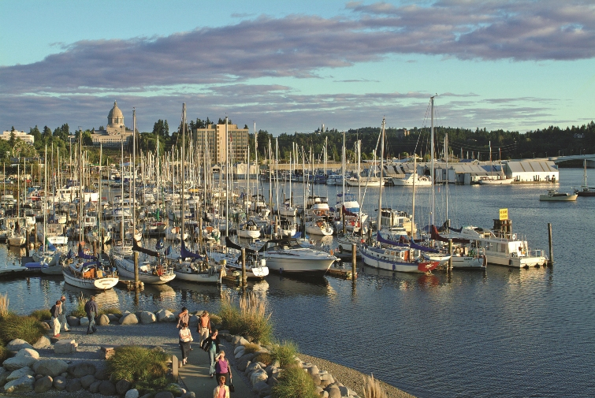
What will future climate feel like?
Olympia, WA

Slide 18
What will future climate feel like?
Sacramento, CA

Slide 19
This is what we know…
There is a natural greenhouse effect.
Humans are increasing the greenhouse effect by adding carbon dioxide and other gases to the atmosphere.
Effects of a changing climate are already apparent.
There will be more global warming to come.

Slide 20



Climate controls ecosystem processes
The hydrologic cycle
Notes:
Many ecosystem processes are either directly or indirectly tied to climate, and so climatic change is likely to affect them in the future.
Land managers need information to assess potential impacts of climate change on these processes in order to adapt management to climate change.
The hydrologic cycle

Slide 21


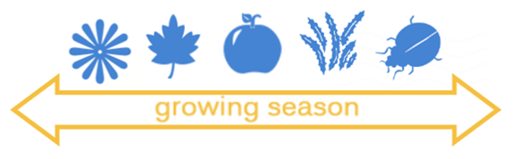
Climate controls ecosystem processes
The hydrologic cycle
Plant establishment, growth, and mortality
Notes:
Many ecosystem processes are either directly or indirectly tied to climate, and so climatic change is likely to affect them in the future.
Land managers need information to assess potential impacts of climate change on these processes in order to adapt management to climate change.
The hydrologic cycle
Biogeochemical cycles
Plant establishment, growth and mortality

Slide 22



Climate controls ecosystem processes
The hydrologic cycle
Plant establishment, growth, and mortality
Disturbance
Notes:
Many ecosystem processes are either directly or indirectly tied to climate, and so climatic change is likely to affect them in the future.
Land managers need information to assess potential impacts of climate change on these processes in order to adapt management to climate change.
The hydrologic cycle
Biogeochemical cycles
Plant establishment, growth and mortality
Disturbance – drought, fire, insects, flooding, invasives

Slide 23
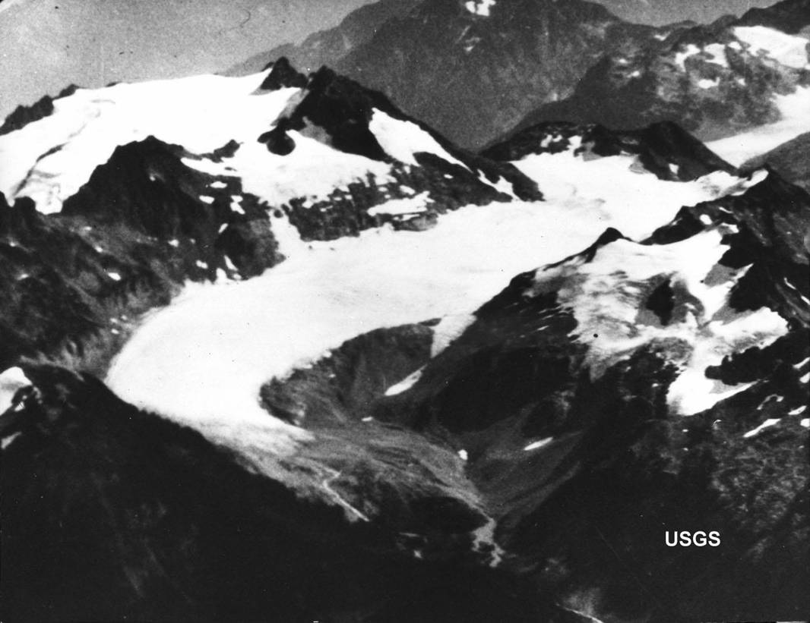
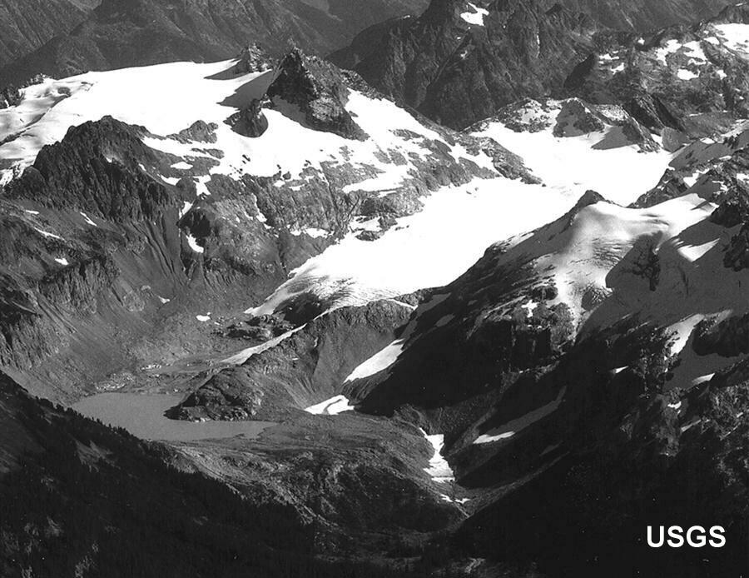
Nearly every glacier in the Cascade Range has retreated during the past 100 years
South Cascade Glacier, 1928 (top)
2016 (right)
Notes:
Looking a little closer to home…These pictures show the South Cascade glacier in 1928 and 2000. The glacier has retreated and thinned substantially, leaving a glacial lake in its place. Glacial retreats have occurred around the world.

Slide 24
Nearly every glacier in the Cascade Range has retreated during the past 100 years
Since 1900, glacial area in the North Cascades
has decreased by 46%
South Cascade Glacier, 1928 (top)
2016 (right)
Notes:
Looking a little closer to home…These pictures show the South Cascade glacier in 1928 and 2000. The glacier has retreated and thinned substantially, leaving a glacial lake in its place. Glacial retreats have occurred around the world.

Slide 25
Snowpack is decreasing
Snow-water equivalent
1955-2016
Mote et al. 2018

Slide 26
Snowpack is decreasing
Snow-water equivalent
1955-2016
Snow-dominant watersheds
Rain-dominant
watersheds
Mote et al. 2018

Slide 27
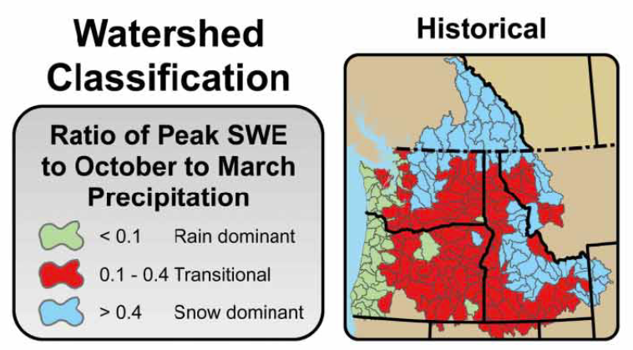
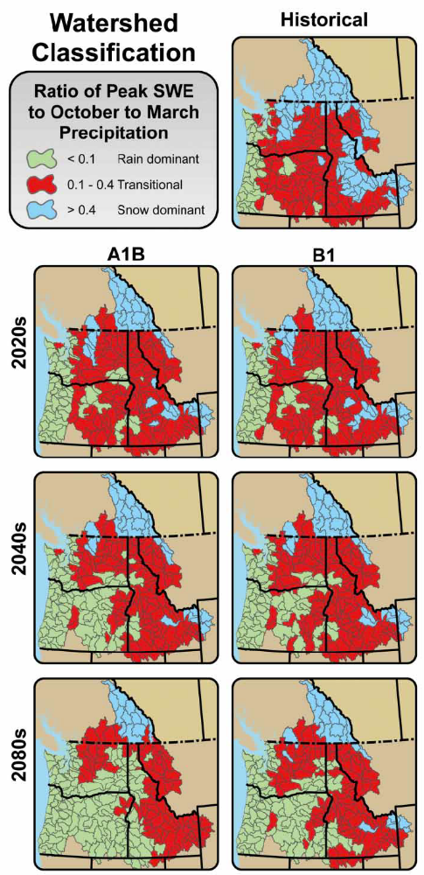
Watershed types will shift
Snow dominant watersheds become transitional (mixed rain and snow).
Transitional watersheds become rain dominant.
A1B
B1
Hamlet et al. 2013
Notes:
Projected changes in the B1 scenario for the 2080s are similar to those for A1B 2040s
Also note that these maps are showing ratios of snowpack to total oct-mar precipitation, so they aren’t accurately depicting streamflow
Patterns for basins that cross into neighboring states or Canada

Slide 28
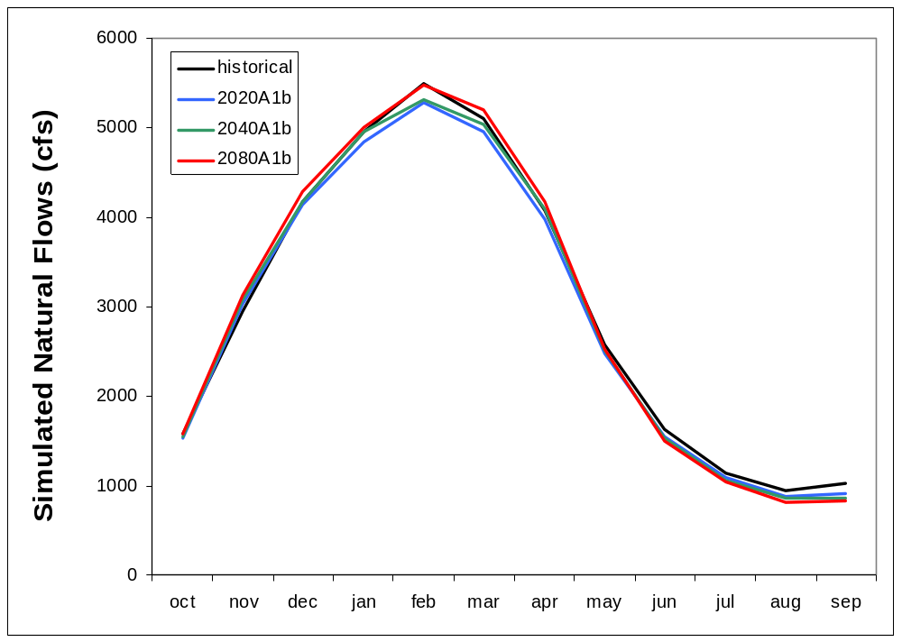
Streamflow will change
Chehalis River
Notes:
Projected changes in the B1 scenario for the 2080s are similar to those for A1B 2040s
Also note that these maps are showing ratios of snowpack to total oct-mar precipitation, so they aren’t accurately depicting streamflow
Patterns for basins that cross into neighboring states or Canada

Slide 29
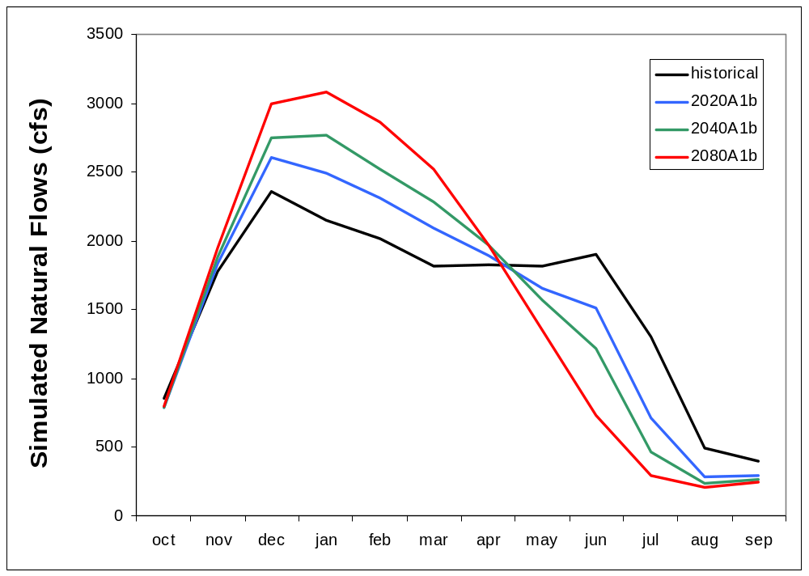
Streamflow will change
Elwha River
Chehalis River
Notes:
Other river systems, such as the Elwha and Dungeness Rivers, are in transient watersheds. Increasing temperatures in the 21st century will likely lead to significant increases in the winter and early spring peak streamflows and significant decreases in the summer low flows in these transient watersheds

Slide 30
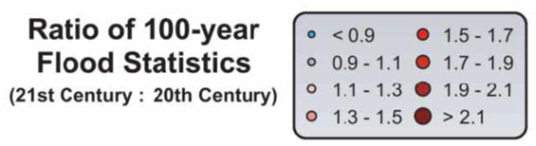
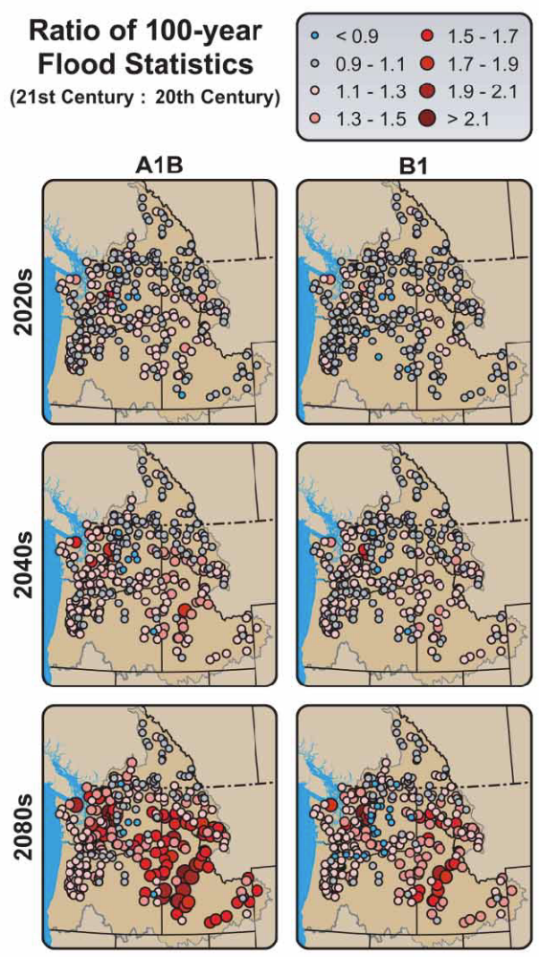
Future projections of flood risk in the PNW
A1B
B1
Hamlet et al. 2013

Slide 31
Changes in Hydrologic Extremes
Notes:
January 2009 flood in Washington
The extreme flooding that occurred in Washington in early January, 2009 had two main contributors: heavy precipitation that fell on Jan 6th and 7th and warm temperatures that melted snow still on the ground in some places from December storms. Streamflow in both western and eastern Washington was high, with many rivers reaching well above flood stage.

Slide 32
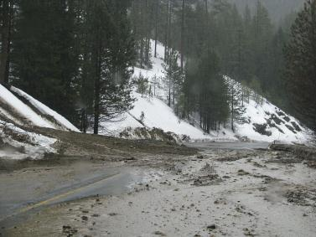
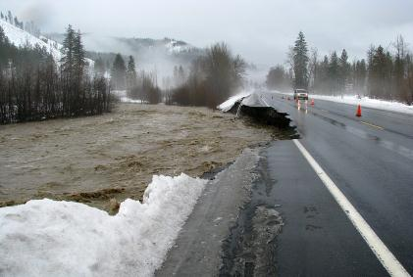
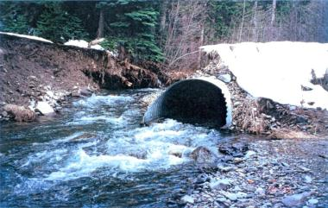
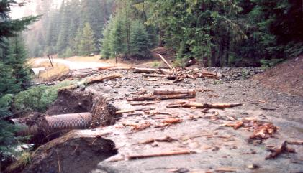
Changes in Hydrologic Extremes
Jan 2009 Flood, Hwy 97 – Blewett Pass

Slide 33
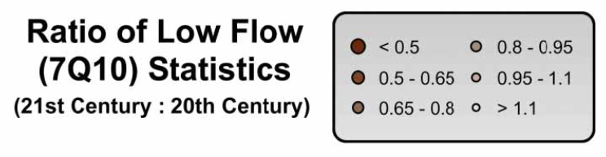
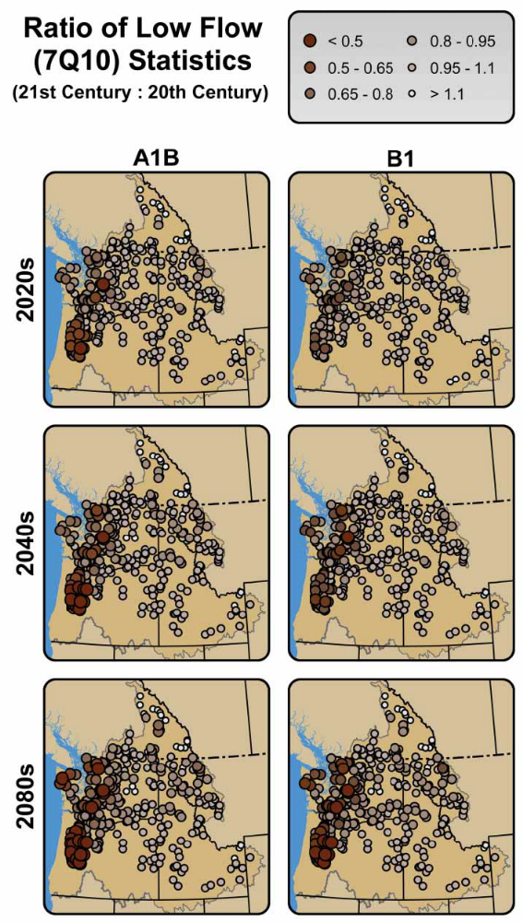
Future projections of low flow risks in the PNW
A1B
B1
Hamlet et al. 2013

Slide 34
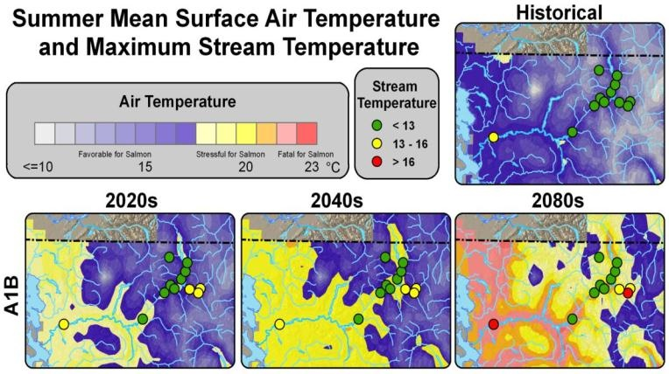
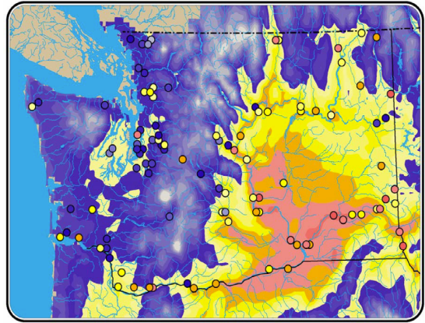
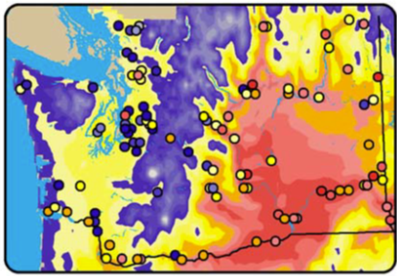
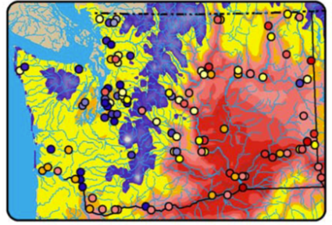
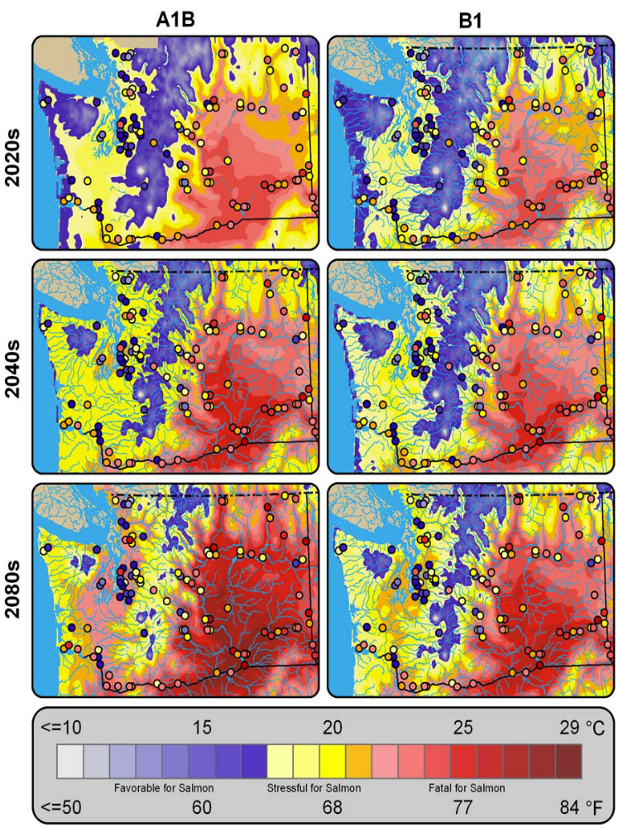
Higher temperatures will stress salmon
13ºC: Spawning, incubation and optimal growth temperature
16°C: core salmon habitat temperature
Mantua et al. 2010
Notes:
Color shading shows mean surface air temperatures for August, and shaded circles show the simulated mean of the annual maximum for weekly
water temperatures for select locations. Historical air temperature and simulated water temperature for the 1980s (1970–99) are in the left panel, while a future scenario derived from a multimodel average under A1B medium level emissions is shown in the right panel.

Slide 35

Extreme weather + increased disturbance: Our primary challenge

Slide 36
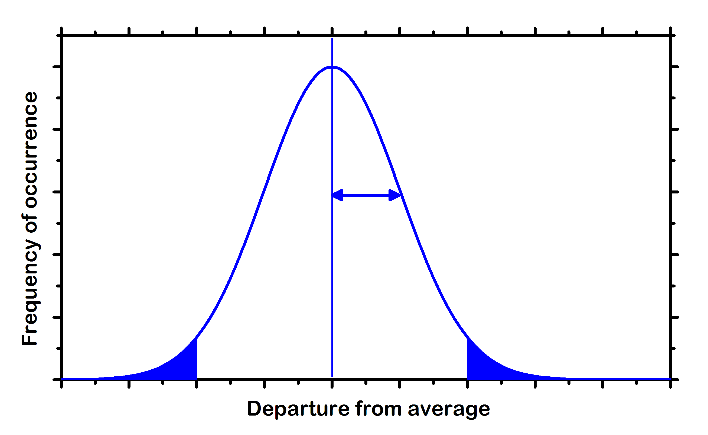
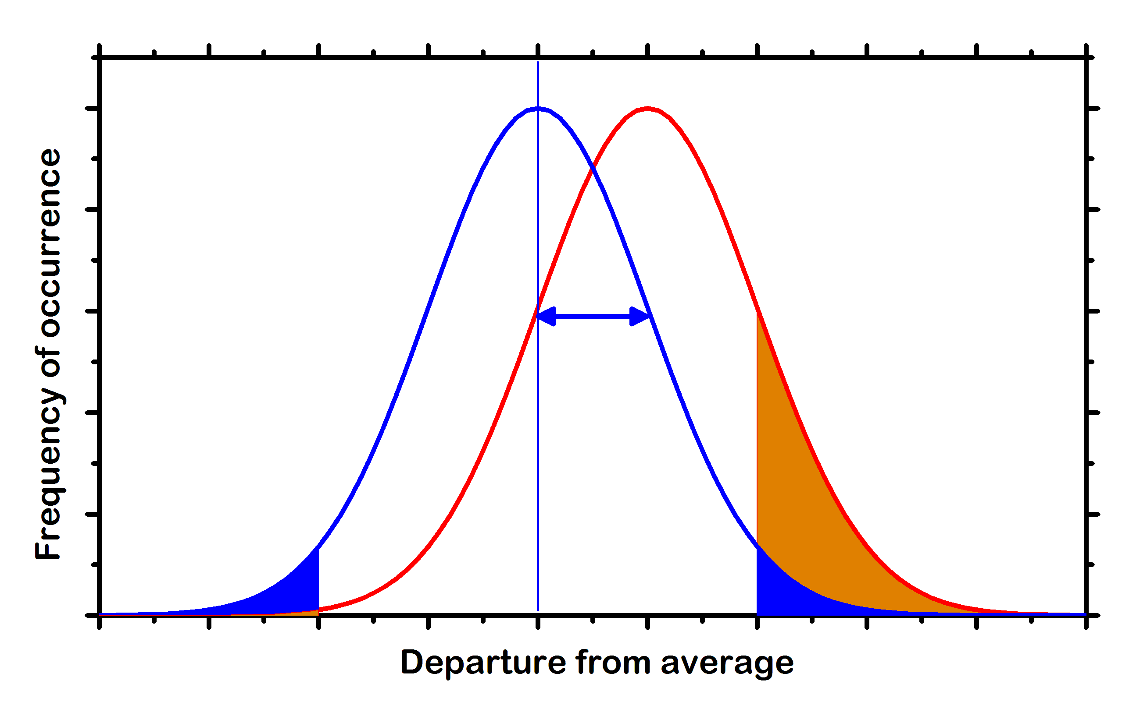
Extremes matter
Frequency, extent, and severity of disturbances may be affected by climate change, altering the mean and variability of disturbance properties.
A shift of 1 standard deviation changes a
1 in 40 yr event to a 1 in 6 yr event
A shift in distribution
of disturbance properties has a larger relative effect at the extremes than near the mean.
Standard deviation
1 in 40 yr high range
It’s all about the tail!
Notes:
36

Slide 37
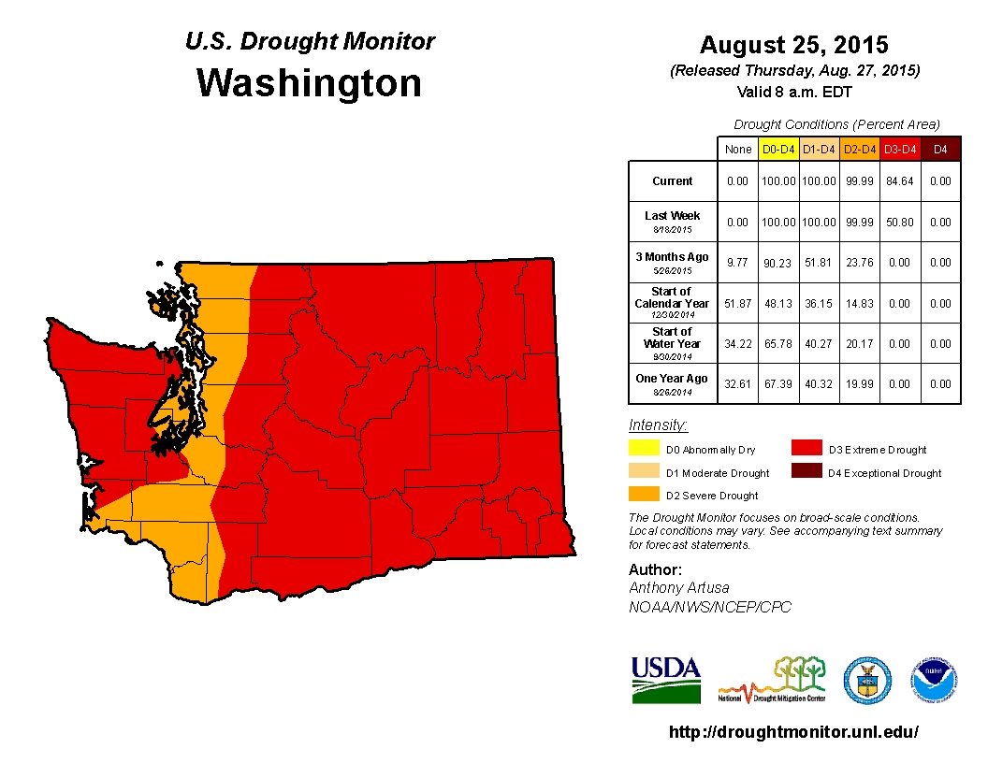

Slide 38
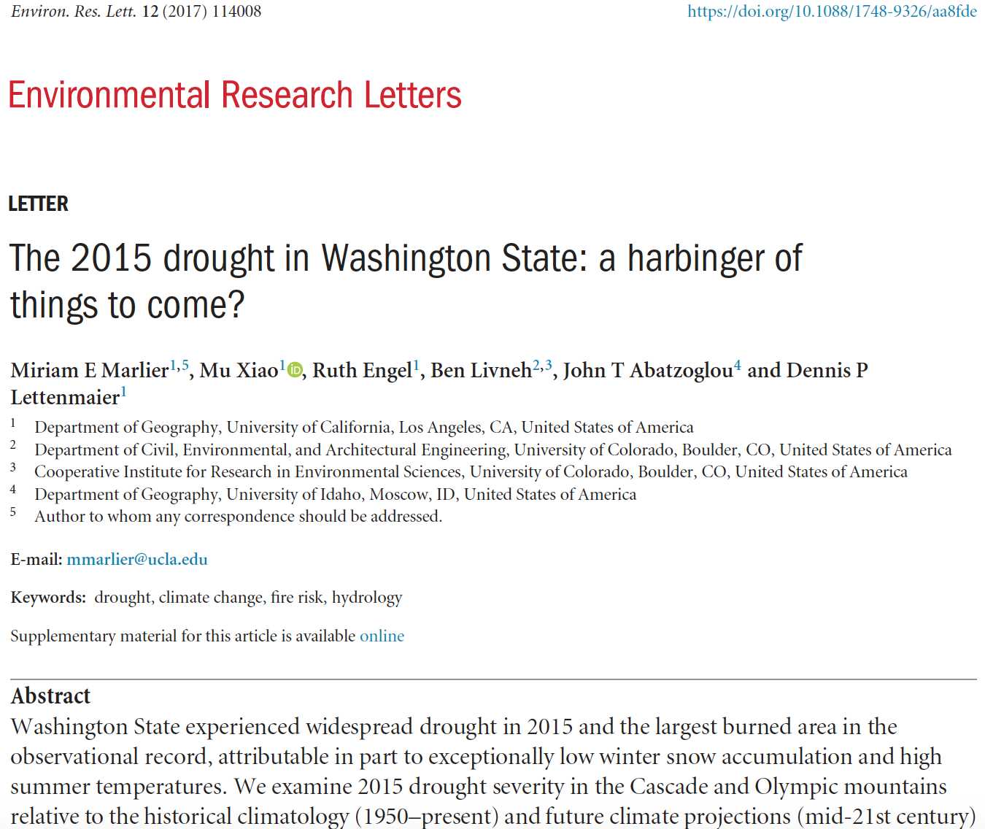

Slide 39
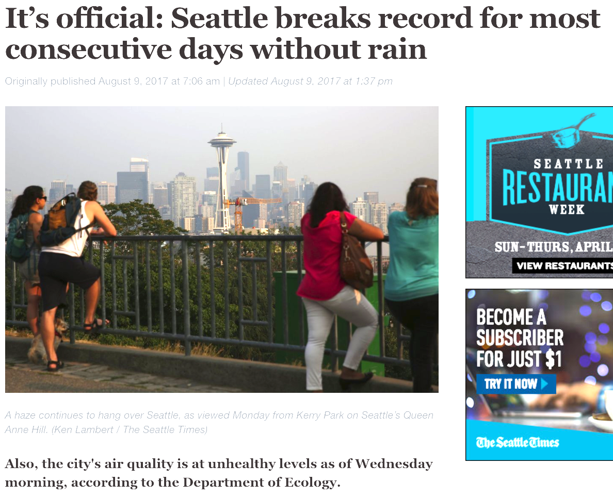
Seattle Times
2017

Slide 40
2018: a very dry summer

Slide 41
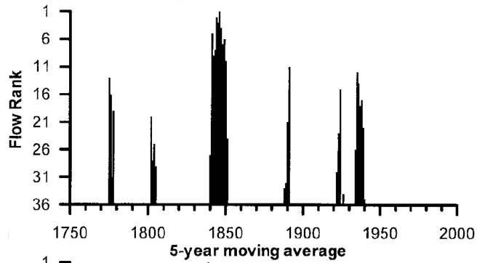
Droughts were formerly more common
Columbia River reconstruction
Gedalof et al. 2004

Slide 42
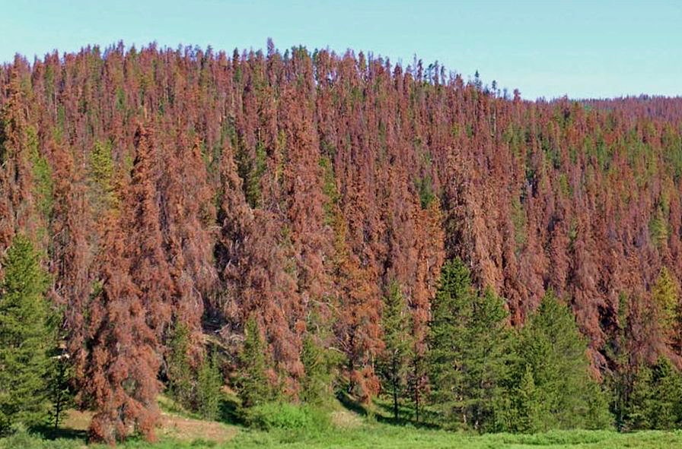
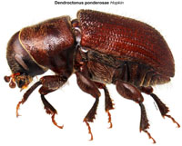
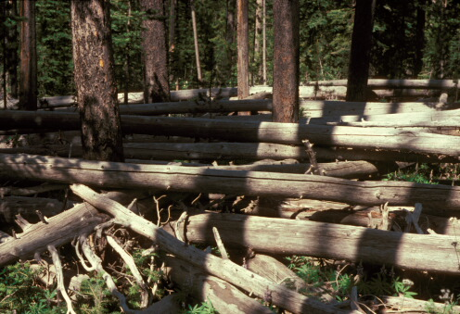
Climate change affects insects
Mountain pine beetle
Warmer temperature has favored MPB by:
Increasing its
reproductive rate
Allowing an expanded
geographic range
Notes:
Climate change affects insects

Slide 43
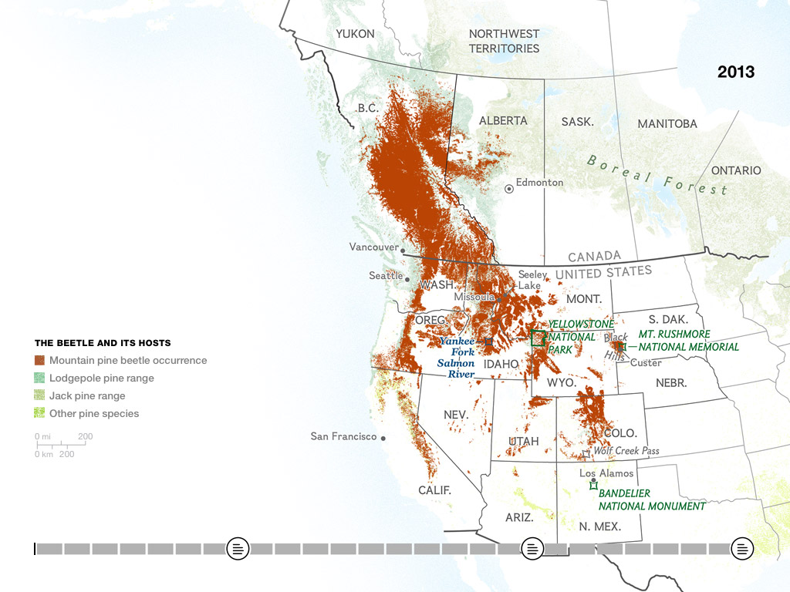
Mountain pine beetle outbreak since 1990
50 million acres

Slide 44
Trees killed by mountain pine beetles
(Okanogan-Wenatchee NF)

Slide 45
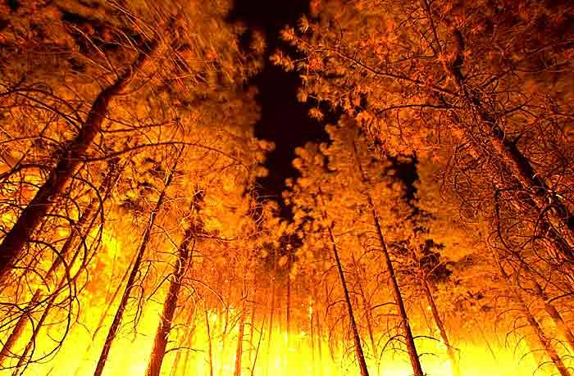
How will climate change affect wildfire?

Slide 46
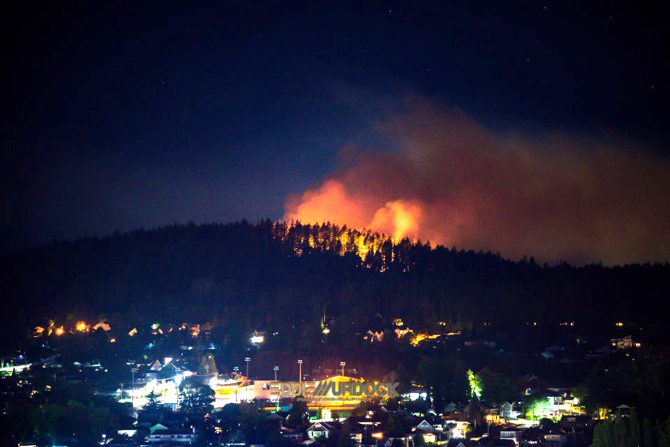
How will climate change affect wildfire?
Anacortes – August 26, 2016

Slide 47
How will climate change affect wildfire?
Goodell Creek Fire, Newhalem (August 2015)

Slide 48
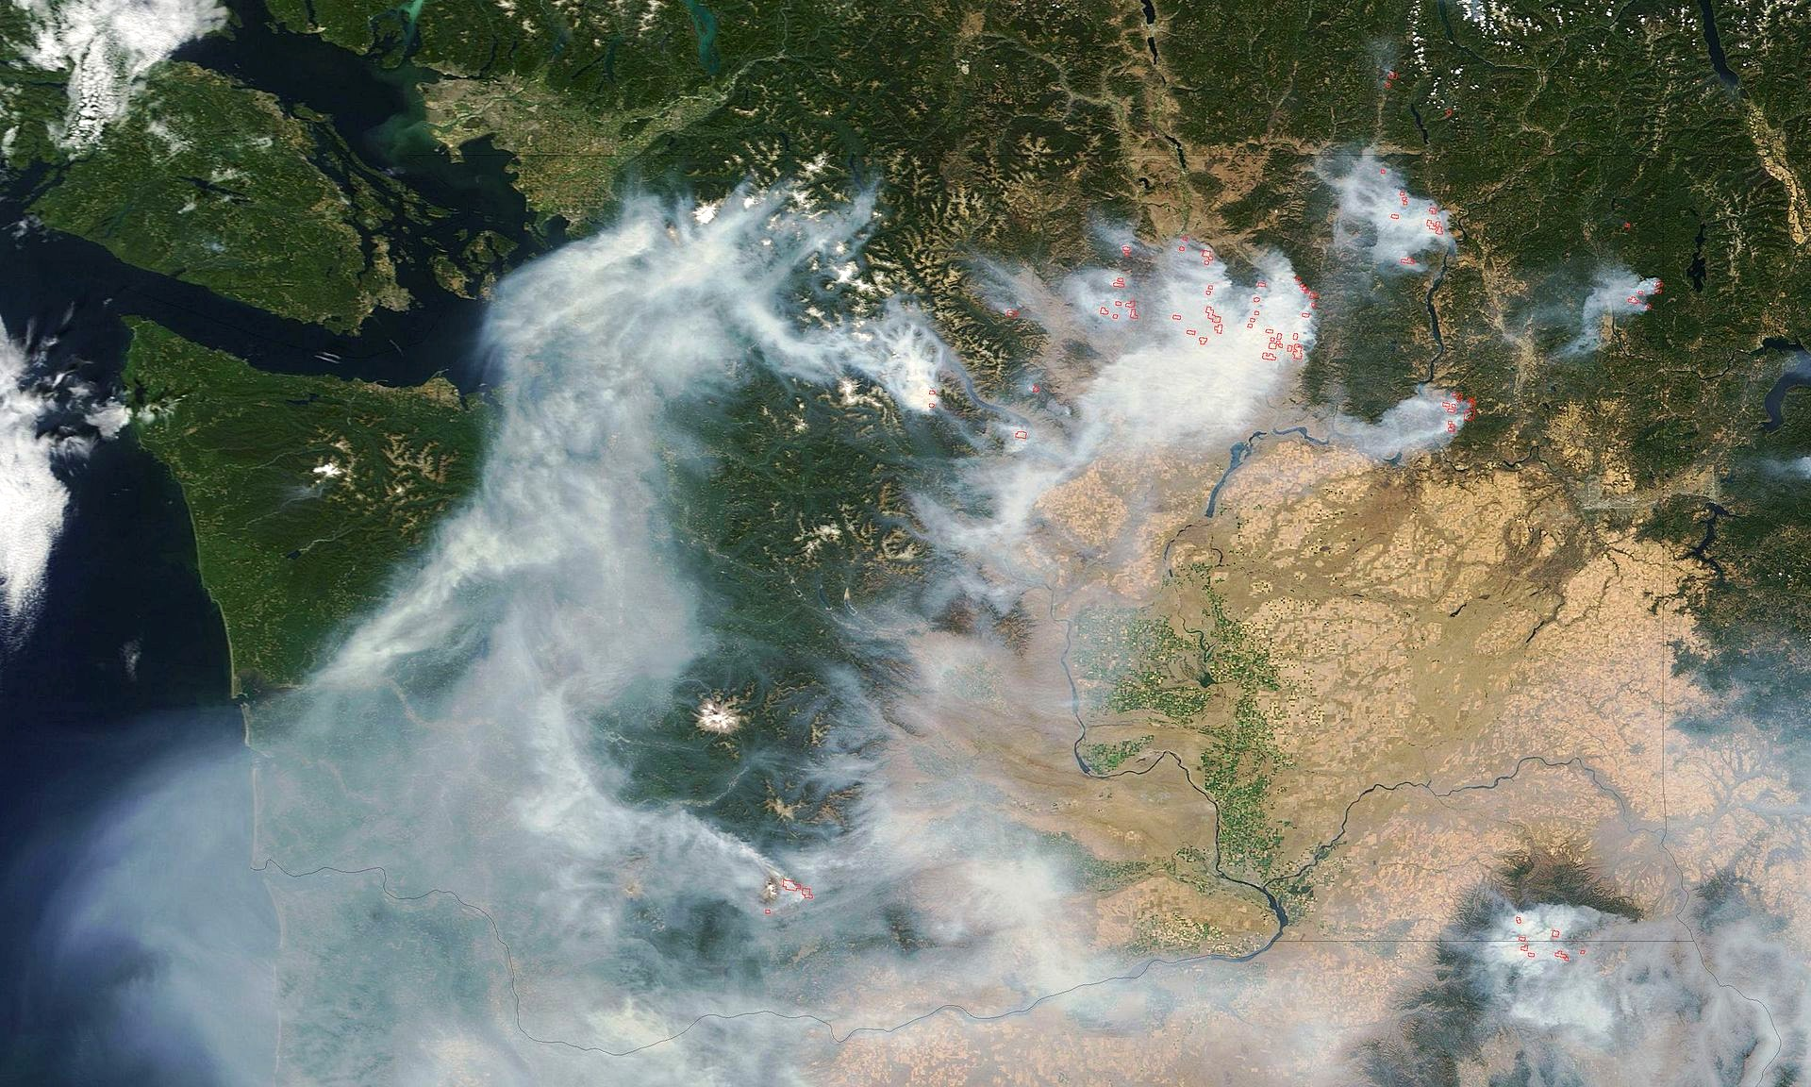
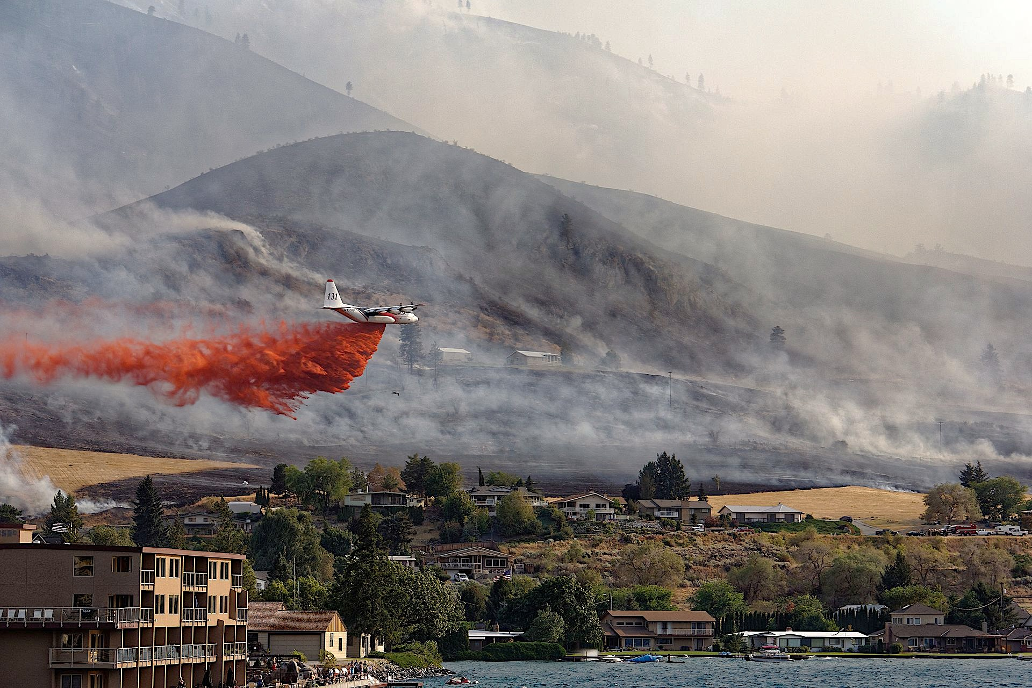
Washington wildfires — 2015
1,541 fires
1 million acres burned (387,000 acres in 2014)
$253 million fire suppression cost
Large economic losses in rural communities
Notes:
Climate change affects insects

Slide 49
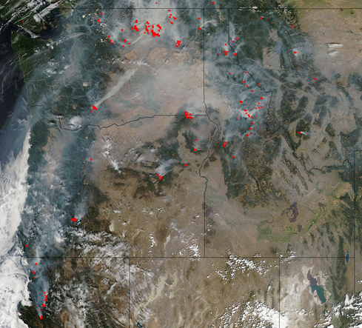
Climatic change and regional wildfires
Pacific Northwest, August 30, 2015
As temperature increases, more water evaporates from the landscape and plant tissues
Larger areas of low fuel moisture
Regional synchronization of fires occurs
MODIS, NASA
Notes:
Years in which large fires or fire complexes are common over an entire region (e.g., PNW this year) are associated with climatic conditions like those we expect under climatic change.
We had very low snowpack this year and higher than average temperatures.

Slide 50
More fires = more smoke
Seattle (August 2018)

Slide 51

Wildfires are colliding
Southwest Washington
Fires have burned some areas 3 times since 2008
Map by R. Norheim

Slide 52

Wildfires are colliding
Southwest Washington
Fires have burned some areas 3 times since 2008
Notes:
In some areas, increased area burned has resulted in short-interval reburns. For example, one location on Gifford Pinchot National Forest in southwestern Washington has burned three times since 2008

Slide 53

Disturbances will interact
Figure by R. Loehman
Notes:
Interactions
Diversity in geographic areas

Slide 54

Interacting disturbances
Wildfire
Insects & disease
Map by R. Norheim

Slide 55

Wildfire area burned, 2050
From J. Littell

Slide 56
Wildfire area burned, 2050
In the western United States, for a 2ºF increase, annual area burned will be 2-3 times higher.
gg
From J. Littell

Slide 57

Warming affects stress complexes
Global
warming
Higher temperatures & more
severe and extended droughts
Stand-replacing
fire regime
Bark beetles
and defoliators
Extensive mature
cohorts (70-80 yrs)
Lodgepole pine
Lodgepole pine mortality
Large severe fires
Fuel
accumulation
Salvage logging
Changes in species composition (including exotics)
McKenzie et al. (2009)
Notes:
Figure 5: Stress complex in interior (BC and USA) lodgepole pine forests. The effects of disturbance regimes (insects and fire) are exacerbated by global warming. Stand-replacing fires, beetle mortality, and changes in environmental niche space (see text) contribute to species changes.

Slide 58
In summary — What to expect
High certainty: Higher temperature, more wildfire, less snowpack, less water in summer
Less certainty: Precipitation
Extreme events (drought, wildfire, insects) will have the biggest effects on ecosystems.
Things may change quickly after 2050.
There will be surprises.

Slide 59

Thank you
For more information: jhalo@uw.edu; wild@uw.edu www.adaptationpartners.org

