Slide 1
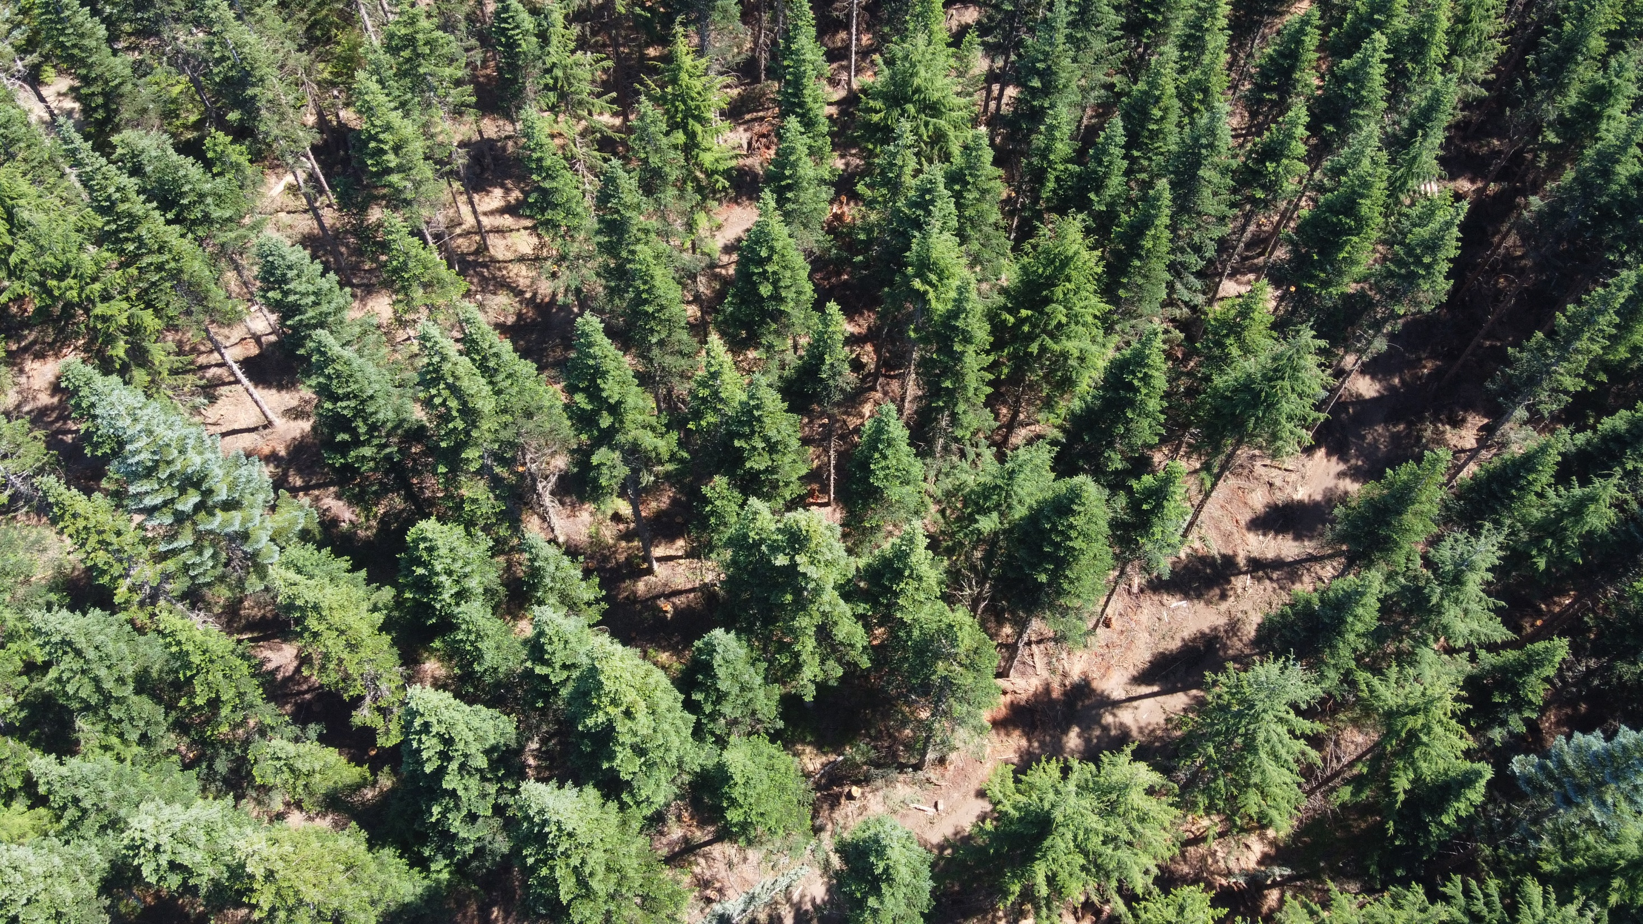

Logging Contracts
Jaal Mann
Northwest Natural Resource Group
jaal@nnrg.org
Notes:
In this chat, I’m going to walk you through our main logging contract template and discuss why we include each section. I’ve included images of each section of the contract on the slides so you can get a sense of how the actual contract sections look -- don’t feel like you need to read through every word as we go, since I’ll be summarizing and discussing each section. Afterwards, we will send this template to you so you can review it as much as you’d like, and this chat will also be uploaded to youtube for you to reference in the future.
Feel free to ask questions in the chat as we go, and we’ll also leave time for questions at the end.

Slide 2
Disclaimer
I’m not a contract lawyer, and this is not legal advice. Always talk to your lawyer to ensure that your contract does what you think it does.
Notes:
What I’ll provide here is a discussion of what you will want to make sure is included in the contract, not the legal specifics of how to make sure the contract is enforceable.

Slide 3
When to enter into a contract?
Show the project to a logger
Come to an agreement on logging costs
Agree to work with them on the project
Enter into a contract
Ideally well before the project begins, but often shortly beforehand.
Notes:
after they see the project, give prices, agree to do it. Before work starts. Ideally well in advance, in reality often right beforehand.

Slide 4
Why have a contract?
A good contract protects both the logger and the landowner, it’s in everyone's interest to make expectations clear and documented.
Notes:
We think contracts are really essential to document expectations and prescriptions. They also provides legal leverage in case things go sideways, but more often we use our contracts as reference documents when we need to remind ourselves what we decided about a certain portion of a project. How many snags did they agree to create? What was the hourly cost for chainsaw work? It’s really nice to have all those sorts of details together in one place, which all parties have seen and agreed to.
It’s important for both parties to really know what’s in the contract, and what they’re agreeing to, so make sure to read your contracts carefully.

Slide 5
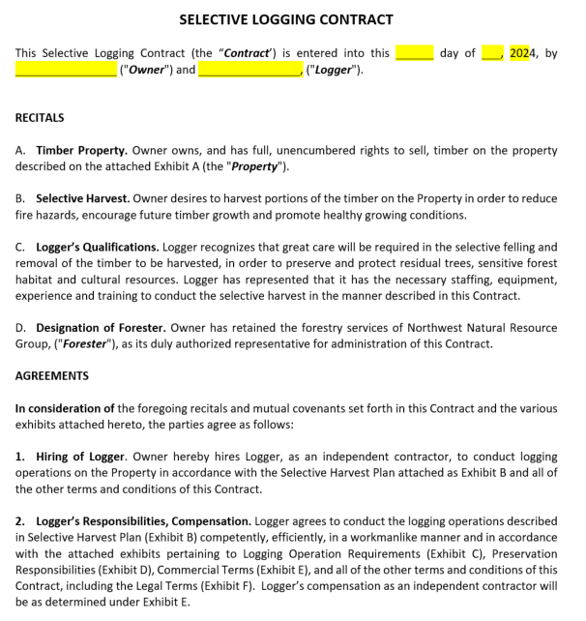
General recitals and agreements – defining the property, the logger, and the forester, and agreeing that the logger will comply with this contract
https://www.oregonconservationstrategy.org/strategy-habitat/late-successional-mixed-conifer-forests/
Notes:
Nothing super interesting here, basically just setting the stage for the rest of the contract.

Slide 6
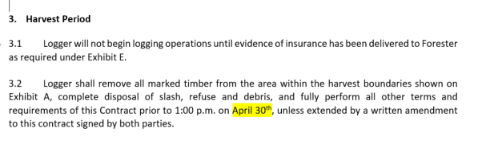
https://www.oregonconservationstrategy.org/strategy-habitat/late-successional-mixed-conifer-forests/
Notes:
important to have an end date when everything must be completed, to set expectations appropriately. Good idea to have language allowing this to be extended though, because delays can and do happen. If you have specific dates you'd like it done (for a family gathering on the property, or the start of the rainy season, for example) you can use that date. Or just set a random date sometime after you expect the project to be completed.
Be aware that projects often take longer than expected due to weather delays, breakdowns, etc., or your project may be delayed by other projects the logger is doing first. It is common to have to amend logging contracts to extend the harvest period, but still valuable to set a harvest period so the initial expectation is clear.

Slide 7
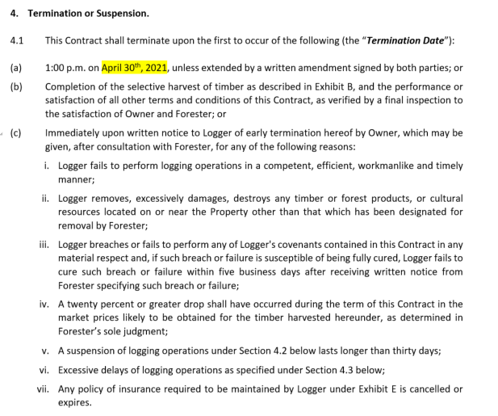
https://www.oregonconservationstrategy.org/strategy-habitat/late-successional-mixed-conifer-forests/
Notes:
Owner should be able to terminate it if logger generally isn't competent, causes excess damage, lets insurance lapse, breaches any other contract requirement, or markets drop substantially (>20%, especially important in per ton/mbf contracts where logger would still make the same amount so LO could end up losing a lot). Owner can also suspend and eventually cancel contract if the logger has excessive delays

Slide 8
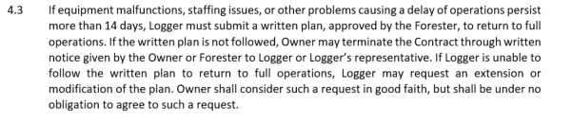
https://www.oregonconservationstrategy.org/strategy-habitat/late-successional-mixed-conifer-forests/
Notes:
Excessive delays are defined as >14 days. Then it requires a written plan, terminated if plan then not followed.
We added this clause about excessive delays after having some issues with loggers dealing with staffing and equipment problems that dragged on. This clause gives you the ability to set clear expectations for a return to full operations, and to cancel the contract if they don’t follow it.

Slide 9
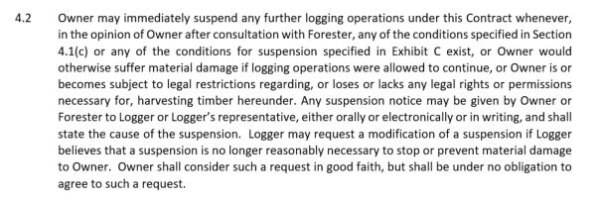
https://www.oregonconservationstrategy.org/strategy-habitat/late-successional-mixed-conifer-forests/
Notes:
The owner can also suspend the contract if they believe they will suffer material damage by operations continuing, or if they lose legal rights for the timber harvest.

Slide 10
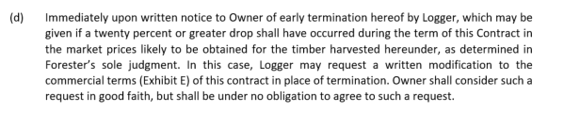
https://www.oregonconservationstrategy.org/strategy-habitat/late-successional-mixed-conifer-forests/
Notes:
Logger is usually given the right to terminate if markets drop substantially (>20%) if they're working on a percentage basis, because in that case they are also harmed by drops in the market.

Slide 11
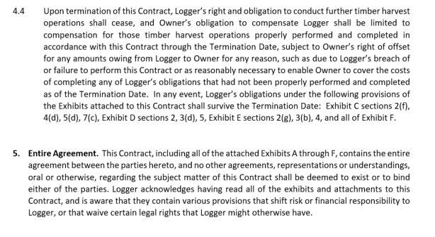
https://www.oregonconservationstrategy.org/strategy-habitat/late-successional-mixed-conifer-forests/
Notes:
If the contract is terminated, logger won’t do any more timber harvest. But owner will pay Logger for harvest work done correctly through the termination date, unless logger owes money due to breach of contract. There are some parts of the contract, such as environmental liabilities, that persist through contract termination.
This contract is the full agreement, so one party can’t later say “hey but you said that we could do it this other way”... The contract is the final word.

Slide 12
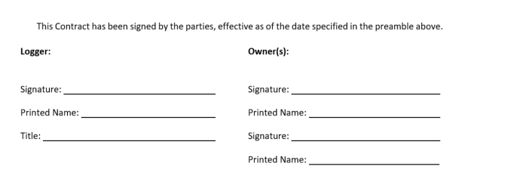

https://www.oregonconservationstrategy.org/strategy-habitat/late-successional-mixed-conifer-forests/
Notes:
And of course, a signature page! We also include places for initials on every page – I think we could skip these initials, but they do help make sure everyone is looking at every page. Now, onto the exhibits.

Slide 13
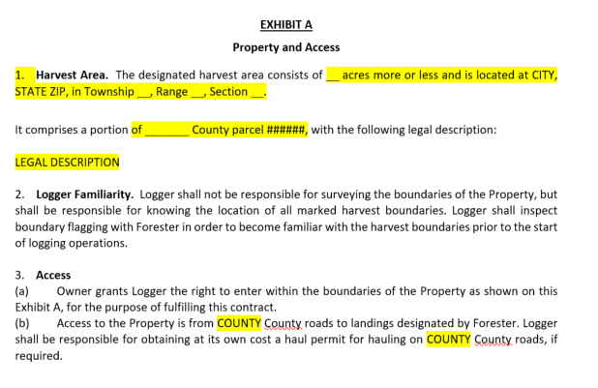
https://www.oregonconservationstrategy.org/strategy-habitat/late-successional-mixed-conifer-forests/
Notes:
Contract area - include details about the property location, so it’s clear where they’ll be working.
Note that logger is not responsible for surveying boundaries, but will use previously flagged boundaries by owner or forester. They are liable for understanding the boundaries as marked, but if the markings are wrong that’s not on them.
Include language giving access for logger to enter the property for the purposes of the contract, and describe the access to the property noting that logger is responsible for obtaining any county haul permits.

Slide 14
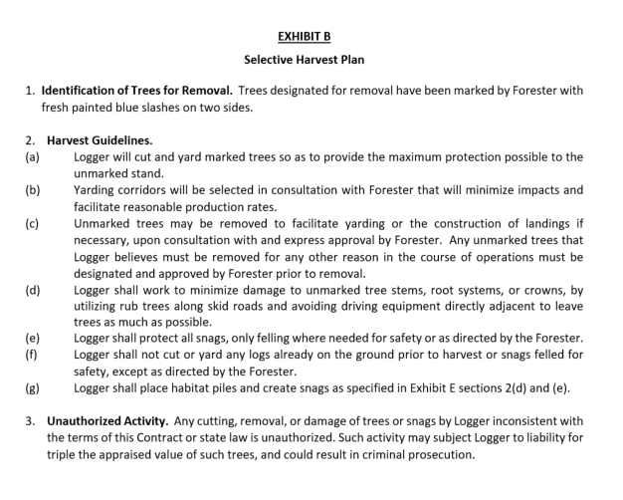
https://www.oregonconservationstrategy.org/strategy-habitat/late-successional-mixed-conifer-forests/
Notes:
6. Harvest plan - describe the harvest prescription, including how trees are marked (if they’re marked, we sometimes also have the logger do their own selection depending on the stand and prescription complexity), how they should be cut and yarded, and noting that damage should be minimized. This is the place to include specifics about retaining or cutting snags, creating habitat piles if applicable, species selection, etc. We also include language stating that the logger can only cut trees following the terms of the contract.

Slide 15
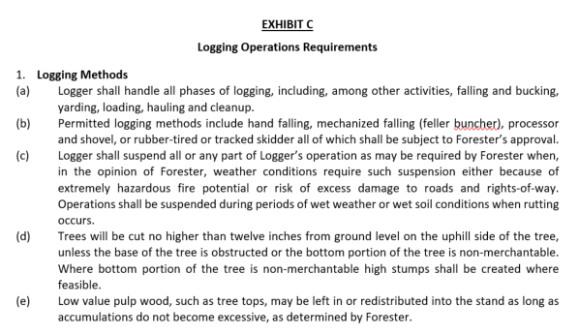
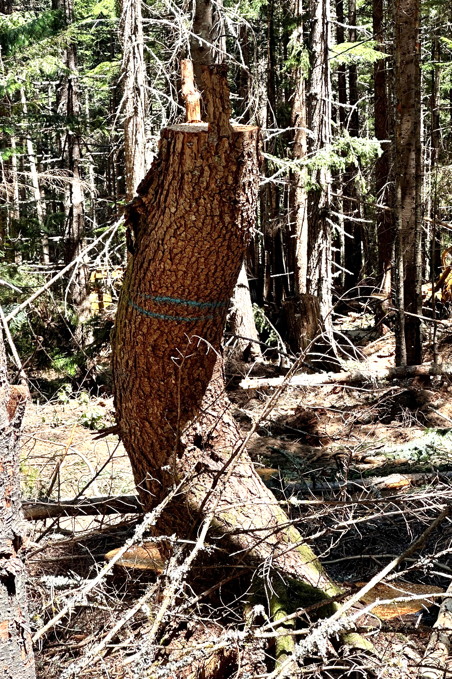
https://www.oregonconservationstrategy.org/strategy-habitat/late-successional-mixed-conifer-forests/
Notes:
7. Logging methods: This section should describe what parts of the operation the logger will do, what equipment is allowed, when weather may cause suspensions to avoid soil damage, slash management, etc. It also provides a maximum stump height (to avoid merchantable wood being left on the stump), but gives an exception for creating snags from non-merchantable tree butts.

Slide 16
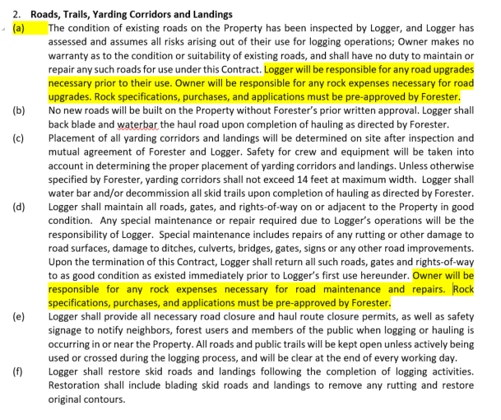
https://www.oregonconservationstrategy.org/strategy-habitat/late-successional-mixed-conifer-forests/
Notes:
This section describes road conditions – the owner does not promise that the roads will work for logging operations, logger assumes that risk. It discusses whether new roads will be built, and who will be responsible for any road construction or maintenance needed.
In most cases, the logger will do the road upgrade work at their own cost but the owner will pay for any rock needed. This is because rock is an investment in the property, and the owner may want the minimum to get the project done, or more to improve the road’s condition for future use. It’s also hard to tell ahead of time how much rock will be needed, and it’s expensive. If roads need substantial improvements before work begins, it’s not uncommon for the logger to request a separate roadwork payment - either a lump sum cost or hourly time and materials. It can also be good to include language here specifying whether or not any materials purchased by logger and passed through to owner will have any markup. A 10% markup isn’t uncommon, but many loggers don’t charge a markup.
It should also state that logger will provide road closure permits and safety signage as necessary, and describe post-logging repairs to skid roads, hiking trails, and landings. Do you want them fully cleared off for easy walking or slash scattered over them to reduce erosion and trespass?

Slide 17
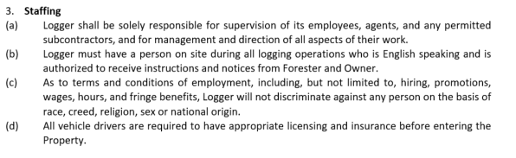
https://www.oregonconservationstrategy.org/strategy-habitat/late-successional-mixed-conifer-forests/
Notes:
An important but not super interesting section – requiring the logger to supervise their employees and subcontractors, have someone on site who can receive instruction, not discriminate in their hiring practices, and have driver’s licenses and insurance.

Slide 18
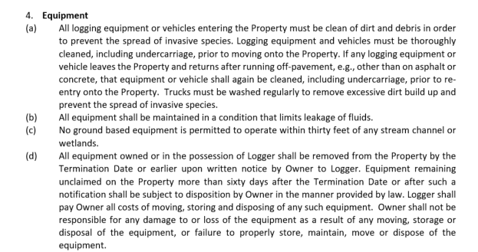
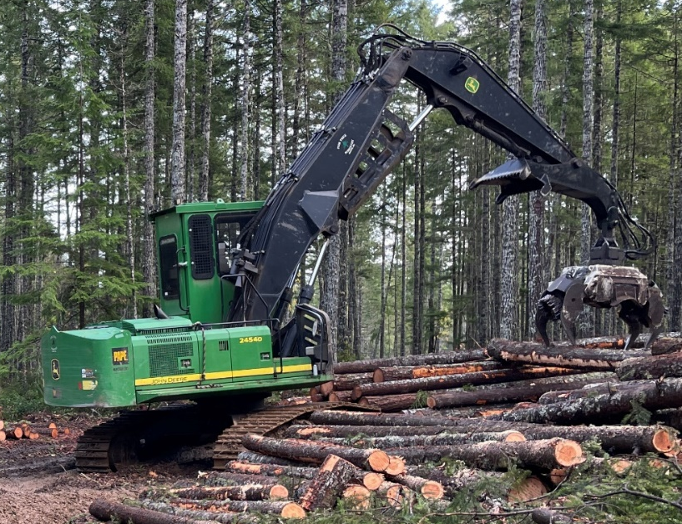
https://www.oregonconservationstrategy.org/strategy-habitat/late-successional-mixed-conifer-forests/
Notes:
9. Equipment: All equipment should be cleaned before coming onto the property, to avoid spreading invasive species.
This can be a difficult one to enforce, but it is really helpful to reduce invasive species if loggers wash off their equipment well. If you include this clause, be sure to remind the logger about it just before they move equipment onto your property.
Equipment should be maintained to prevent fluid leakage.
Logging equipment leaks, it’s just the reality of it. Seals age, lines break, etc. What’s important is making sure that the loggers know you expect them to clean up any significant spills, by removing the contaminated soil.
If you have specific areas you don't want equipment to operate this is a place to note that. These could include a septic drainfield, particular area of the forest where you pick mushrooms, etc.
Equipment should be removed from the property by termination date, or sooner with written notice by owner to logger. Provide a timeline (60 days recommended) for owner to dispose of abandoned equipment at Logger's cost.
We have never had to attempt to confiscate a logger’s abandoned equipment, but this is important to include so that you don’t end up with an abandoned piece of equipment and no legal way to remove it.

Slide 19
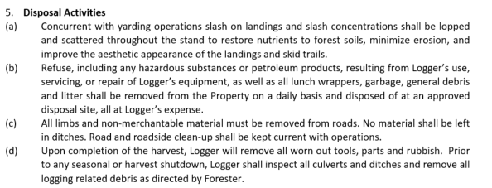
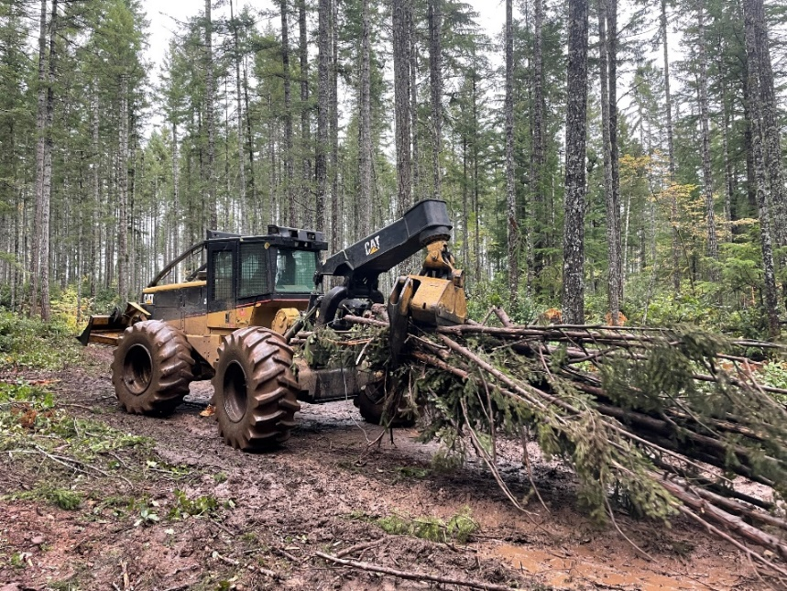
https://www.oregonconservationstrategy.org/strategy-habitat/late-successional-mixed-conifer-forests/
Notes:
10. Disposal activities: Slash management, trash removal, road cleanup. Slash is generally redistributed into the woods.

Slide 20
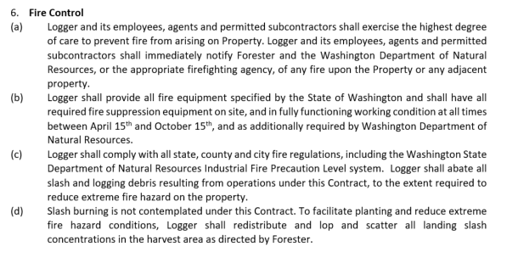
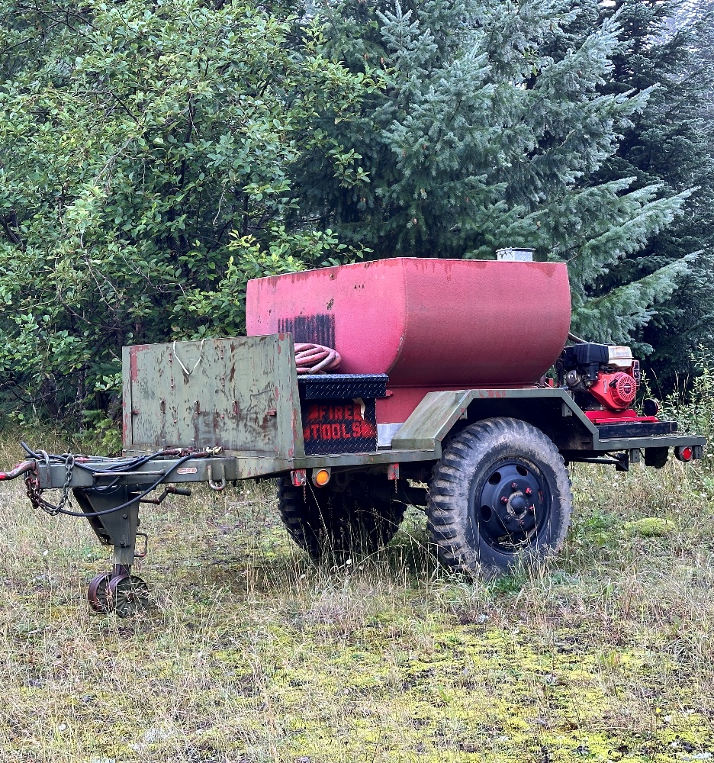
https://www.oregonconservationstrategy.org/strategy-habitat/late-successional-mixed-conifer-forests/
Notes:
11. Fire control: Notify owner and DNR about fires. Have appropriate equipment for the season. Follow IFPL rules. No slash burning.

Slide 21
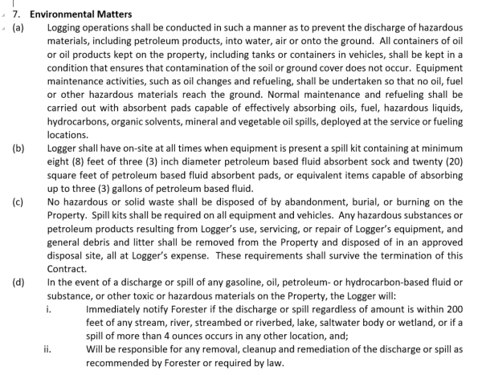
https://www.oregonconservationstrategy.org/strategy-habitat/late-successional-mixed-conifer-forests/
Notes:
12. Env. matters: Avoid spills. Have spill kit. Process for notification/cleanup of spills.

Slide 22

https://www.oregonconservationstrategy.org/strategy-habitat/late-successional-mixed-conifer-forests/
Notes:
13. Safety: Logger responsible for worker safety, and use of PPE meeting L&I standards.

Slide 23

https://www.oregonconservationstrategy.org/strategy-habitat/late-successional-mixed-conifer-forests/
Notes:
14. Move-out: Logger must get approval before removing equipment, otherwise is liable for move-in costs to bring equipment back if needed.
This is an important item, as loggers are often eager to move on to their next project when they’re finishing up yours. This ensures that they won’t remove equipment before they have approval from the forester to do so, following a final inspection.

Slide 24
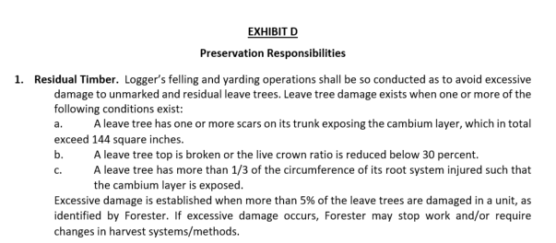
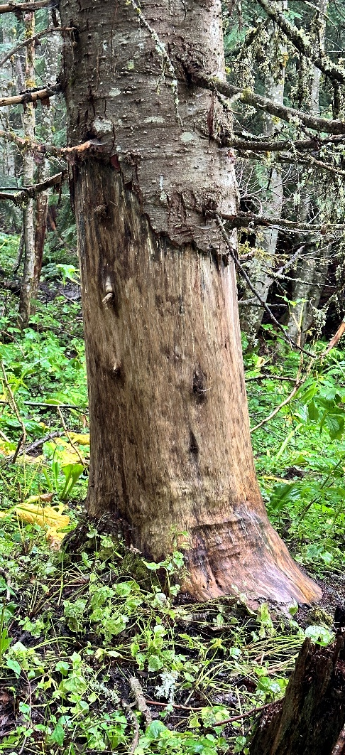
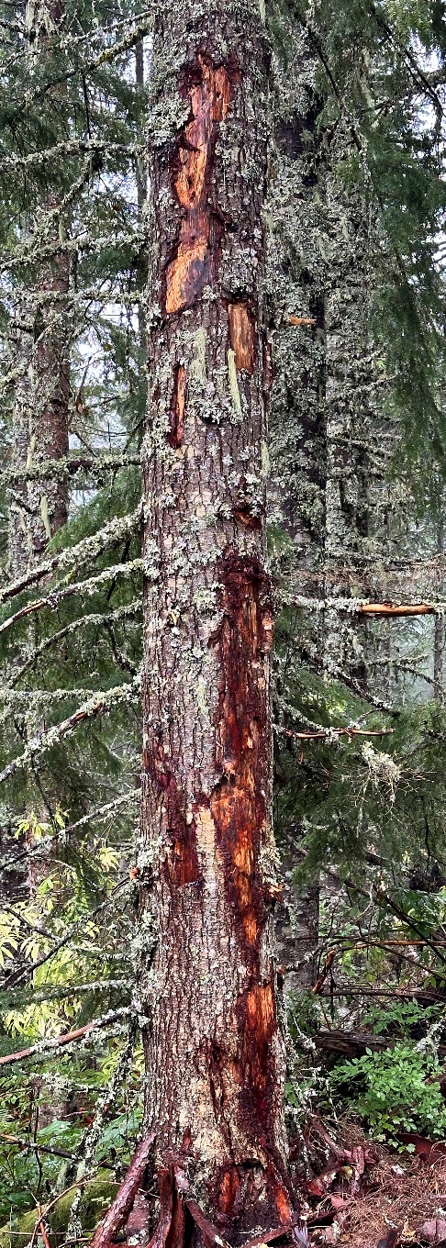
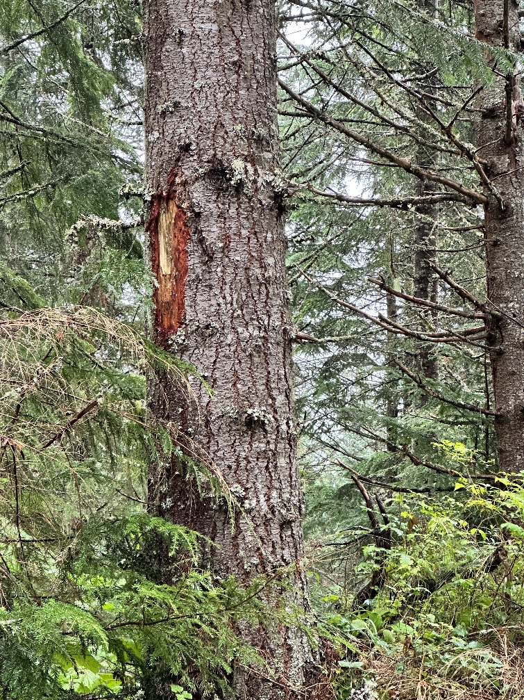
https://www.oregonconservationstrategy.org/strategy-habitat/late-successional-mixed-conifer-forests/
Notes:
15. Residual timber: establishes what a "damaged" leave tree is, and how many damaged trees qualifies as "excessive damage".

Slide 25
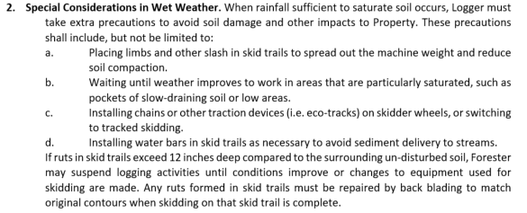
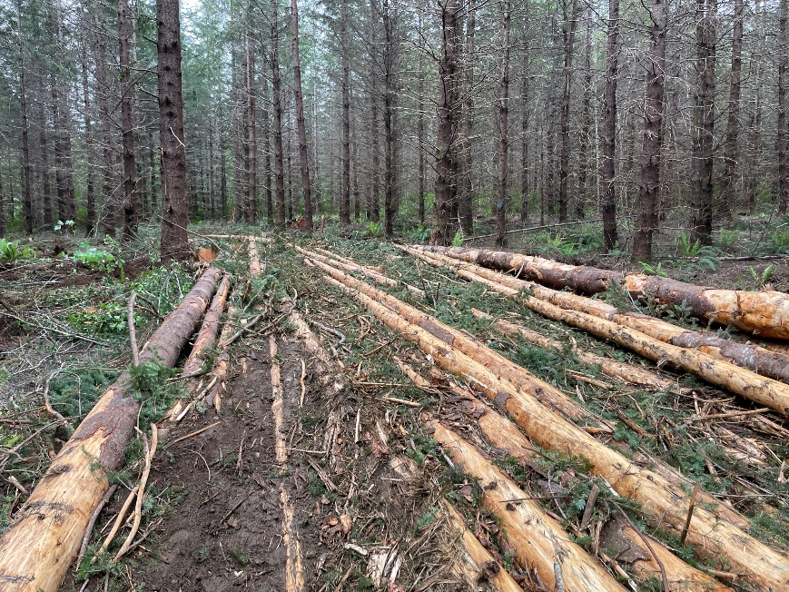
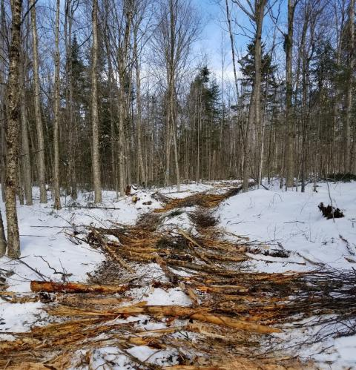
https://extension.unh.edu/blog/2018/12/emergency-erosion-control-techniques-dealing-severe-weather-conditions-during-active-timber-harvest
https://www.oregonconservationstrategy.org/strategy-habitat/late-successional-mixed-conifer-forests/
Notes:
16. Wet weather special conditions: specific things to watch for. How to know whether your property is suitable for wet weather logging.

Slide 26
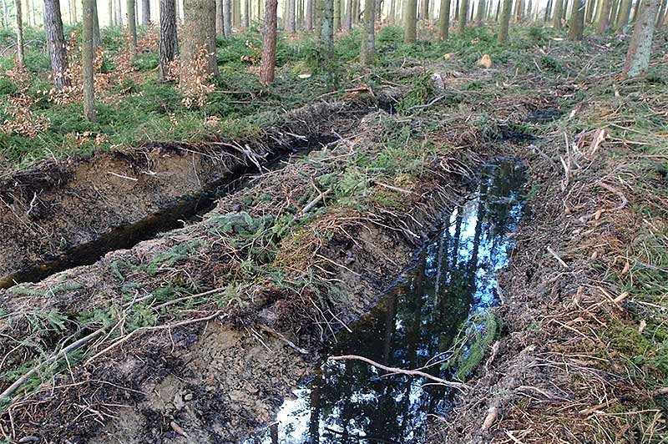
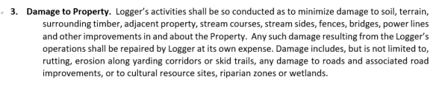
https://www.waldwissen.net/en/technique-and-planning/forest-technology/soil-protection/take-care-of-the-soil
https://www.oregonconservationstrategy.org/strategy-habitat/late-successional-mixed-conifer-forests/
Notes:
16. Damage to property: logger is liable for damage to natural or built features on the property and surrounding properties.

Slide 27
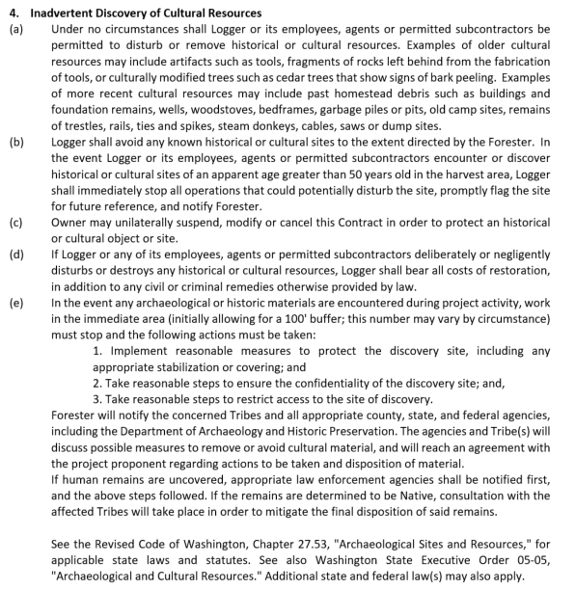
https://www.oregonconservationstrategy.org/strategy-habitat/late-successional-mixed-conifer-forests/
Notes:
17. Inadvertent discovery: It’s a good idea to include an inadvertent discovery policy in your contract. Tribes will sometimes also request that landowners have one if a project is taking place in an area they believe is more likely to have cultural resources. Logger must be on the lookout for cultural resources, and must stop work in the area near them if found. Owner may cancel contract to protect cultural resources, and if logger destroys or disturbs them they will bear costs of restoration/penalties. After work in the area stops, note who will be notified and what next steps will be.
This section states that any cultural sites/items over 50 years old should be protected. While this is the official definition of a historic or cultural resource, it’s clear that not all 50 year old things need protection. It’s common to find old pieces of logging cable or old growth stumps with springboard notches, for example, but there is no requirement to protect them. But many landowners do want to protect old growth stumps, so this is something to discuss ahead of time with your forester and with the logger. If you or your forester are not sure whether a cultural resource warrants protection, contact your County cultural resources coordinator or historic preservation officer.

Slide 28
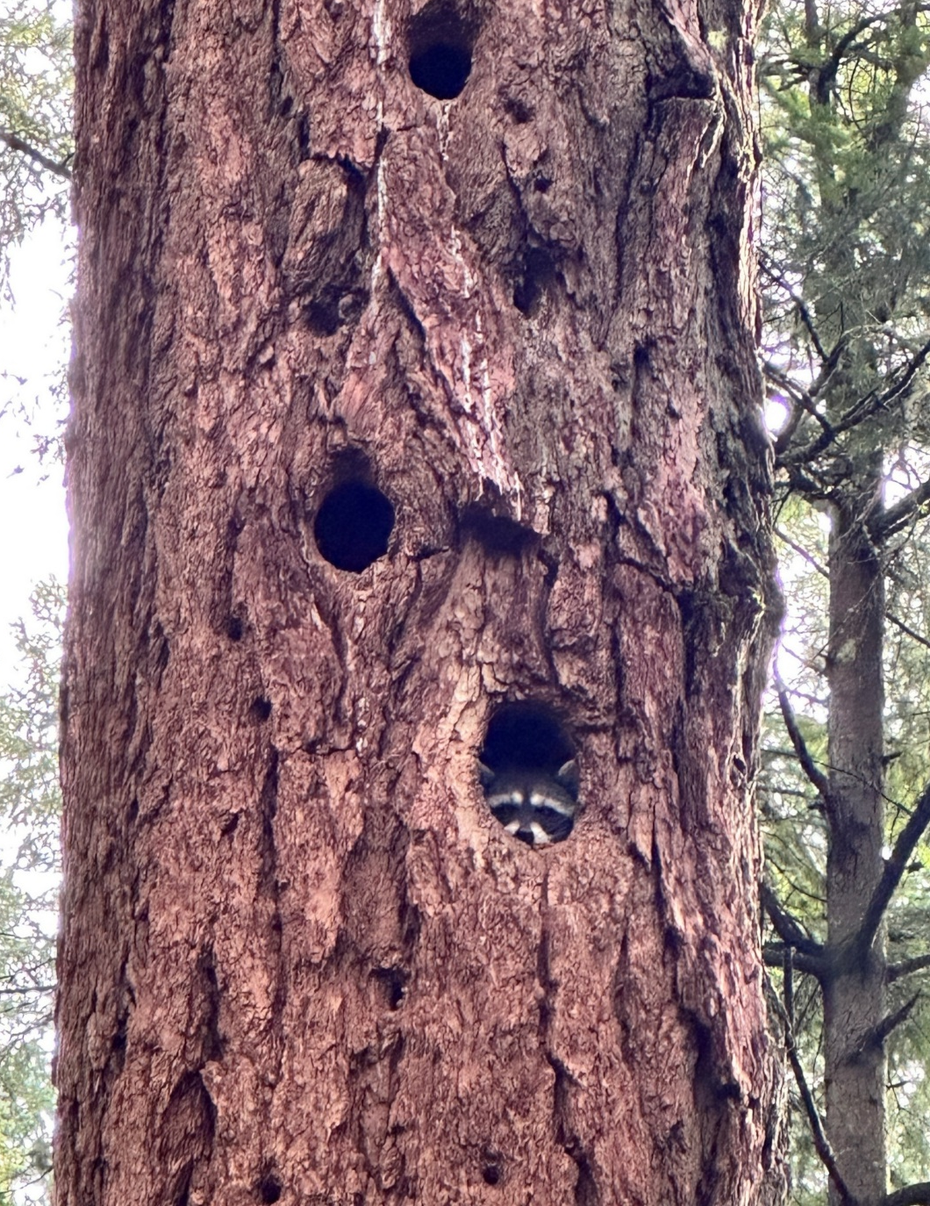
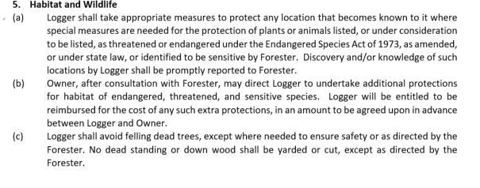
https://www.oregonconservationstrategy.org/strategy-habitat/late-successional-mixed-conifer-forests/
Notes:
18. Habitat and wildlife: Logger will protect endangered species, including additional protections beyond what law requires if Owner desires (but logger can be compensated extra for extra work here). Can also note no felling of dead trees here except where required for safety.
We include this section in the contract, but defer to the logger when it comes to which trees need to come down for safety reasons. Snags can be a major hazard, especially to people working outside of machine cabs, and L&I often requires loggers to remove them or top them in areas where they’ll be working. This section also states that no dead wood will be yarded or cut - in some cases, freshly dead trees may still have value at the mill. Consider whether you want to leave all of those for habitat purposes, or if you want to salvage some dead standing or downed wood.

Slide 29

https://www.oregonconservationstrategy.org/strategy-habitat/late-successional-mixed-conifer-forests/
Notes:
19. Markers: Surveyors are very expensive, so the Logger must protect property corners/witness markers, or resurvey them if destroyed.

Slide 30
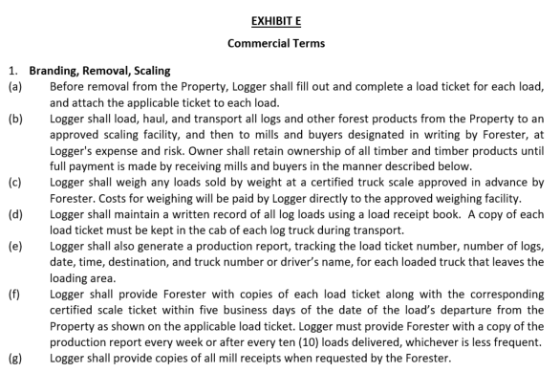
https://www.oregonconservationstrategy.org/strategy-habitat/late-successional-mixed-conifer-forests/
Notes:
Commercial terms -
20. Branding, removal, scaling: Logger will fill out load tickets, and send logs to mills approved by owner/forester.
Owner retains ownership of logs until mill pays for them (logger does not take ownership), but logger transports logs at their own risk.
Logger will pay weighing costs, and weigh at approved scales.
Logger should generate a production report, or you can just have them provide you with the tickets instead. You can require them to provide any mill receipts here too so you or your forester can independently verify that everything looks right.

Slide 31
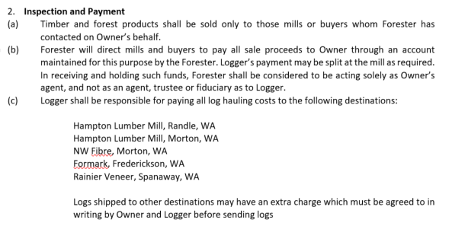
https://www.oregonconservationstrategy.org/strategy-habitat/late-successional-mixed-conifer-forests/
Notes:
Inspection & payment:
Logs only sold to mills owner/forester approve, and forester will contact mill ahead of time to set up payments.
Describe how mill payments will be sent, usually split at the mill to logger/owner (/truck). In most cases we have the owner’s revenue come to us, so we can verify it against the production reports and mill receipts, make any necessary payments out of the revenue on owner’s behalf, and then send the balance to the landowner.
For haul rates, note who will pay trucks and what mills they agree to send logs to.
We include specific mills here because depending on the haul payment scheme some parties could otherwise have an incentive to bring logs to a mill that disincentivizes the other party. For example, if the logger is paying the full cost of the hauling then the landowner may want the logger to send logs to a far away mill for a slightly higher log price, which would benefit the landowner but harm the logger. If the trucking and hauling is off the top with about a 50/50 split, then it’s less essential to list destinations since the landowner and logger incentives are aligned, but it’s still helpful so everyone can see what sort of haul distances they’re agreeing to.

Slide 32
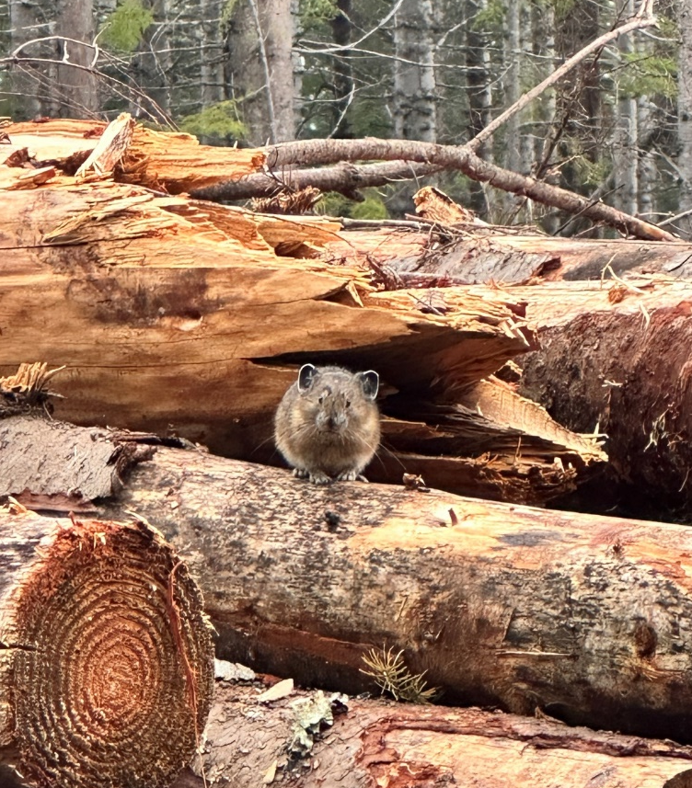
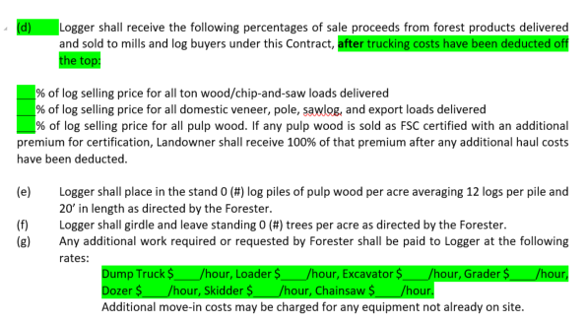
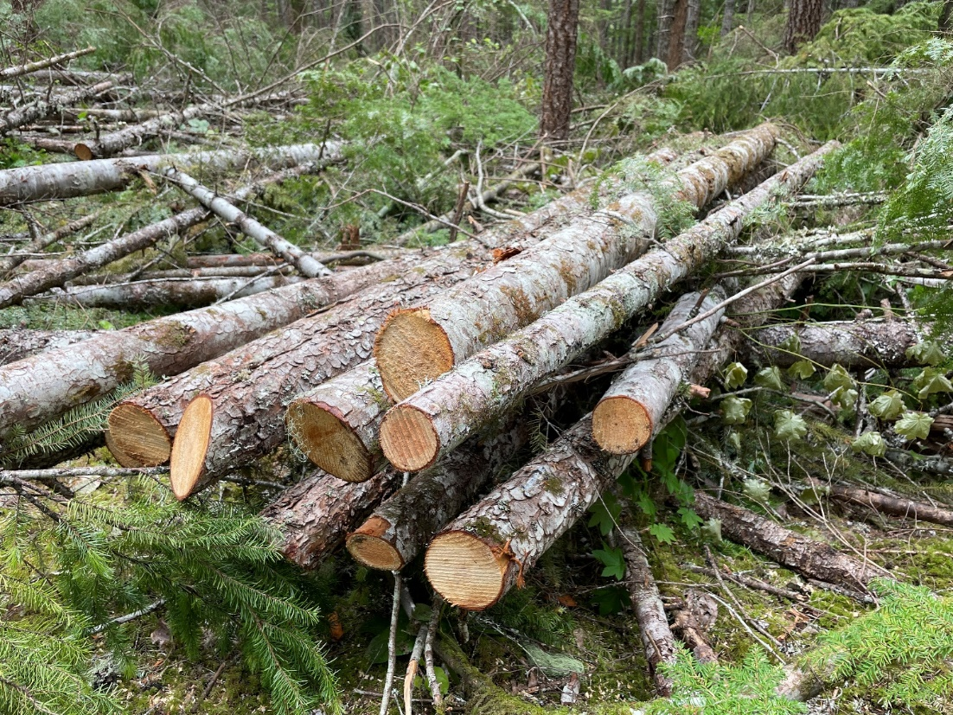
https://www.oregonconservationstrategy.org/strategy-habitat/late-successional-mixed-conifer-forests/
Notes:
Include logger payment rates here. Sometimes a per MBF or per ton rate, more often a percent with trucking either included or off the top (deducted before doing the percent split, so each party is paying a proportionate share of the trucking).
This is also the place to include any habitat piles or snag creation quantities, and hourly rates for any additional work beyond the scope of the contract. Good to have in case you want them to do some extra bit of roadwork while there, take down a couple of extra hazard trees, or move a boulder around in your yard.

Slide 33
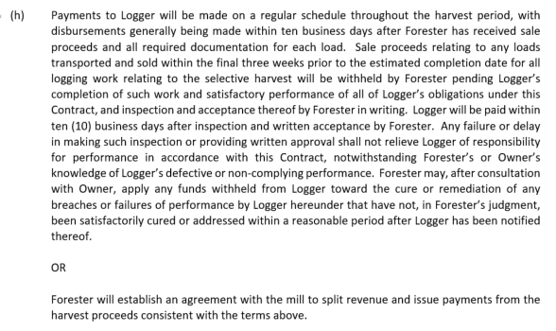
https://www.oregonconservationstrategy.org/strategy-habitat/late-successional-mixed-conifer-forests/
Notes:
Describe how payments to logger will be made - usually by mill split for timely payment. Owner can receive all funds and pay logger, including language holding back the final payment until a satisfactory inspection, but logger may push back on this because it will slow down their payments for funds to go to owner first.

Slide 34
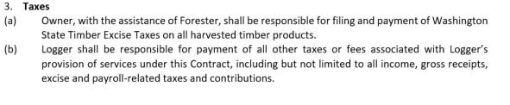
https://www.oregonconservationstrategy.org/strategy-habitat/late-successional-mixed-conifer-forests/
Notes:
22. Taxes: Include language stating that owner will pay FET/B&O E.T., but logger will pay all other taxes/fees related to their income/payroll.

Slide 35
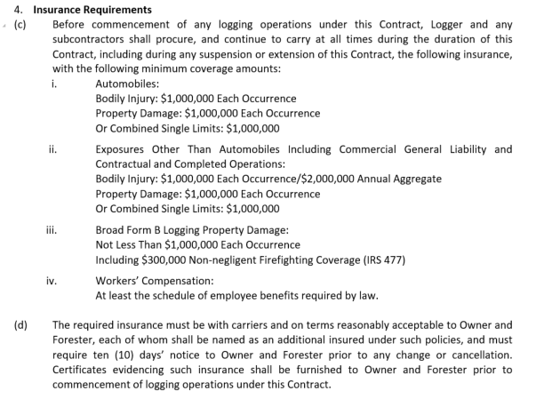
https://www.oregonconservationstrategy.org/strategy-habitat/late-successional-mixed-conifer-forests/
Notes:
23. Insurance requirements: Document logger insurance req. here. Generally $1 million policy for auto, commercial general liability (2M bodily injury annual aggregate), logger's broad form. Increasing these requirements can be problematic, since loggers can't change insurance to suit each job. Owner (and forester) should be listed as Additional Insured on logger's policy, meaning that each party will receive an insurance certificate.

Slide 36

https://www.oregonconservationstrategy.org/strategy-habitat/late-successional-mixed-conifer-forests/
Notes:
24. Bonding: Note that no bond is requested. You could require a performance bond, but it's uncommon for logging projects that aren't state/federal timber sales.

Slide 37
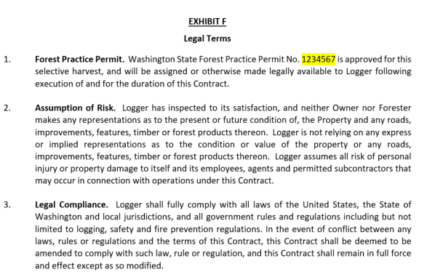
https://www.oregonconservationstrategy.org/strategy-habitat/late-successional-mixed-conifer-forests/
Notes:
Forest practice permit: Note the FPA number and that it will be assigned to logger.
Logger doesn't rely on owner/forester-implied representations of the project
Logger will follow laws

Slide 38
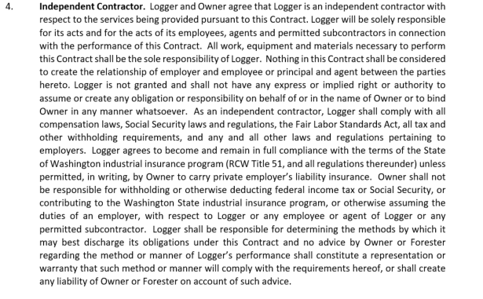
https://www.oregonconservationstrategy.org/strategy-habitat/late-successional-mixed-conifer-forests/
Notes:
Logger is an independent contractor

Slide 39
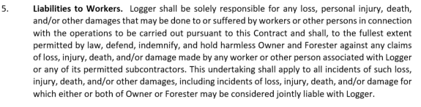
https://www.oregonconservationstrategy.org/strategy-habitat/late-successional-mixed-conifer-forests/
Notes:
Logger is responsible for injury/death/damage to workers or other people in connection to the operations.

Slide 40
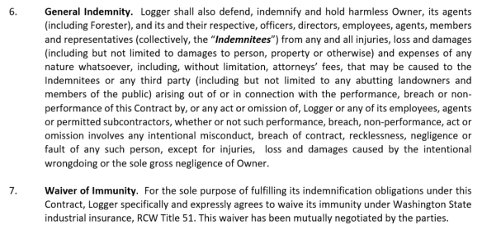
https://www.oregonconservationstrategy.org/strategy-habitat/late-successional-mixed-conifer-forests/
Notes:
Logger is generally responsible for anything bad that happens related to the contract, unless caused by intentional wrongdoing or gross negligence of owner.
Waiver of immunity: WA law says that if a logger's employee gets injured, and gets worker's comp, logger is immune from suit by employee. So employee could still sue owner for full damages if they think owner is liable. If logger waives this immunity, then employee could sue the logger, reducing risk of lawsuit to owner.

Slide 41
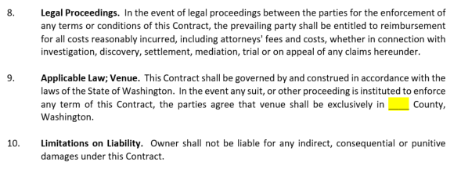
https://www.oregonconservationstrategy.org/strategy-habitat/late-successional-mixed-conifer-forests/
Notes:
State that prevailing party will get legal fees paid in a lawsuit,
the county where lawsuits will be handled,
and owner isn't liable for damages.

Slide 42
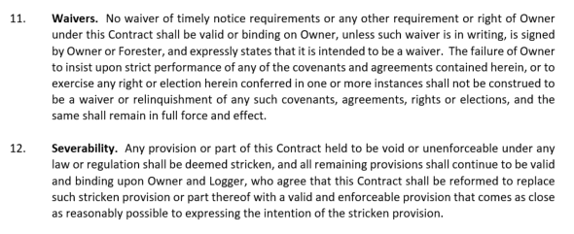
https://www.oregonconservationstrategy.org/strategy-habitat/late-successional-mixed-conifer-forests/
Notes:
Owner's failure to insist on strict compliance of a provision doesn't weaken any other provisions of contract.
Unenforceable/illegal provisions will be stricken, but the rest of the contract will stand.

Slide 43
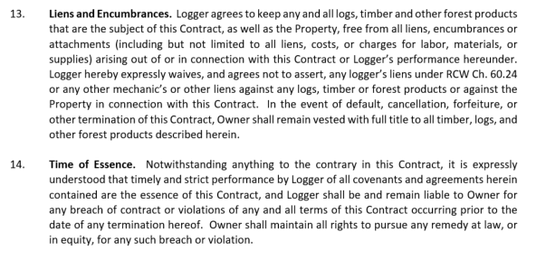
https://www.oregonconservationstrategy.org/strategy-habitat/late-successional-mixed-conifer-forests/
Notes:
Logger won't assert any liens against logs, timber, property, etc.
Logger liable for any breach of contract occuring before termination.

Slide 44
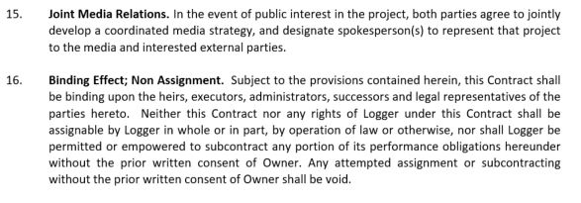
https://www.oregonconservationstrategy.org/strategy-habitat/late-successional-mixed-conifer-forests/
Notes:
Logger and Owner will coordinate media strategies if there's public interest.
Logger cannot subcontract without written consent!
This one often comes up, so make sure the logger knows that they need written consent from owner before subcontracting. It’s common for loggers to subcontract for the cutting, for example, and you want to require them to get permission so that you have more control over who will be doing the actual work on your property.

Slide 45

https://www.oregonconservationstrategy.org/strategy-habitat/late-successional-mixed-conifer-forests/
Notes:
Provide address and delivery method for legal notices to both parties.
Note that either party can request changes to the contract, but changes must be mutually agreed upon.
If owner or forester provided contract form, note that logger has been advised to consult their legal counsel and that owner or forester doesn't have any legal exposure by providing the initial contract form.

Slide 46

Thanks for coming!
jaal@nnrg.org

